Slide 1
Presented by: James Cornett & Dan Miller
Facility Painting
Sherwin-Williams
Notes:
1

Slide 2
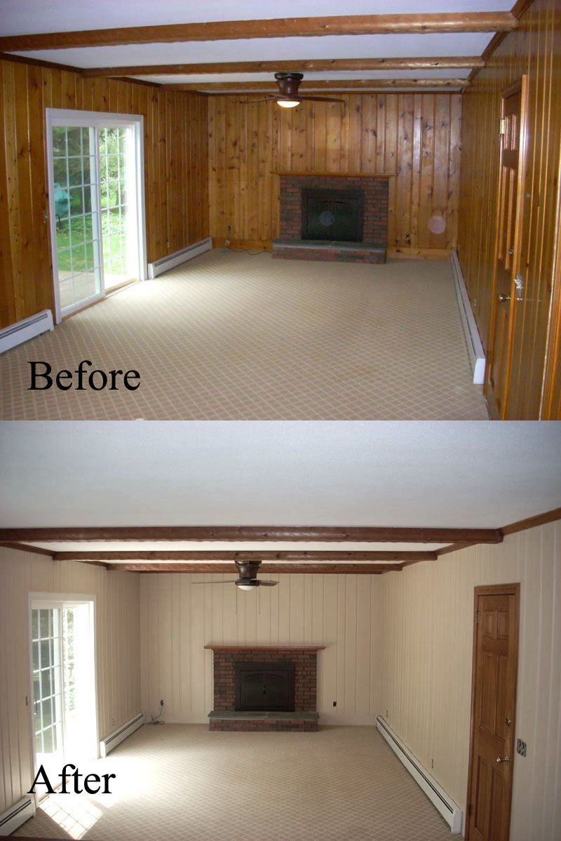
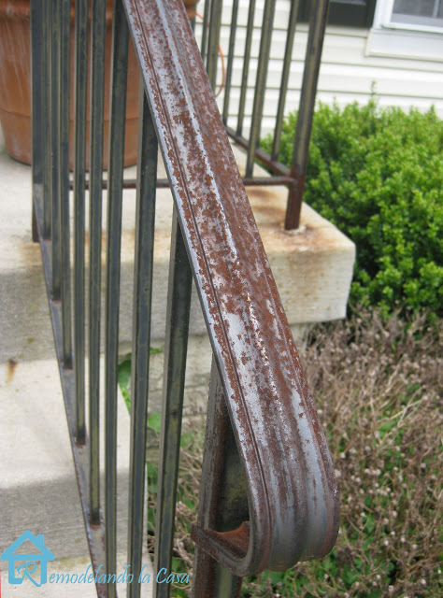
What’s the purpose of paint?
Aesthetics
Protective Coating
Notes:
2
2

Slide 3
Common Paint Failures
Majority of paint failures is due to improper surface preparation.
Four things to consider when prepping a surface:
Clean- free of dirt, oil, and other contamination (TSP, Simple Green, Kurd-Kutter)
Dry- no moisture trapped in the substrate (wood and masonry is most common)
Dull- scuff sand glossy/slick surfaces to create a profile
Sound- scrape all loose material/your top coat is only as good as the bottom coat
Notes:
3
3

Slide 4
Paint VS Primer
Paint
Durable
Weather resistant
Provides color
Sheen options
Primer
Sealing
Bonding
Blocking
Needs topcoat
**Paint and Primer in One is for previously painted surfaces. It is considered a “color blocking primer”, in which it achieves the truest color with the least amount of coats as possible.
Notes:
4
4

Slide 5
When to use a primer?
Bare substrate* (drywall, masonry, wood, metal)
Stains (water, smoke, mold,grease/dirt, odors)
Adhesion (oil paint, stained woodwork, veneer, other slick surfaces)
Extreme color change
Under dark colors
Removed wallpaper
Patchwork
Notes:
5
5

Slide 6
When to use a primer?
Latex
Oil
Drywall
Masonry
Color changes
Galvanized steel
Bare wood*
Stained wood*
Oil based paint
Water stains
Removed wallpaper
Smoke stains
Nicotine stains
Rusted metal
Shellac primer is best for odor stains
(pet stains, smoke damage, heavy nicotine odors)
Notes:
6
6

Slide 7
Latex VS Oil Paint
Latex Paint Oil Paint
Pros
Flexible forgiving coating
Excellent gloss and color retention
Low odor/VOC’s
Easy clean up
Added mildewcides
Fast drying
Cons
Soft film
Low chemical resistance
Pros
Hard durable coating
Higher chemical resistance
Self leveling
Cons
Always curing
Brittle
Strong odor/higher VOC’s
Slow dry time
Solvent clean up
No mildewcides
Chalks and fades in sunlight
Notes:
7
7

Slide 8
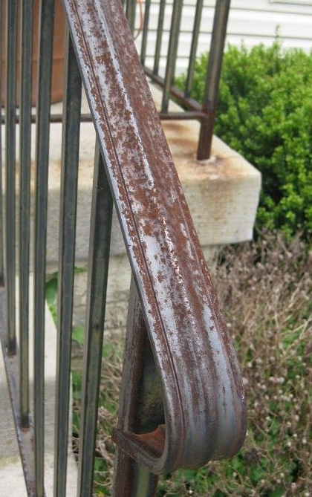
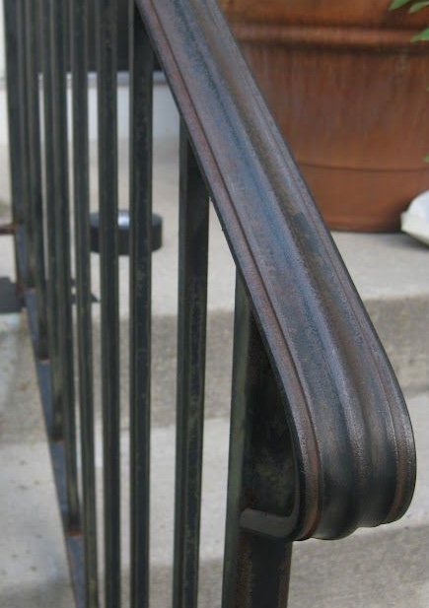
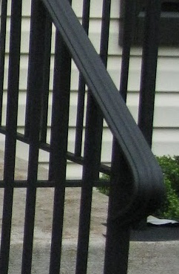
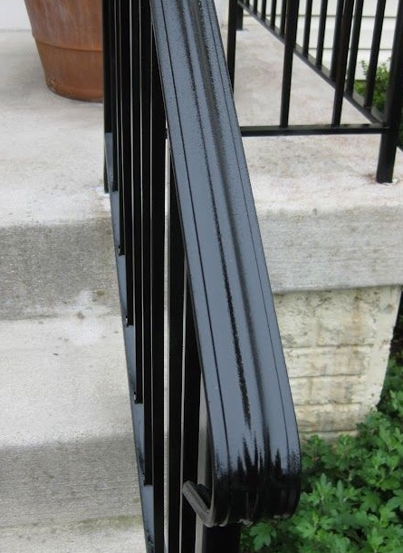
Rusted Metal
Notes:
8
8

Slide 9
Color Psychology
Red- The most emotionally intense color, red stimulates a faster heartbeat and breathing. Red is considered an appetite stimulant since it is a common food color in nature. A lot of restaurants will use red to increase appetites. In decorating, red is usually used as an accent. Decorators say that red furniture should be perfect since it will attract attention.
Blue- Peaceful, tranquil blue causes the body to produce calming chemicals, so it is often used in bedrooms. People are more productive in blue rooms. Studies show weightlifters are able to handle heavier weights in blue gyms.
Yellow- Cheerful sunny yellow is an attention getter. While it is considered an optimistic color, people lose their tempers more often in yellow rooms, and babies will cry more. It is the most difficult color for the eye to take in, so it can be overpowering if overused. Yellow enhances concentration, hence its use for legal pads.
Notes:
9
9

Slide 10
Color Psychology
Orange- Evokes excitement and enthusiasm, and is an energetic color. While not a good idea for a living room or for bedrooms, this color is great for an exercise room; it will bring out all the emotions that you need released during your fitness routine.
Green- It is a calming, refreshing color. People waiting to appear on TV sit in "green rooms" to relax. Hospitals often use green because it relaxes patients.
Purple- in its darkest values (eggplant, for example), is rich, dramatic and sophisticated. It is associated with luxury and creativity; as an accent or secondary color, it gives a scheme depth. Lighter versions of purple, such as lavender and lilac, bring the same restful quality to bedrooms as blue does, but without the risk of feeling chilly.
Notes:
10
10

Slide 11
Facility Products
ProMar 200
Exceptional durability, easy application, and excellent hide
Outstanding touch-up reduces repaint costs
Zero VOCs meets the most stringent environments
Complies with LEED, MPI, GREENGUARD, Environmental Institute and other green
guidelines and regulations
Notes:
11
11

Slide 12
Facility Products
Harmony
This zero-VOC paint helps improve indoor air quality with Formaldehyde Reducing Technology* and has the
power to reduce common indoor odors with Odor Eliminating Technology*
Features breakthrough innovations that help promote better indoor air quality and reduce common indoor odors.
Contains Formaldehyde Reducing Technology* helps reduce the levels of certain volatile organic compounds
(VOCs) from potential sources such as insulation, carpet, cabinets and fabrics.
Offers Odor Eliminating Technology* helps reduce common indoor odors, such as those from cooking, smoke and pets. Rooms stay fresher longer.
Features anti-microbial agents that inhibit the growth of mold and mildew on the paint surface.
Zero VOC formula and meets the most stringent VOC regulations, all while providing great hide and a durable finish.
Notes:
12
12

Slide 13
Facility Products
Porch and Floor Enamel
Ideal for both interior and exterior high-traffic surfaces – porches, patios,
basement stairs and floors, workshops, storage rooms, and more
Great washability maximizes the life cycle of the coating
Compliant with low-slip rating required by the Americans with Disabilities act
Available in satin and completely tintable in many colors
Meets the most stringent VOC regulations
Notes:
13
13

Slide 14
Facility Products
Loxon XP
Exceptional flexibility, durability, and fade resistance
Protects against wind driven rain, alkali, cracking and efflorescence
Hide build for one less coat compared to conventional masonry coatings
Save time and turn jobs fast – applies directly to bare concrete with a pH
as high as 13. Can be applied to fresh concrete and masonry less than 28
days old. No primer needed.
Notes:
14
14

Slide 15
Facility Products
Pre-Catalyzed WB Epoxy
Enhanced performance, single-component convenience
Excellent stain blocking properties
Flows and levels to a smooth finish
Effortless application by brush, roll or spray
Corrosion and chemical resistant
Excellent adhesion and durability
Suitable for use in USDA inspected facilities
Notes:
15
15

Slide 16
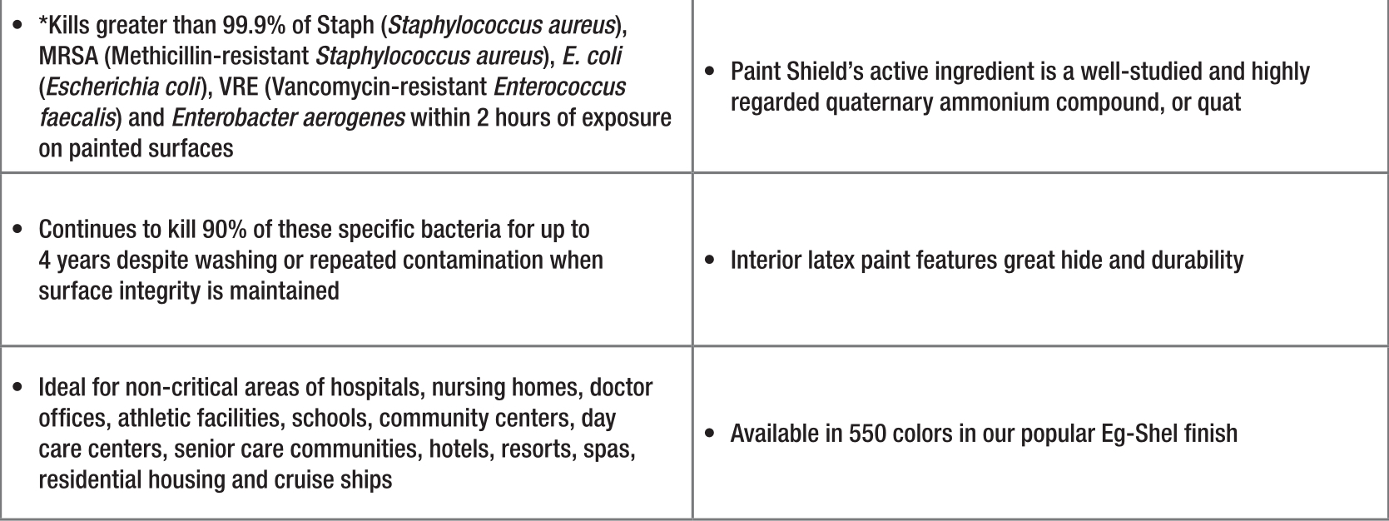
Facility Products
Paint Shield
Notes:
16
16

Slide 17
Facility Products
Dry Erase Coating
Turns most walls into a dry erase board
Use this clear gloss over any paint color
Durable finish wipes clean – no “ghosting”
For use in: Schools, offices, homes, and commercial buildings
Notes:
17
17

