Slide 1
The Garland Company, Inc.
A Full Service, ISO Certified, Roof Asset Management Company, Established in 1895
Manufactures a Full Line of High Performance Products:
  Modified Bitumen Roof Systems
  Built-Up Roofing
  Standing Seam and Flat Seam Metal Roofing
  Liquid Membranes
  Full Line of Maintenance Products
  Green Roofing and Sustainable Design
Notes:
*

Slide 2
Ohio Indiana Roofing
Established in 1986
Manufactures a Full Line of High Performance Products:
  Full Array of Membrane Systems (KEE, PVC, TPO, EPDM)
  Full Line of Maintenance Products
  Green Roofing and Sustainable Design
Notes:
*

Slide 3
Tecta America
In 2000, 10 roofing companies became 1; creating a national company comprised of the best of the best local roofing contractors. We are Tecta America and we are redefining roofing.
Tecta America went from 17 locations and just over 1200 people to over 70 locations and over 3000 people. With strong local ties and the strength of a national company we can offer the best of both worlds.
Notes:
*

Slide 4
Tecta America
Michelle Craddock, Account Manager
Tecta America Zero Company LLC * Tecta America Columbus
D/DF: 513.977.4358 | C: 513.518.0436 | mcraddock@tectaamerica.com| tectaamerica.com
Cincinnati Office (My Mailing Address) | 6225 Wiehe Road | Cincinnati, OH 45237 | O: 513.541.1848 | F: 513.541.1918
Columbus Office | 1230 Goodale Boulevard | Columbus, OH 43212 | O: 614.291.9747 | F: 614.291.9753
Dayton Office | 6104 Executive Boulevard | Huber Heights, OH 45424 | O: 937.723.7662 | F: 937.660.7662
Corporate Office | 9450 W. Bryn Mawr Ave., Suite 500 | Rosemont, IL 60018 | O: 847.581.3888 | F: 847.581.3880
I have been in the roofing industry for over 2 decades; I started as a customer service representative and as the years flew by I learned more and moved forward with my career. I specialize in lifecycle extension of existing roof systems, I believe
that a building’s most valuable asset is the roof system
as it protects the building and all its contents.
Notes:
*

Slide 5
Tecta America
Tecta America Zero Company started its journey in 1929 in Cincinnati, OH as “The Zero Company” and joined Tecta America in 2002. Our Dayton office was acquired in 2013 and our Columbus office was acquired in 2016. Our local philosophy is simple: It is our mission to provide our customers an experience that exceeds their expectations by providing quality roof construction, efficient project management and dependable service for a fair return.
Notes:
*

Slide 6
Getting the Most Out of Your
Roof Asset
Notes:
*
This presentation will provide an overview of the most common types of roofing systems in the commercial market place today. Along with a brief description, history and application of each of the systems, the advantages and disadvantages will also be reviewed.
We hope that this presentation will provide you with information you find useful. If you have any questions or need further information, please contact your local Garland representative or contact garland at IW@garlandco.com or the Product Management Department at 1-800-321-9336.

Slide 7
What Is the Cost of Neglecting Your Roof Asset?
Depreciation for a Roof Is 39 Years, Per the Federal Government
Average Life Expectancy of Today’s Commercial Low-slope Roof Is Only 17 Years
Only Seven Percent of Building Owners Extend the Working Lives of Their Roofs 26 Years and Longer
- Roof Longevity and Replacement Report Funded by Roofing Alliance for Progress

Slide 8
What Is the Cost of Neglecting Your Roof Asset?
Roofs That Are Reactively, Rather Than Proactively Maintained, More Than Double the Total Life-cycle Cost of Ownership Over a 20-year Period
- RSI Magazine, Roof Maintenance, “Try the Math.”

Slide 9
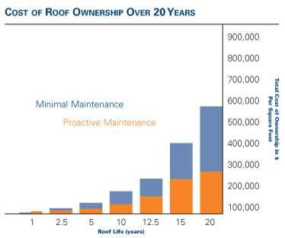
What Is the Cost of Neglecting Your Roof Asset?
Based on 100,000 SF roof; Original cost $350,00 Tear-off and replacement cost $500,00; Leak repairs $750 per occurrence. PM costs: Annual inspections - $1000; Annual Visual Surveys $1000; Periodic moisture scans $5,000

Slide 10
Additional Costs of Roof Neglect
Shutdown Time / Internal Damage (Computers, Machinery, Stock)
Safety Issues
Environmental Issues
Mold

Slide 11
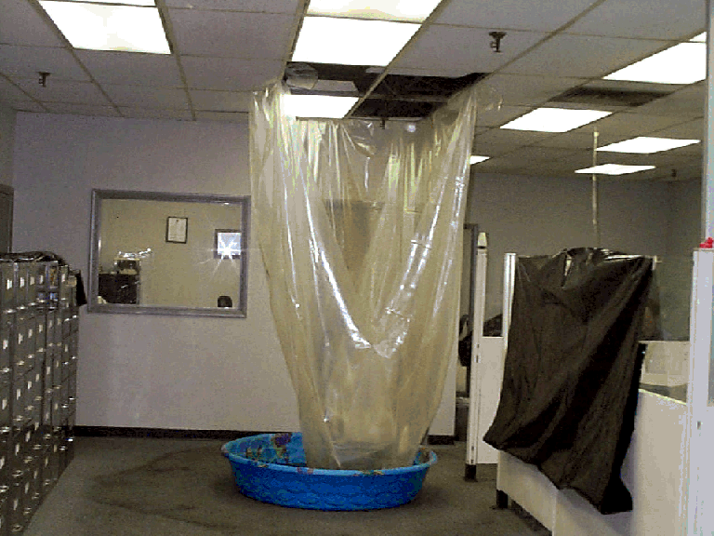
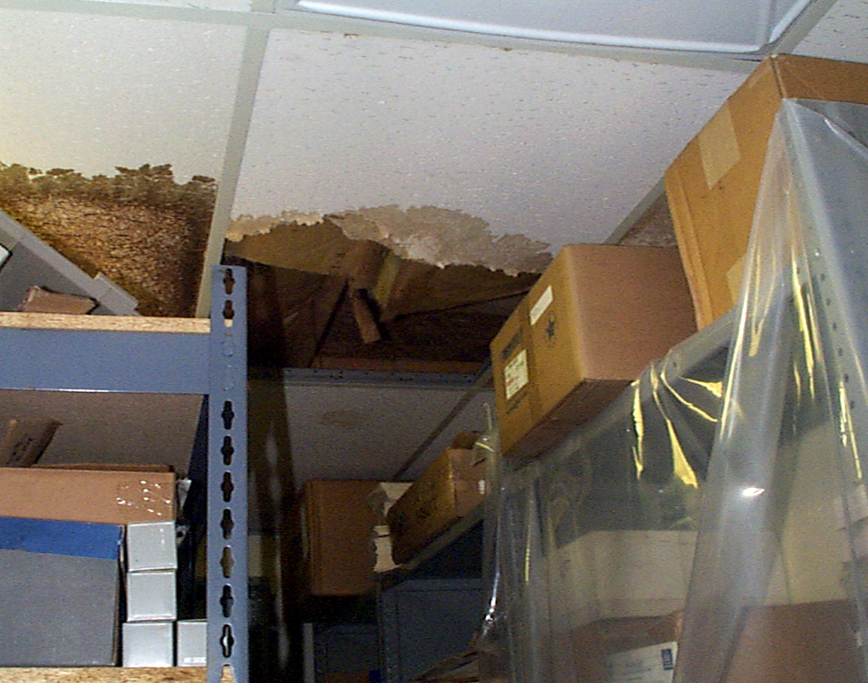
Shutdown Time & Internal Damage
Notes:
*
It’s the hidden costs that are expensive. Fixing the problem is cheap. But potential structural damage is expensive, especially when you’ve got leaks onto specialized equipment. That’s one way of how roofing leaks can be so expensive.
Roof leaks in any facility can disrupt operations. But in unique areas, such as inventory storage, a roof leak can have devastating consequences, from structural damage to destruction of expensive equipment and or inventory.

Slide 12
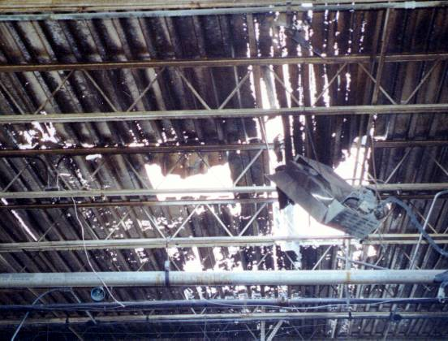
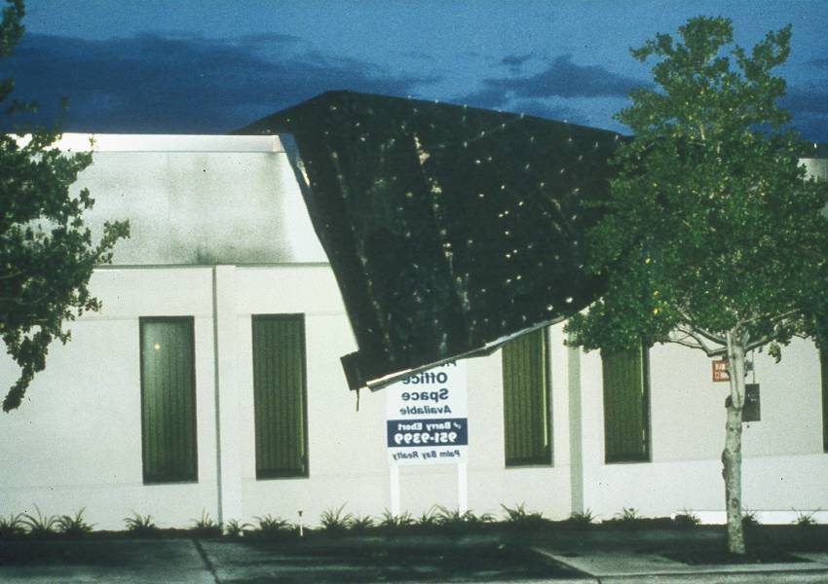
Safety Issues
Notes:
*
The water entrapped in the existing system can do a lot worse than void a warranty. If the deck is steel, wood, wood fiber or gypsum, the moisture can cause potential life safety problems due to rusting through a steel deck or rotting of wood or wood fiber

Slide 13
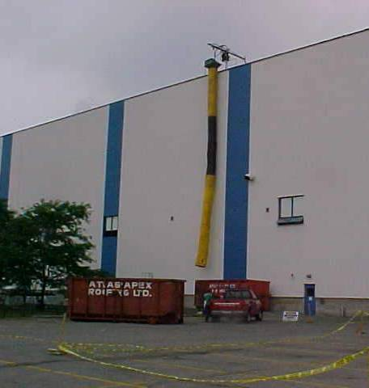
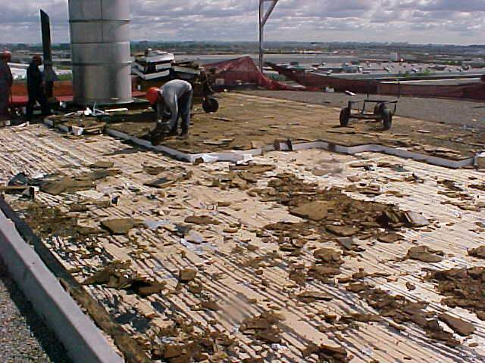
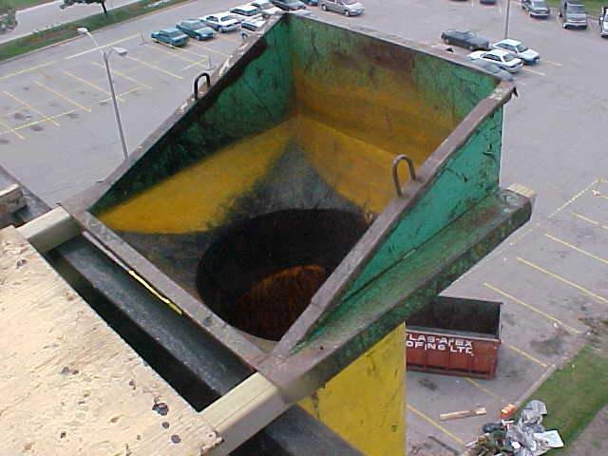
Environmental Issues

Slide 14
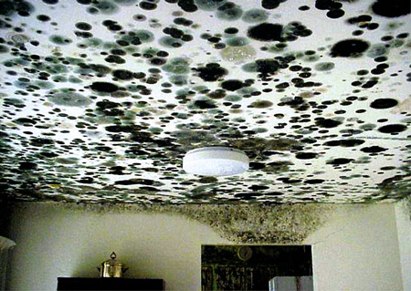
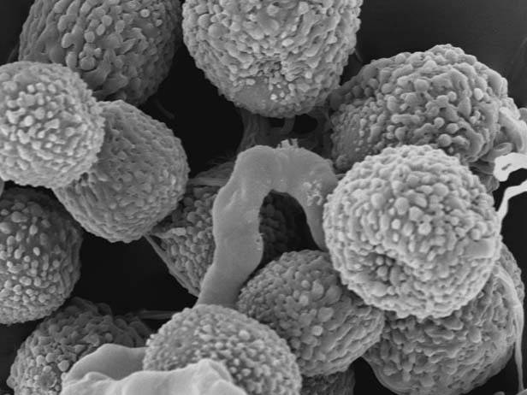
Mold
Notes:
*
The water intrusion from the leaking roof spread over a wide area of the room. This photo shows an area of mold growth on the ceiling. Moisture damage and mold growth continued down the walls and into the floor materials and carpet.

Slide 15
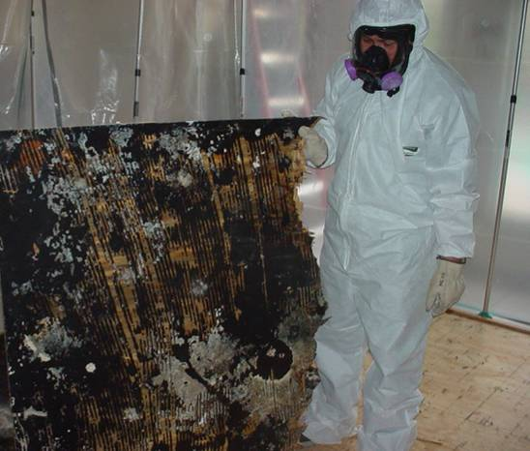
Mold Signs
Water Damage
Musty Smell
Relative Humidity Above 55%
Odors When HVAC System is on
Notes:
*
Picture of wood decking covered in mold.

Slide 16
Mold and Health
Breathing Difficulties
Flu-Like Symptoms
Loss of Balance
Memory Loss
Dizziness
Chronic Fatigue
Chronic Sinus Infections
Allergies
Asthma
Bleeding Lung
Hearing Loss
Brain Damage

Slide 17
Mold Prevention
“The Only Factor That Can Be Controlled Is Moisture.”
      - National Association of Home Builders
“The Only Way to Control Indoor Mold Growth Is to Control Moisture.”
      - US Environmental Protection Agency

Slide 18
Mold Regulations
No Current Standards for Levels of Mold
No Known Mold Exposure Limits for Indoor Environments
No State or Federal Agencies Currently Offer Testing of Mold Samples
OSHA is Developing Standards for Permissible Exposure Limits

Slide 19
Preventive vs. Reactive Maintenance

Slide 20
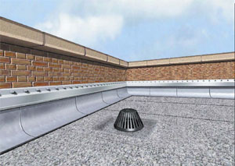
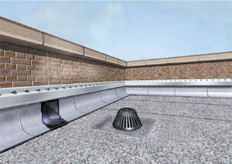
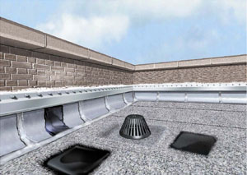
What is Preventive Maintenance?
System Is Inspected at Least Annually
Maintenance Is Planned and Scheduled Components Are Repaired or Replaced Periodically
One of the Most Effective Tools to Maximize the Service Life of a Roofing System

Slide 21
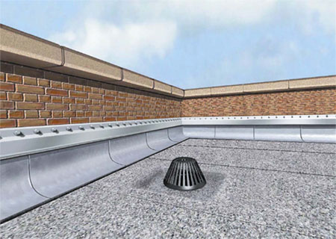
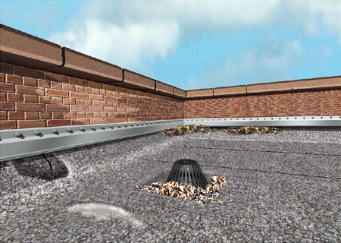
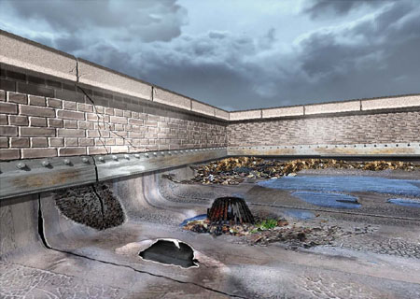
What is Reactive Maintenance?
Definition:
System Is Out of Sight, Out of Mind
Repairs Only Made When Emergency Exists

Slide 22
Four Step Process to Successful Roof Management
Step 1: Proper Inspection, Analysis, Recommendations and Design
Step 2:
Quality Products
Step 4: Corrective and Preventive Maintenance
Step 3:
Proper Application & Regular Inspections
Notes:
*

Slide 23
Facts of Preventive Maintenance
Every Warranty Contains an Exclusion Stating That If PM Is Not Performed the Warranty Is Null and Void
Approximately 80% of All Roof Leaks Could Be Prevented by Timely and Effective Roof Repairs – NRCA
Today's Re-roofing Alternatives Actually Provide Long-term Solutions, Not Just Band-aid Fixes to Leaks or Problems

Slide 24
“Car Owners Know That Regular Oil Changes and Tune-ups Are Simply Necessary in Maintaining and Operating a Vehicle. Regular Maintenance and Inspections Are the Same for Roofs.”
– Karen Kane, Director of Contractor Management, NRCA

Slide 25
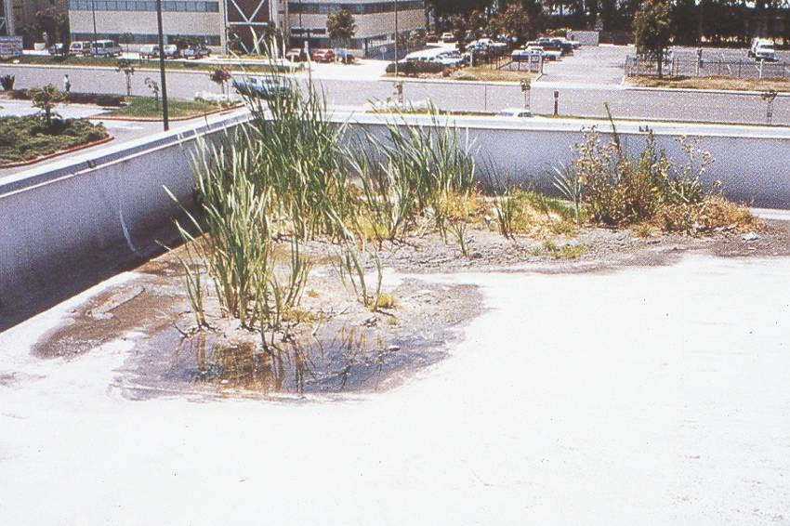
Facts of Preventive Maintenance
52% of Owners Report Their Roof As the #1 Construction Problem (1996 AIPE)
More Than Half of All Related Legal Claims Brought Against Architects/Consultants Involve the Roofing Part of the Building Envelope (1997 AIA)
15% of New Roofs Fail Within First 6 Years (1996 AIPE)
Notes:
*
28% of All Capital $ for School Improvements Are Spent on Roof Related Problems (1996 AS&U)

Slide 26
Why Preventive Maintenance?

Slide 27
Why Preventive Maintenance?
Proactive Money Management
  Allows For a Planned, Organized Approach to Management of a Roof Asset
  Leads to Responsible, Timely Preparation of Long-Term Capital Expenditures
Saves Money
Saves Time

Slide 28
Why Preventive Maintenance?
Increases Life-Cycle of Roof
Positive Environmental Impact
Tax Depreciation
  Roofing Repairs May be Written Off in the Current Tax Year
  New Roofing is Depreciated Over 39.5 Years

Slide 29
Life-Cycle Cost of
Roofing Asset
New Roof System with Proactive PM
  50,000 Sq. Ft. X $7 Per Foot
Tear off and Replacement = $350,000
  50,000 Sq. Ft. X 10¢ Per Foot
Annual P.M. Fee = $5,000 X 25 Years = $125,000
Total Investment for 25 Years of Performance = $475,000* or $19,000 Per Year
*Does not factor in savings in time and lack of frustration

Slide 30
Life-Cycle Cost of
Roofing Asset
New Roof System with Reactive PM
  50,000 Sq. Ft. X $7 Per Foot
Tear off and Replacement = $350,000
  12,500 Sq. Ft. Or 25% of Roof Needs Repair in Year 10 @ $3.50 Sq. Ft. = $43,750
Total Investment for 15 Years of Performance = $393,750* or $26,250 Per Year
*Does not factor in lost dollars in time and lack of frustration

Slide 31
Life-Cycle Cost of
Roofing Asset
New Roof System with no PM
50,000 Sq. Ft. X $7 Per Foot
Tear off and Replacement = $350,000
Total Investment for 10 Years of Performance = $350,000* or $35,000 Per Year
*Does not factor in lost dollars in time and lack of frustration

Slide 32
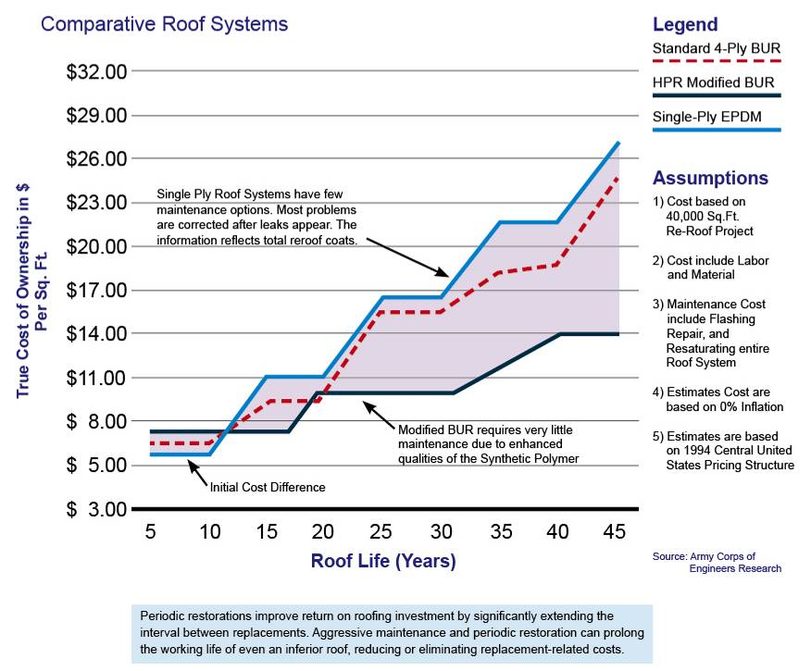
Life-Cycle Cost

Slide 33
Components of a Preventive Maintenance Program

Slide 34
Preventive Maintenance Program Components
Survey/Testing
Document and Record Findings
Results
Appoint Preventive Maintenance Program Team
Schedule Repairs and Inspections

Slide 35
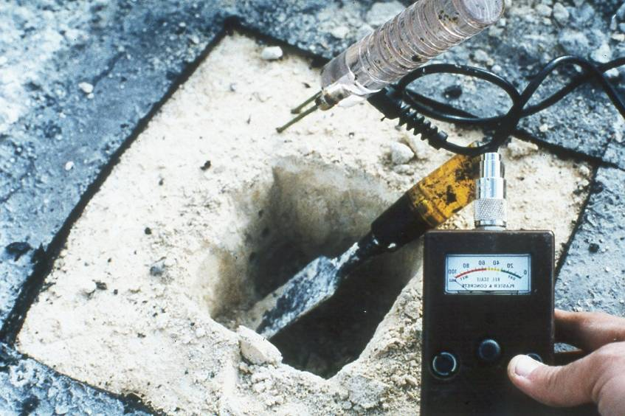
Survey
Analysis of roof construction (core cuts)
Thorough inspection of all roof components
  Membrane Field
  Flashings
  Perimeter
  Penetrations
  HVAC and other equipment
  Parapet Walls
  Seams
  Fasteners

Slide 36
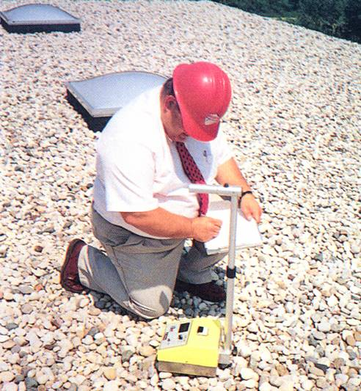
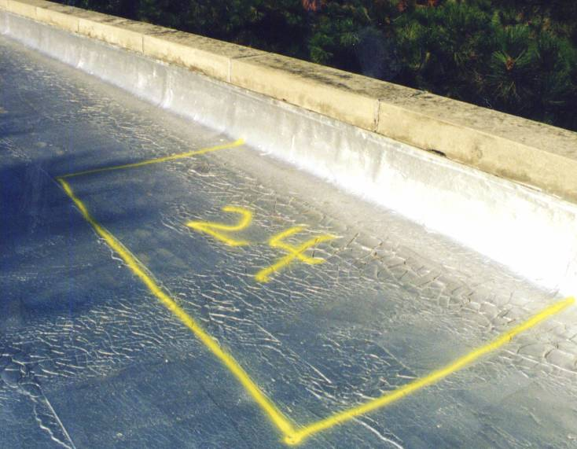
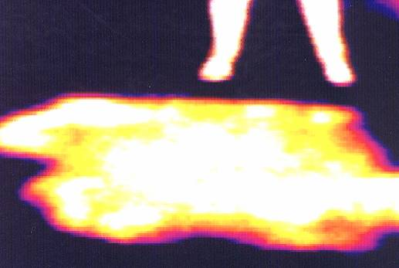
Non-Destructive Testing
Infrared Testing
Moisture Probes
Notes:
*
Infrared electrical, roof moisture or infrared NDT can provide proof of a situation before it becomes a problem, or help document a problem once it does exist as a step toward its solution.

Slide 37
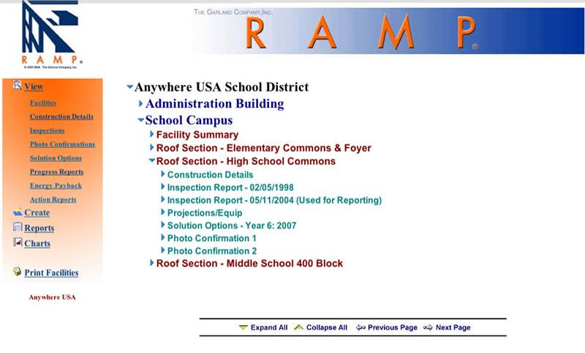
Documentation

Slide 38
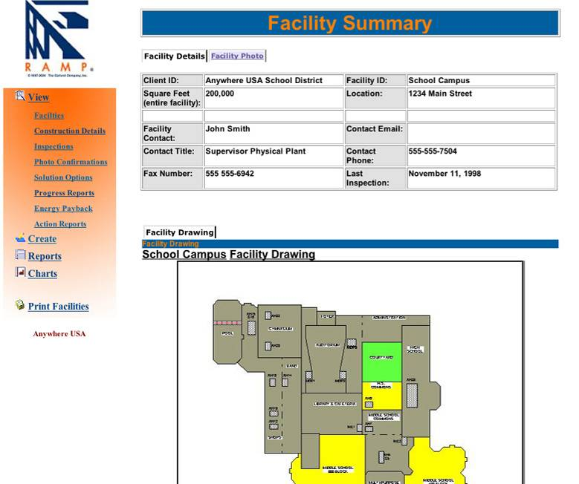
Documentation

Slide 39
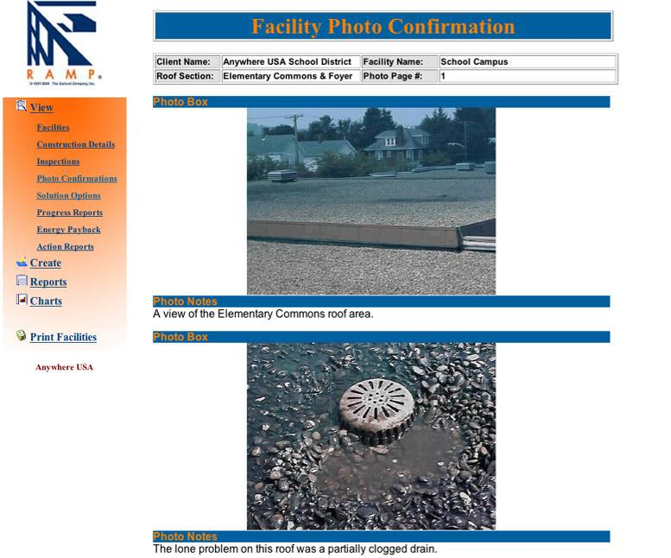
Documentation

Slide 40
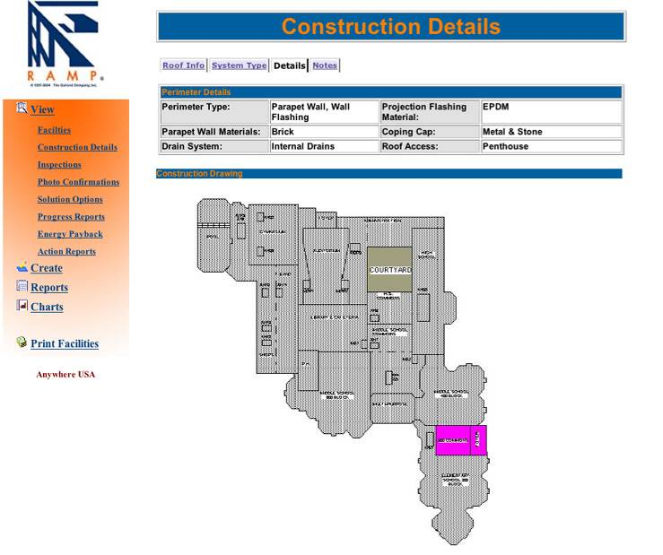
Documentation

Slide 41
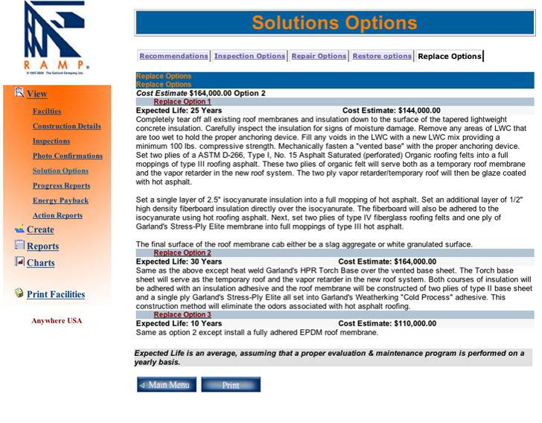
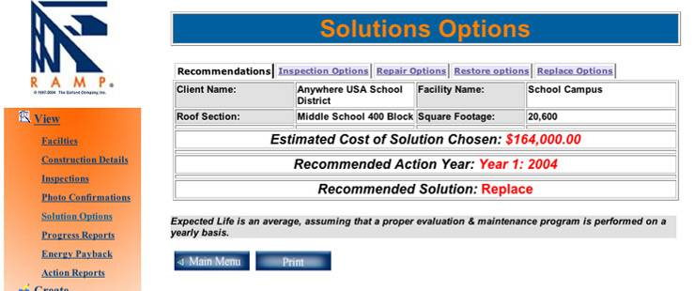
Solution Options

Slide 42
PM Program Team
In-House Personnel
Roofing Contractors
Manufacturer’s Representatives That Offer Help in Coordinating P.M. Programs

Slide 43
Schedule Repairs and Inspections
Fill Out Roof Plan and Survey Plan Form
  Breakdown into Manageable Sections
Begin a Semi-Annual Maintenance Inspection Checklist
  Minimum Two Inspections Per Year
  Always Inspect After Bad Storms

Slide 44
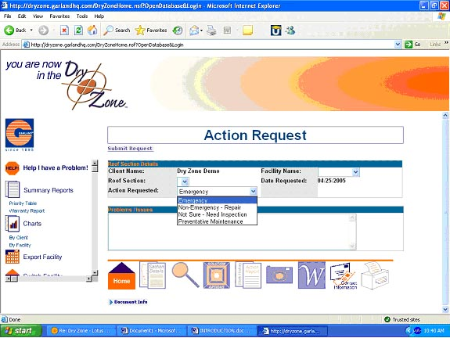
Schedule Repairs and Inspections

Slide 45
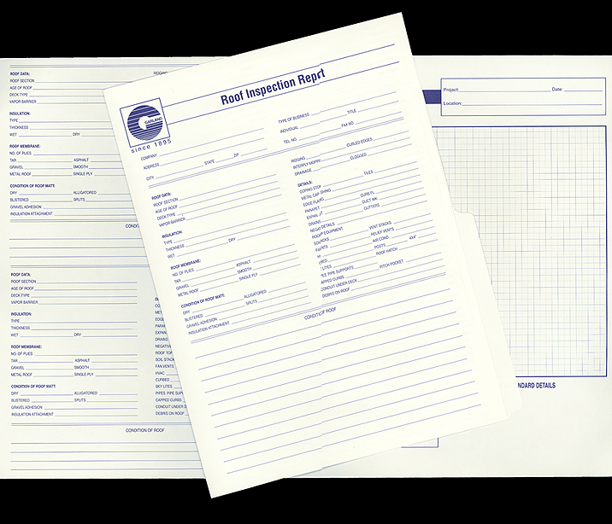
Roof Inspection Report

Slide 46
Areas to Examine When Inspecting a Roofing System

Slide 47
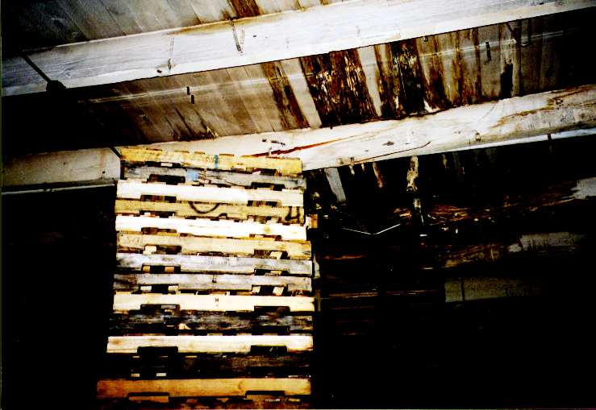
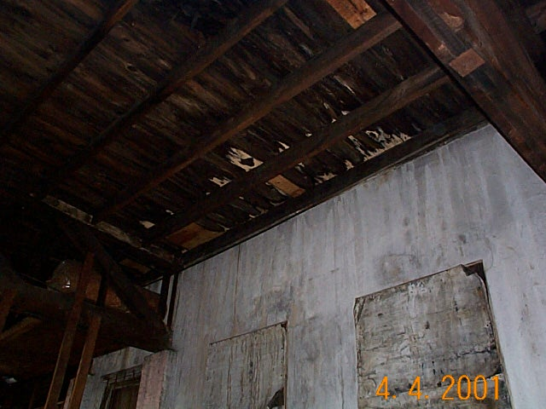
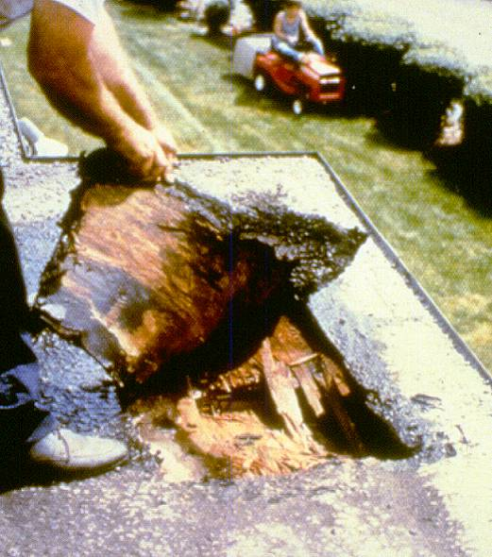
The Deck

Slide 48
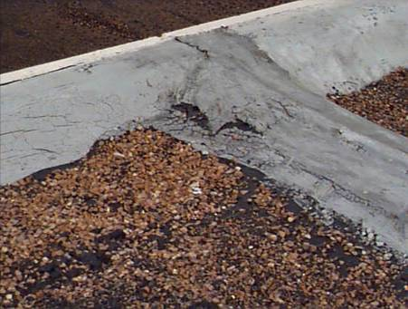
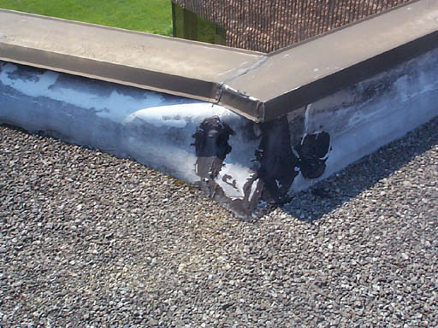
Perimeter Flashing
(Parapet Wall, Metal Edge)

Slide 49
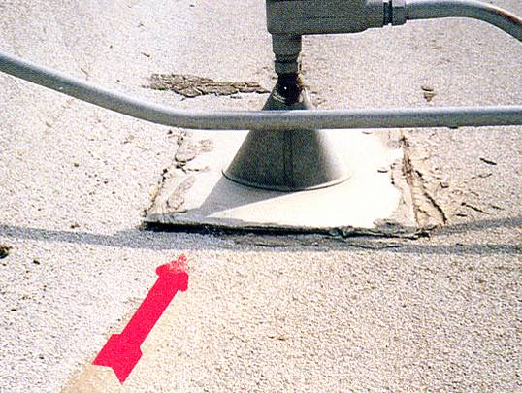
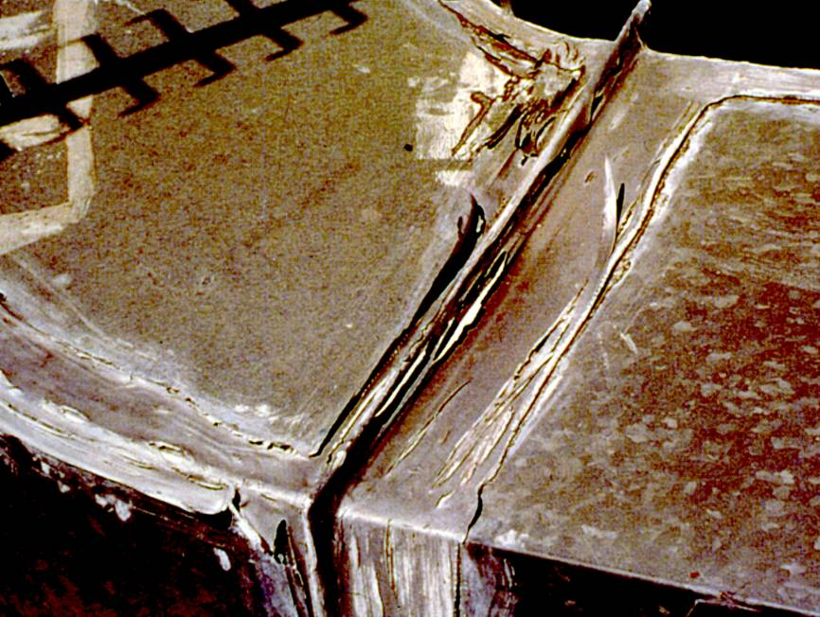
HVAC Units, Pipes, Supports, Signs, Etc.

Slide 50
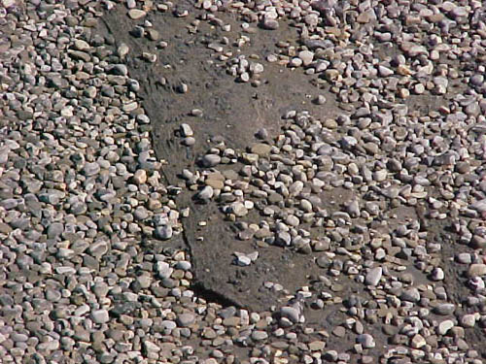
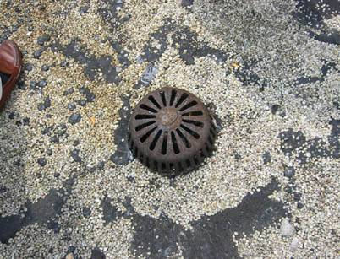
Bare Spots on Gravel
Surface System

Slide 51
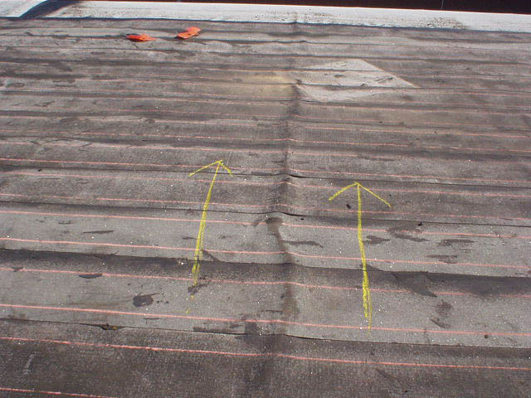
Improper Installation

Slide 52
Wet Insulation
Wet Insulation Raises Energy Costs
Can Cause Structural Damage to the Deck
A Non-Destructive Scan of Roof May Be Needed to Locate Wet Areas

Slide 53
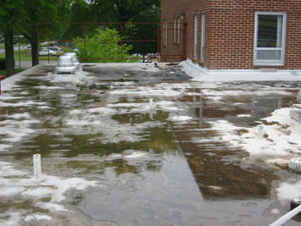
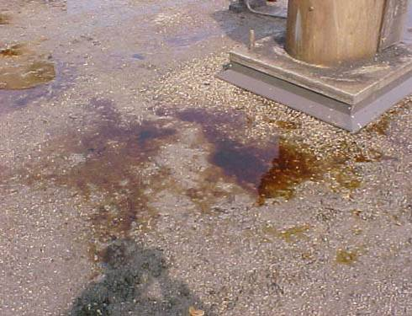
Ponding Areas

Slide 54
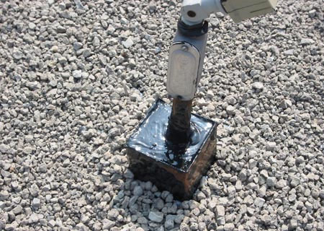
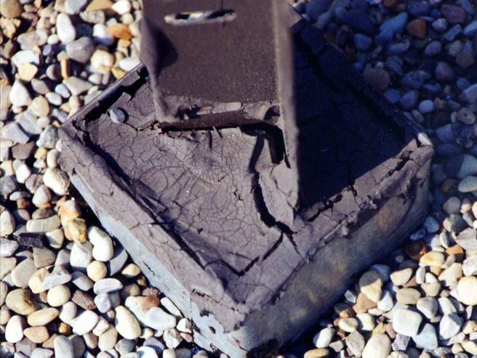
Pitch Pans

Slide 55
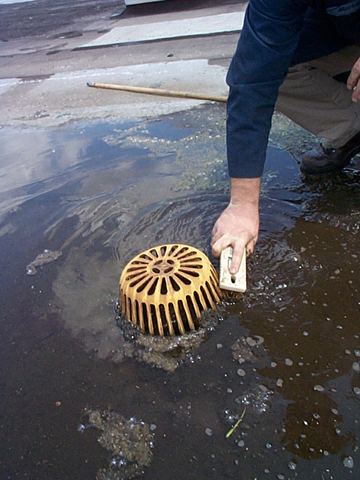
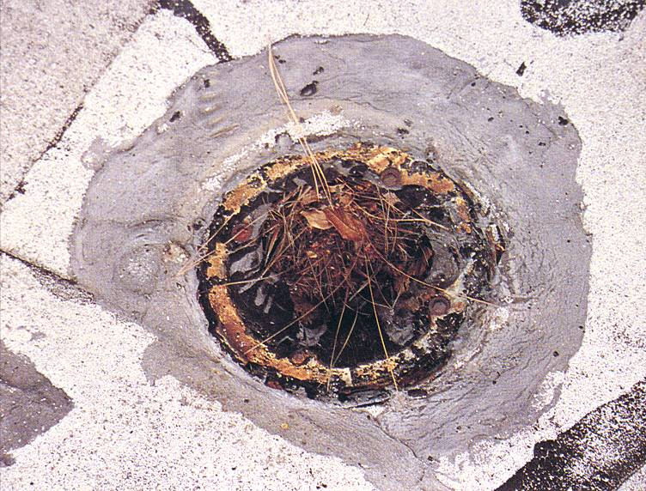
Clogged Drains

Slide 56
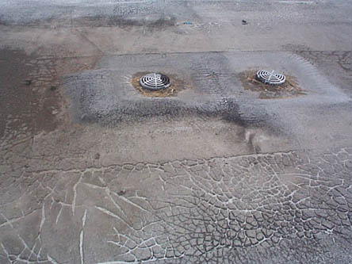
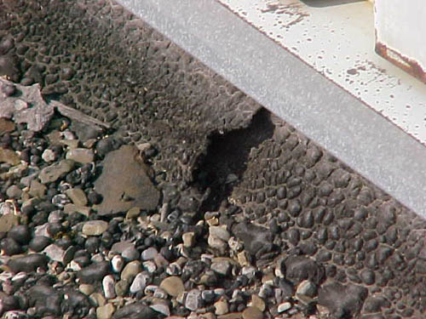
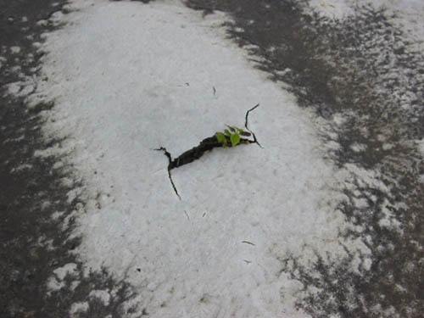
Blisters, Splits & Alligatoring

Slide 57

Structural Damage

Slide 58
Restoration
Proactive Preventive Maintenance Process
Recommended Within Second Decade of Roof’s Life-Cycle
Reconditions and Corrects Imperfections in an Existing, Functioning Roof
Cost-effective, Maximizes Roofing Asset
Delays Replacement, Keeps Building Dry Longer
Warranted Systems

Slide 59
Restoration - Steps
Roof Inspection
Analytical Testing
  Infrared Moisture Scan
  Core Evaluation
Repair Defects
  Flashings
  Penetrations
  Membrane Faults
Restore Weatherproofing Integrity
  New Top Coat to Protect From UV and the Environment

Slide 60
Systems Covered
Single Ply
Built-Up
Modified Bitumen
Metal
Masonry Walls

Slide 61



Restoration
Before
After

Slide 62


Restoration
Before
After

Slide 63


Restoration
After
Before

Slide 64
Restoration Advantages
Reuses Existing System
Upgrade Weathering and UV Resistance
Improves Aesthetic and System Strength
Recognized As a Maintenance Expense
Limits Building Occupant Disruption
Extends the Interval Between Roof Replacements
Not Considered Re-roofs

Slide 65


Slide 66


Slide 67


