Slide 1


Slide 2

Dayton IFMA
Key Points
Extending the Life of Your Roof
Roof Asset Management
Fall Protection
Building Code, R Value, and Good Roofing Practices
Technology and Capabilities

Slide 3

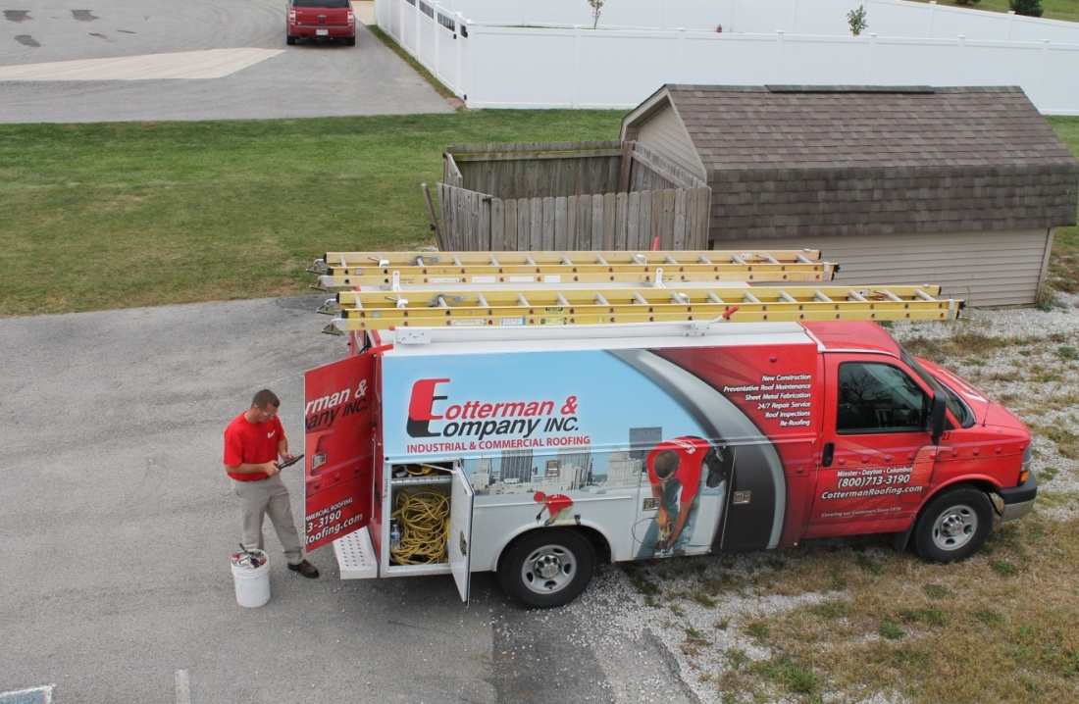
Extending the Life of your Roof
Roof Preventative Maintenance Programs
  Annual or Semi-Annual roof inspections

Slide 4
PREVENTATIVE MAINTENANCE PROGRAM
The National Roofing Contractor’s Association along with major roof manufacturers, recommend adopting a Roof Management Program (RMP). It is a comprehensive preventative maintenance plan that extends the service life of your roof well beyond the warranty. It is also beneficial in extending the life of any other existing roofs that you may have.
It is recommended to have Annual or Semi-Annual inspections to evaluate the conditions of your roof.
Roof evaluations should include a detailed analysis of all roof components, identifying potential problems and damage.
Following the evaluation, a written report along with photographs should be provided.

Slide 5
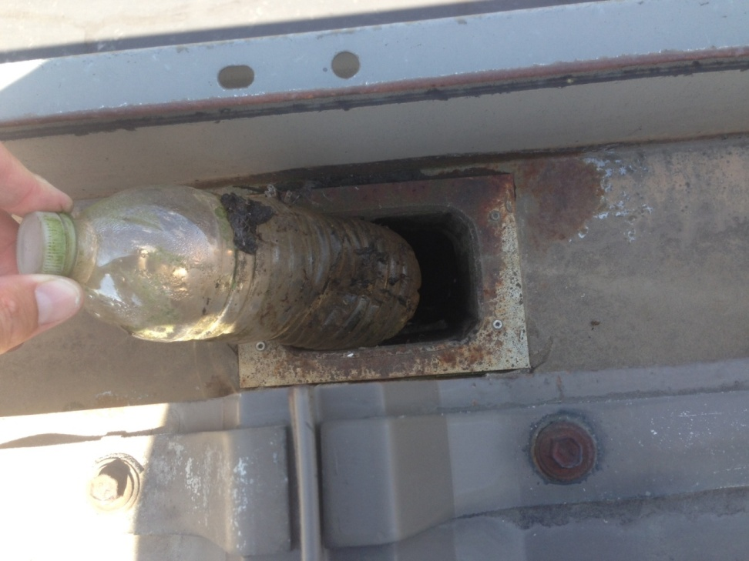
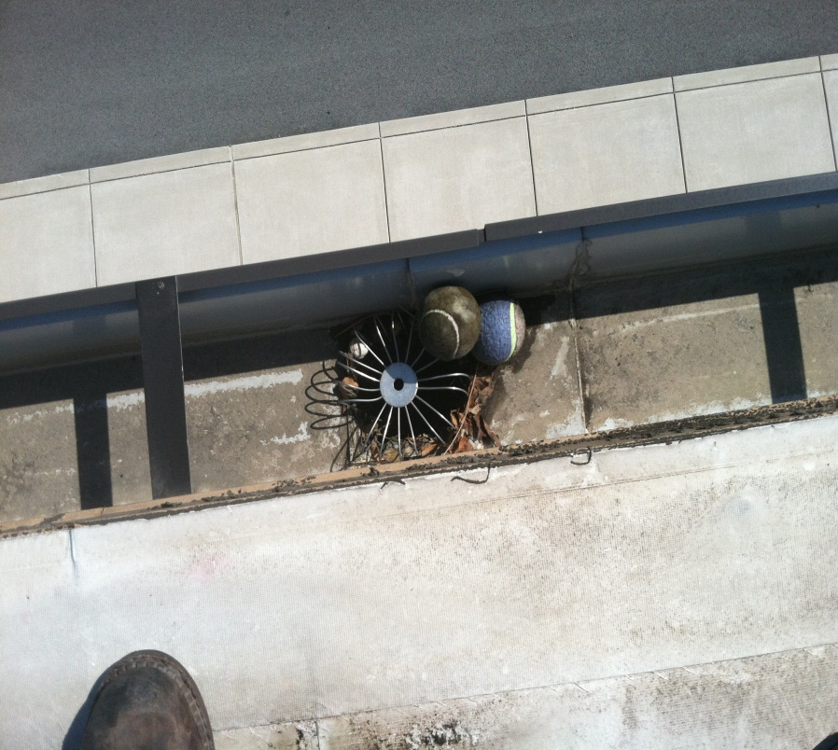
Inspect entire roof area for damage that may have resulted from foreign objects or from human activity

Slide 6
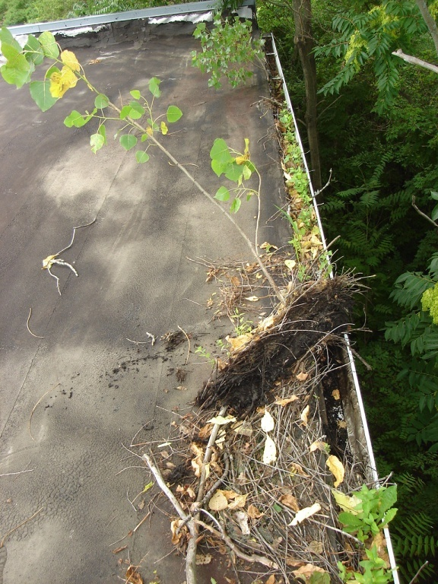
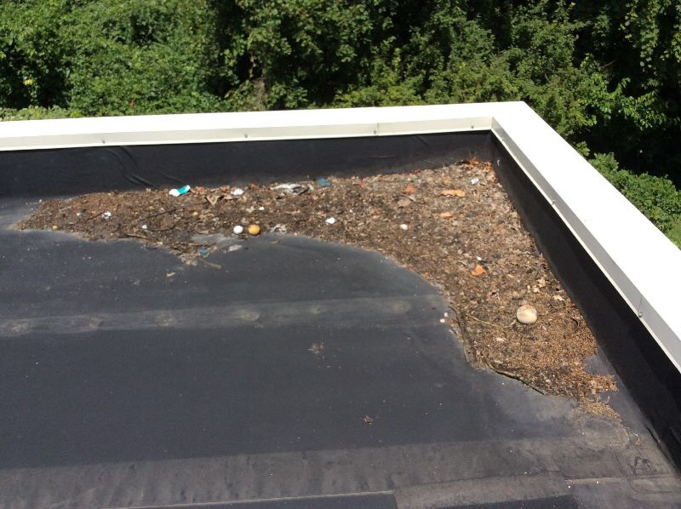
Remove all debris that may have accumulated on the roof surface to ensure it does not restrict drainage

Slide 7
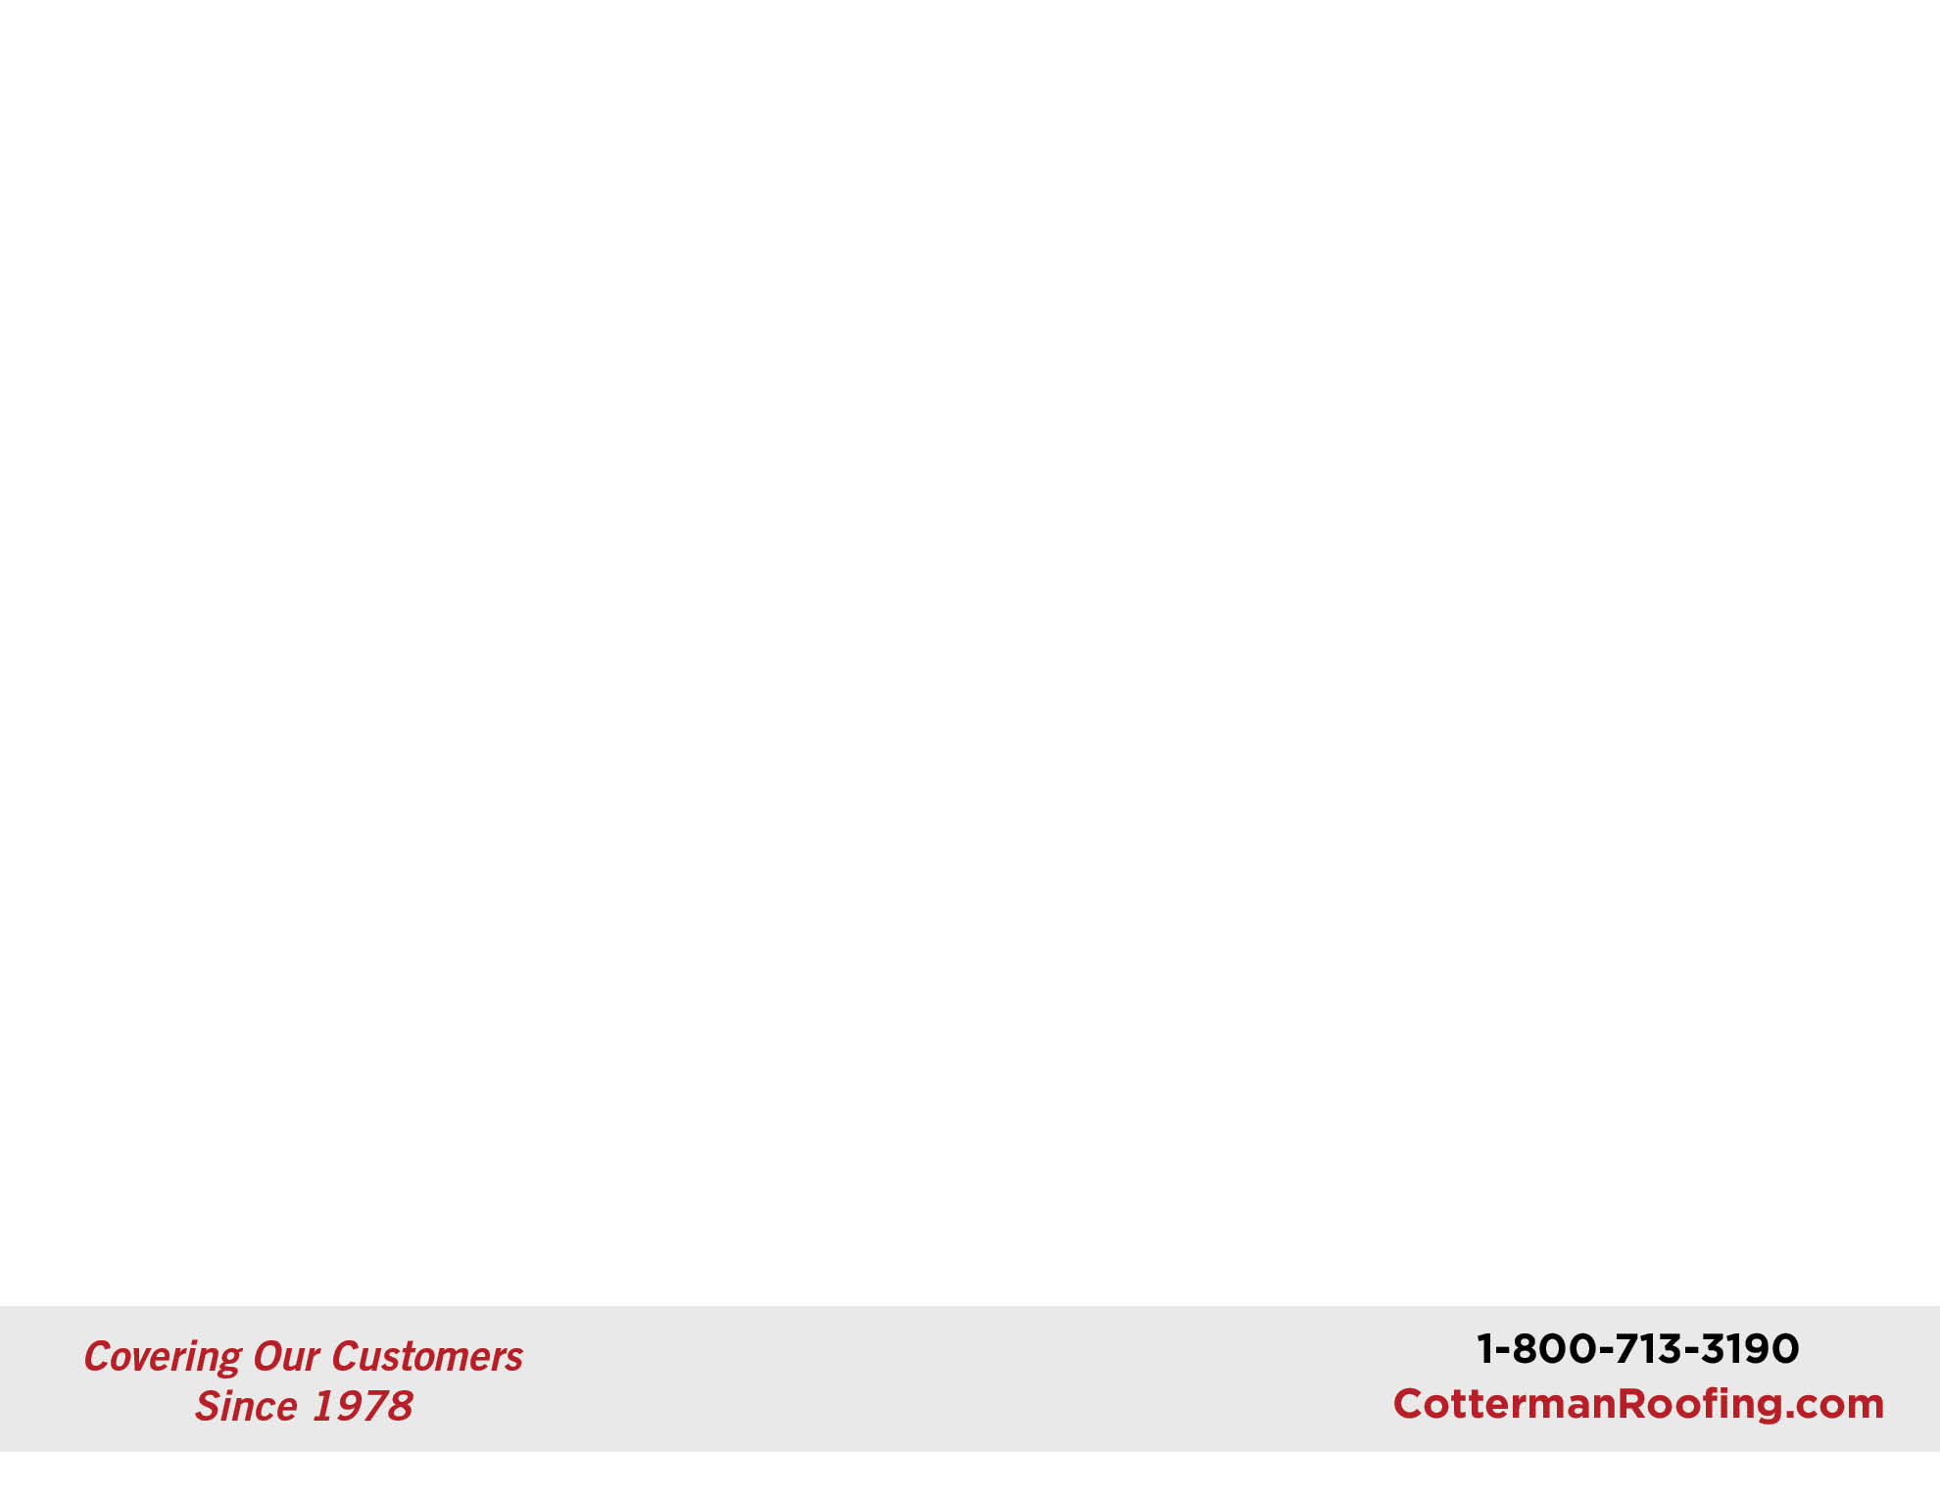
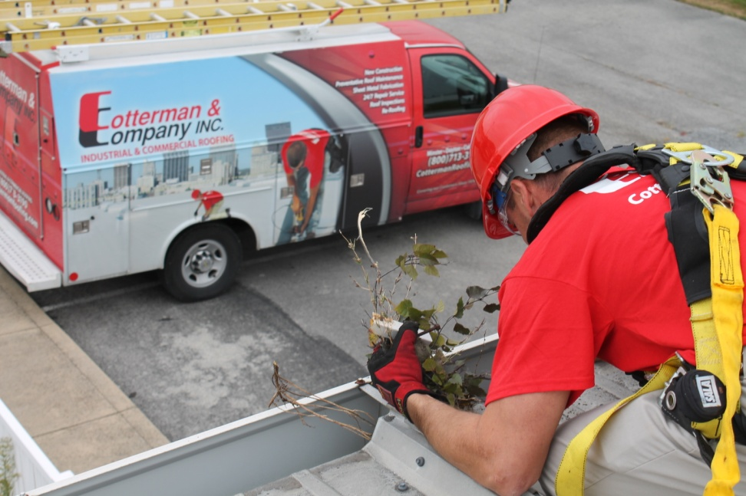
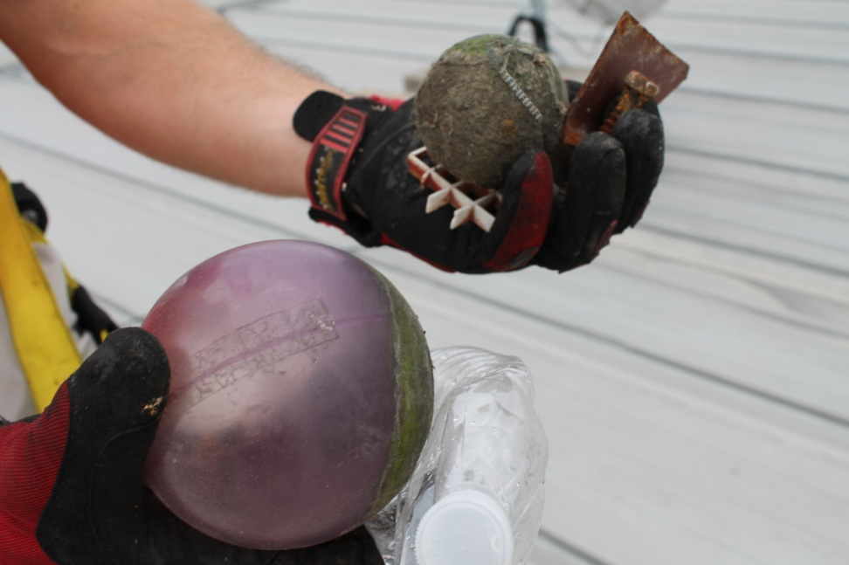
Inspect and clean all roof drains, overflow drains, gutters and scuppers

Slide 8
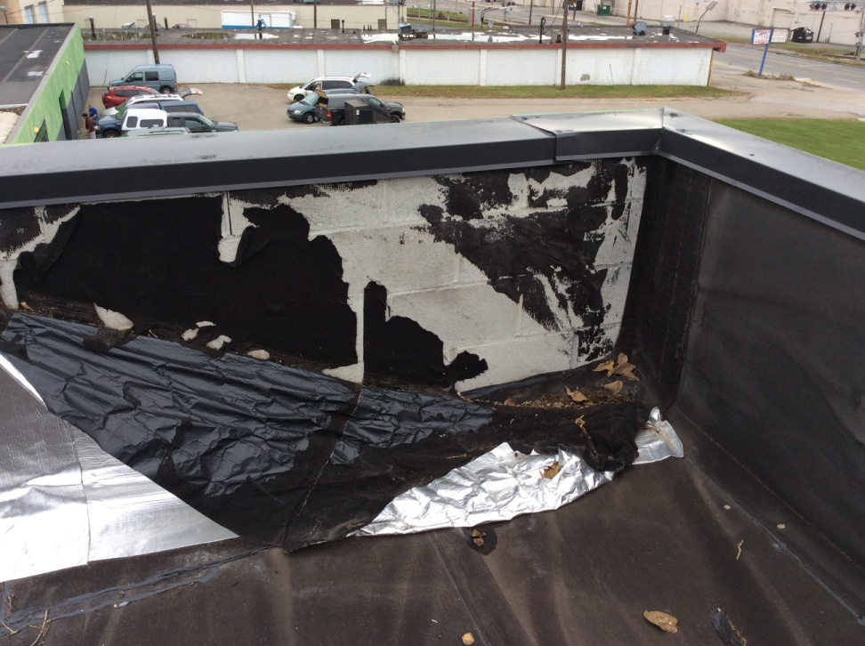
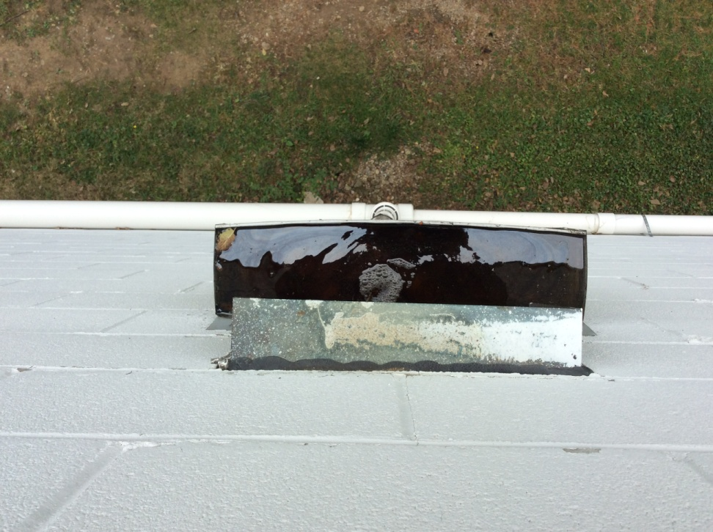
Inspect the entire roof area

Slide 9
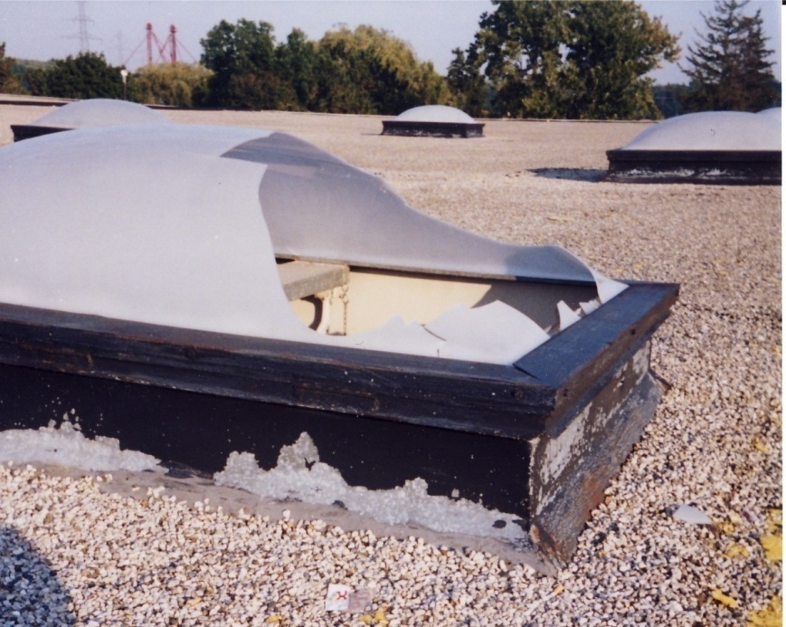
Inspect skylights

Slide 10
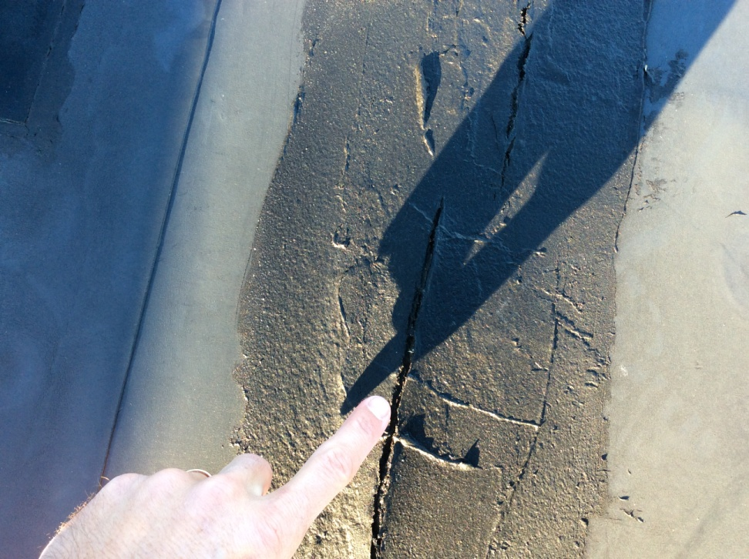
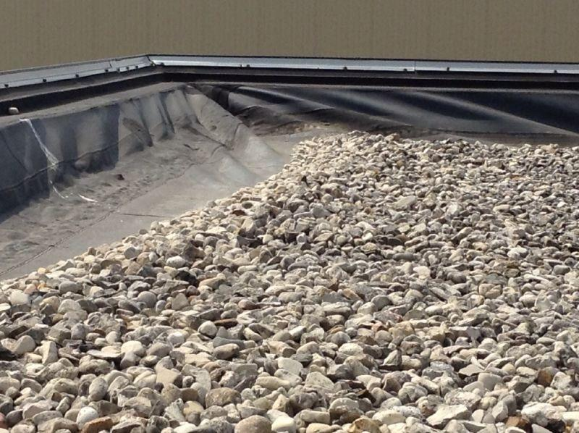
Inspect roof membrane

Slide 11
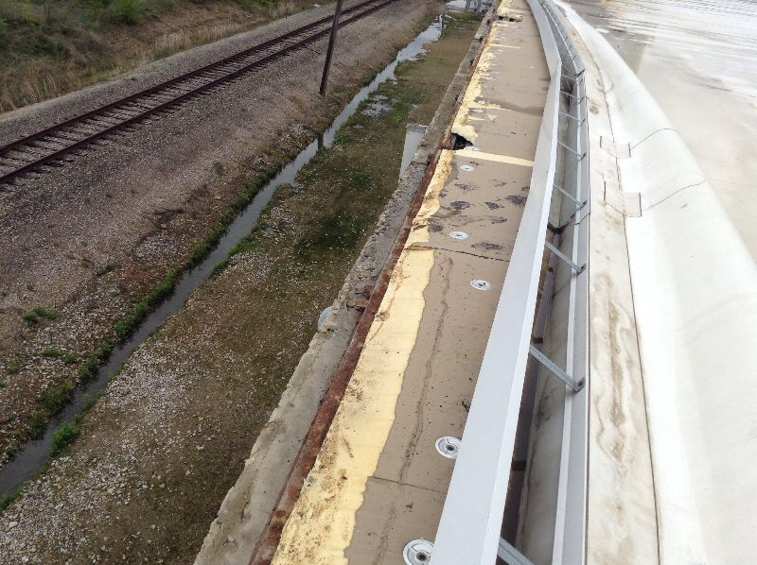
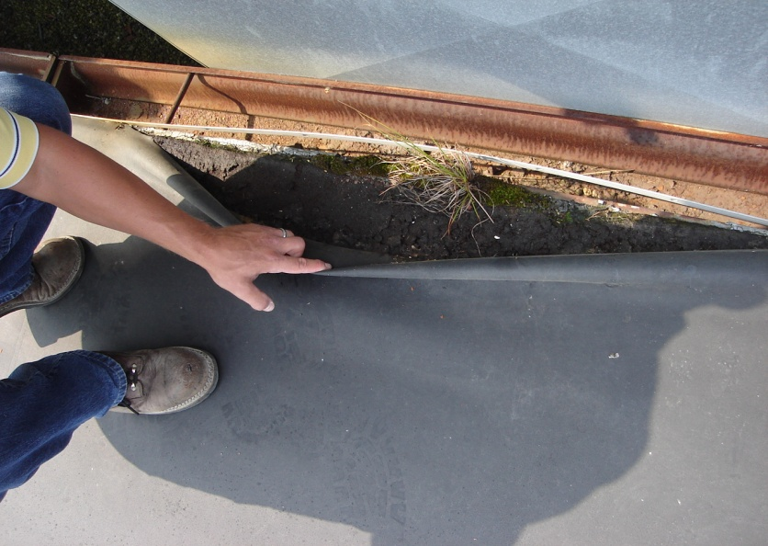
Inspect edge securement

Slide 12
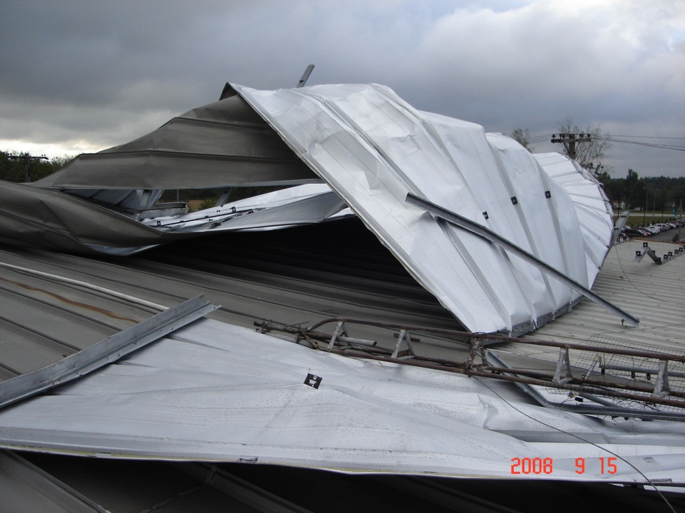
Edge securement failing allowing roof to be blown off

Slide 13
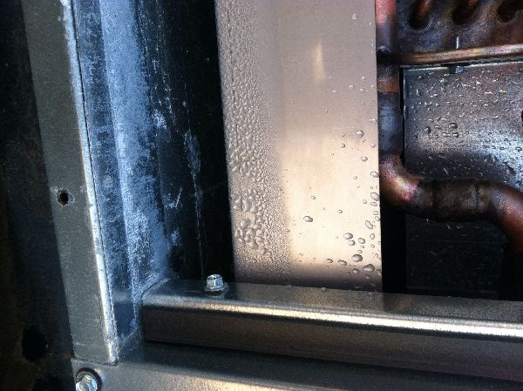
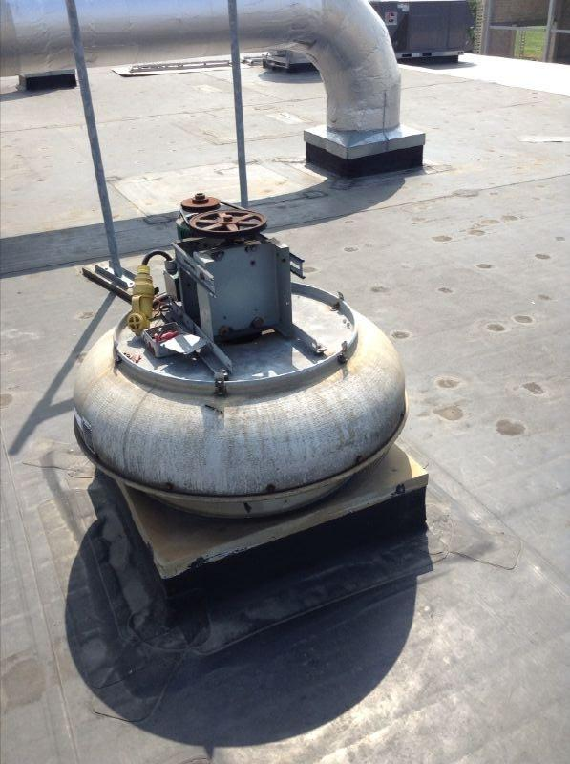
Inspect HVAC units and fans

Slide 14
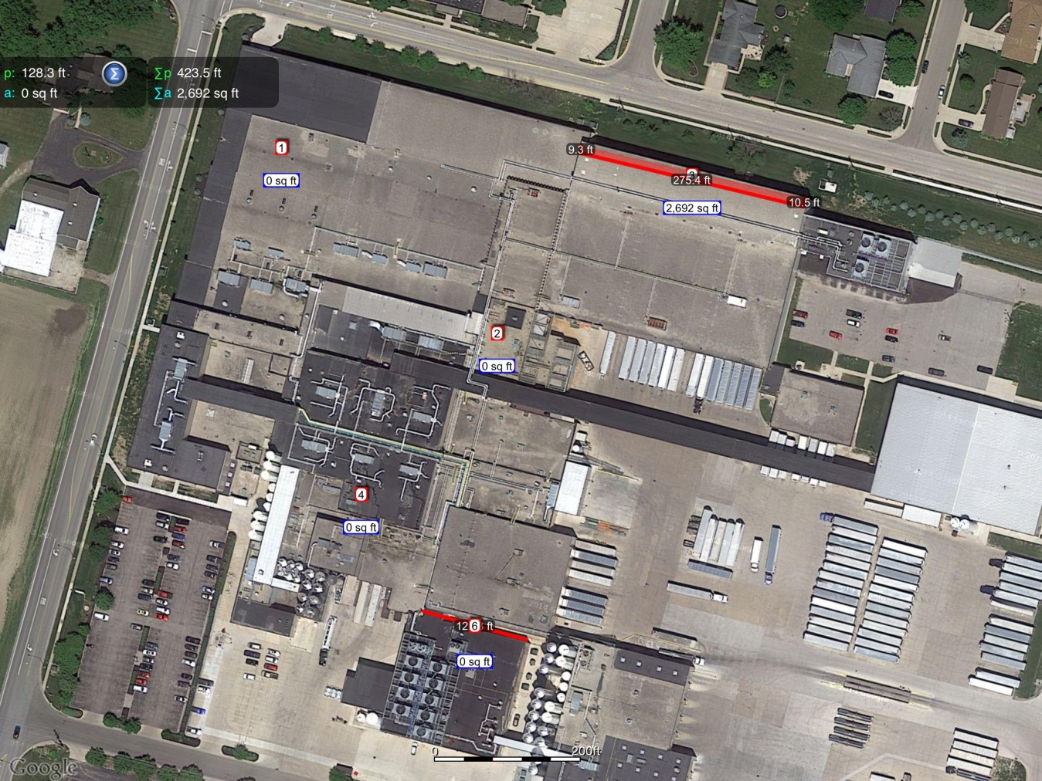
Overview pictures provide the overall condition of the roof

Slide 15
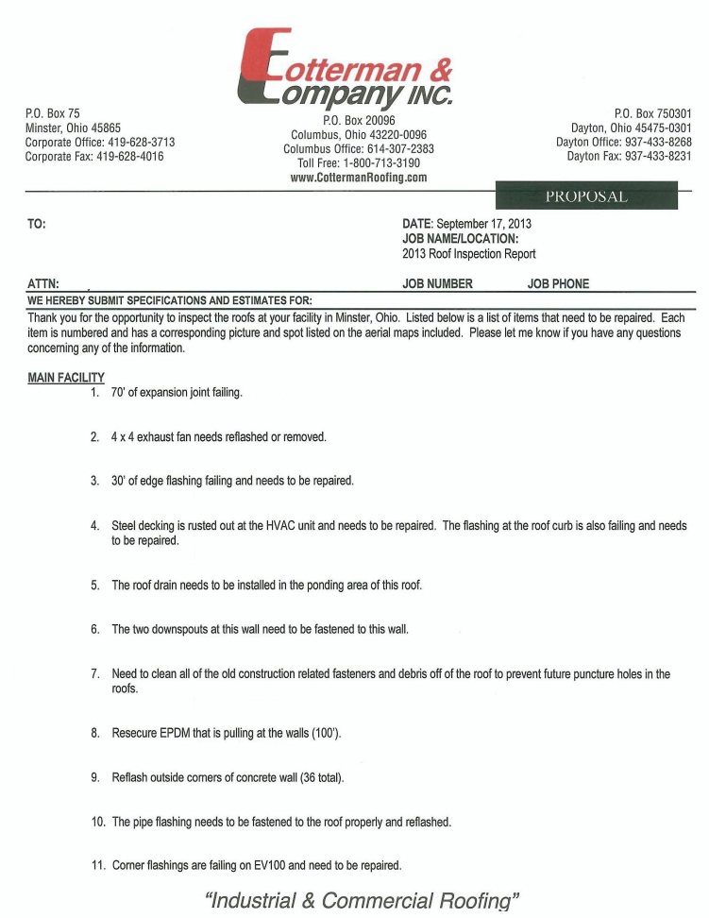
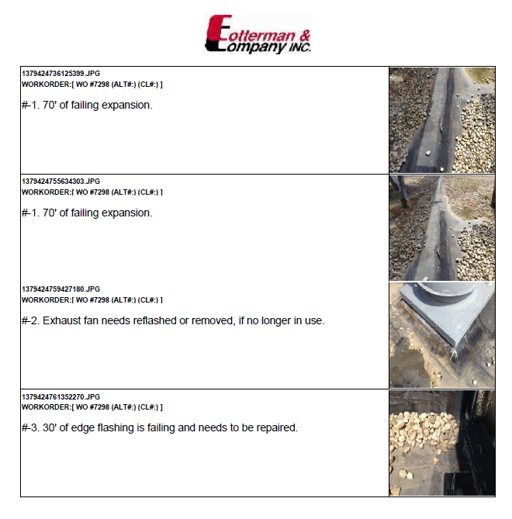
SAMPLE INSPECTION REPORT

Slide 16
National Roofing Contractors Association Claims
“Proactive roof maintenance extends the lifetime of your roof by 30%-100%”

Slide 17
It Makes $ense
Reduce emergency expenses- travel time costs, temporary repairs, multiple trips
One year guarantee protection
Limit potential liabilities
Costly interruptions of operations

Slide 18
QUESTIONS ?

Slide 19
Understanding Your Warranty
Your roof warranty specifies
  Type of roof system
  Duration of coverage
  Warranty Number
  Terms, Conditions and Limitations
  Manufacturer’s contact info

Slide 20
What the typical manufacturer’s warranty covers
Field sheets, flashings, components provided by manufacturer
Material defects
Workmanship

Slide 21
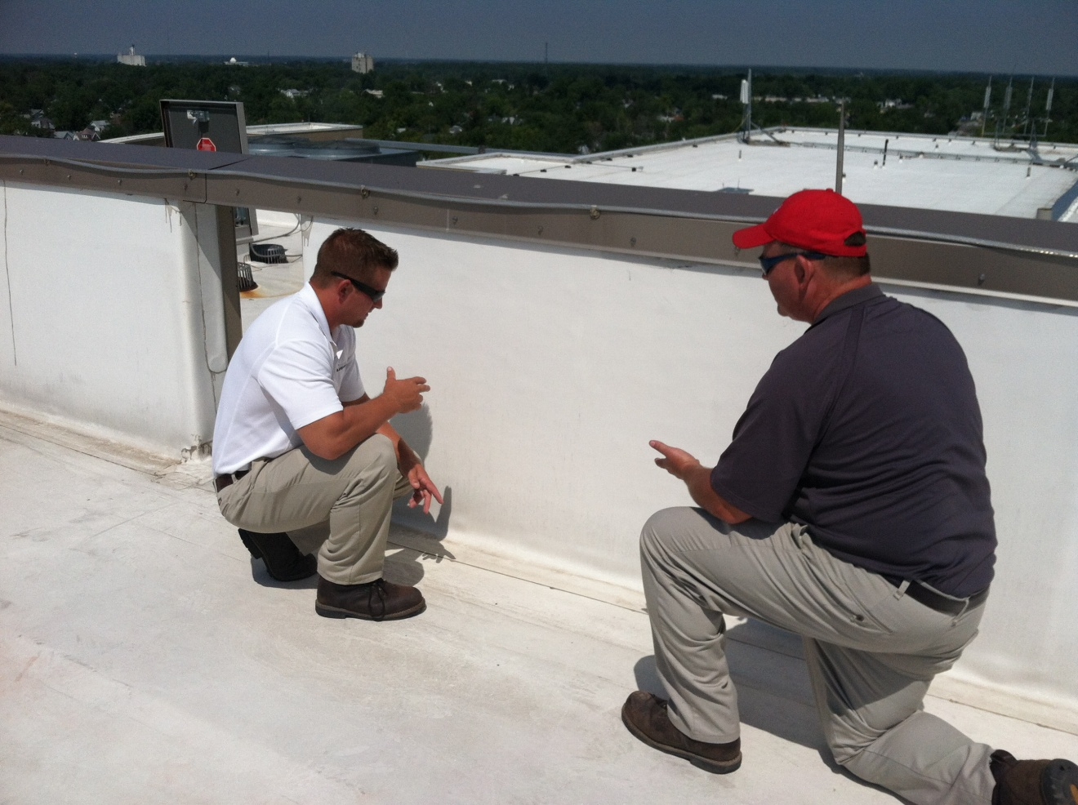
ON-SITE INSPECTION
REVIEWING WALL DETAILS TO COMPLY WITH
MANUFACTURER’S SPECIFICATIONS

Slide 22
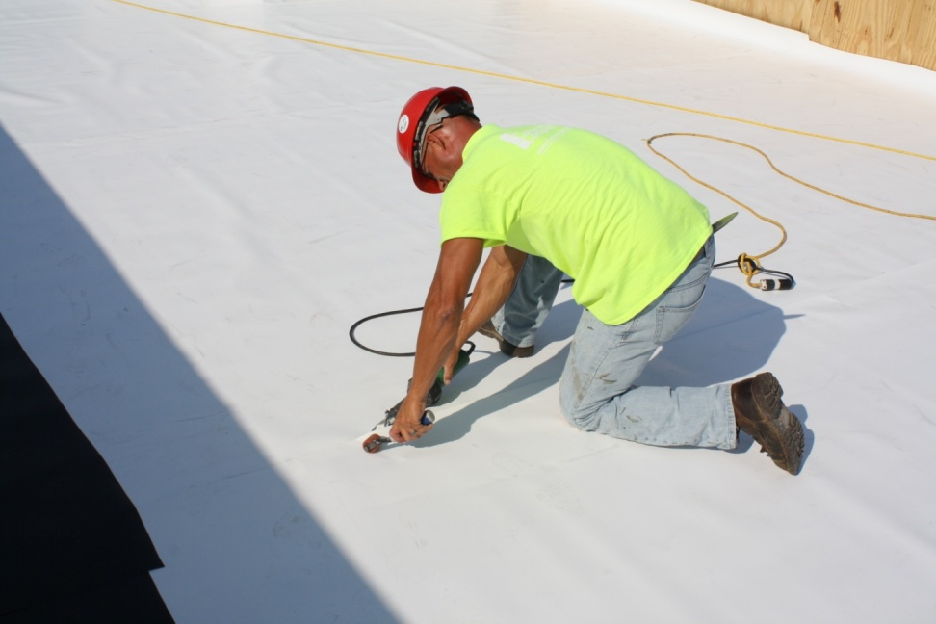
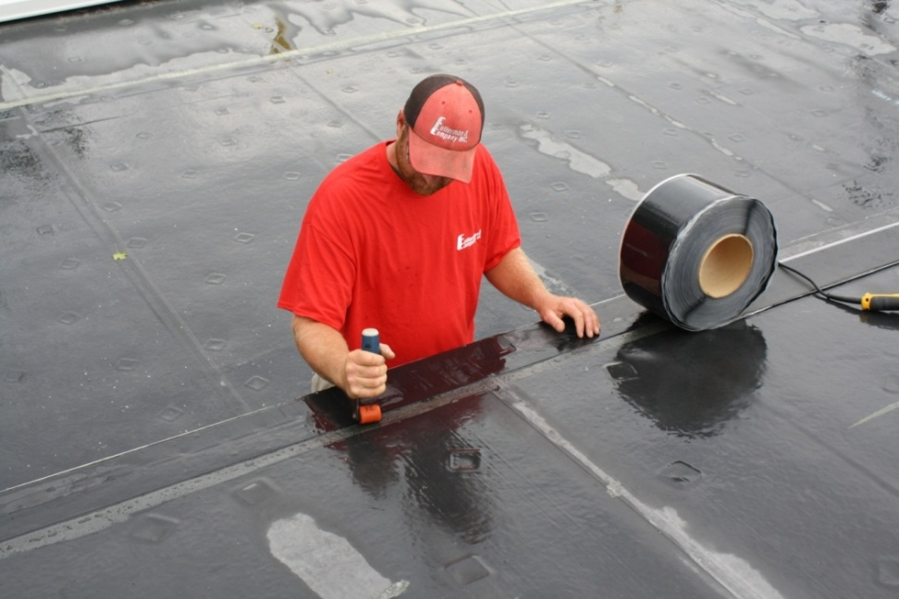
WARRANTY REPAIRS
VOIDS IN SEAMS BEING REPAIRED

Slide 23
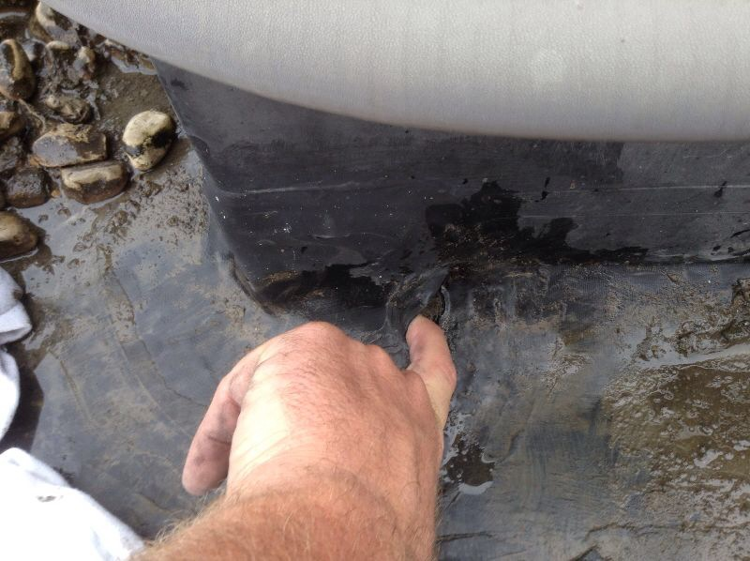
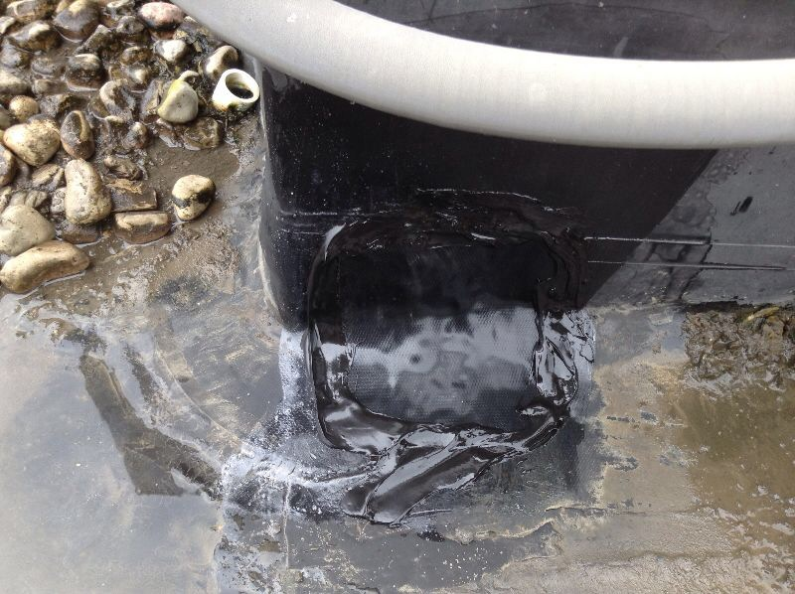
WARRANTY REPAIRS
All repairs completed per manufacturer’s specifications

Slide 24
Typical Warranty Exclusions
Foot traffic
Third Party Damage
Acts of God
Structural movement
Alterations to roof that do not meet specs
Use of products not provided by manufacturer
Condensation/Moisture entering the roof system

Slide 25
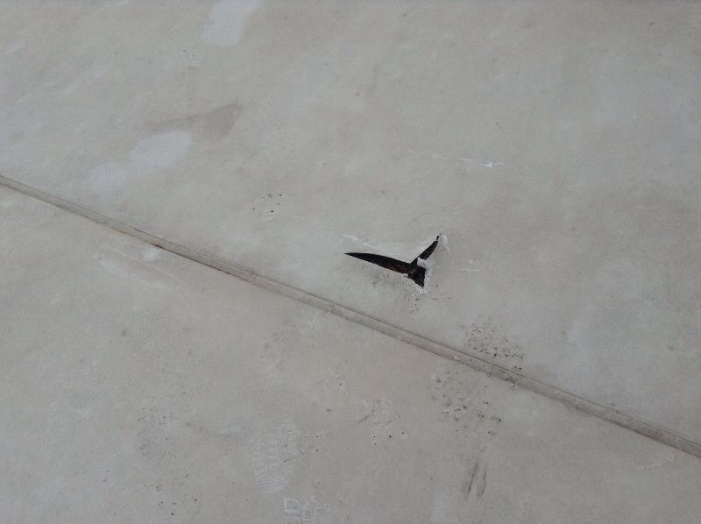
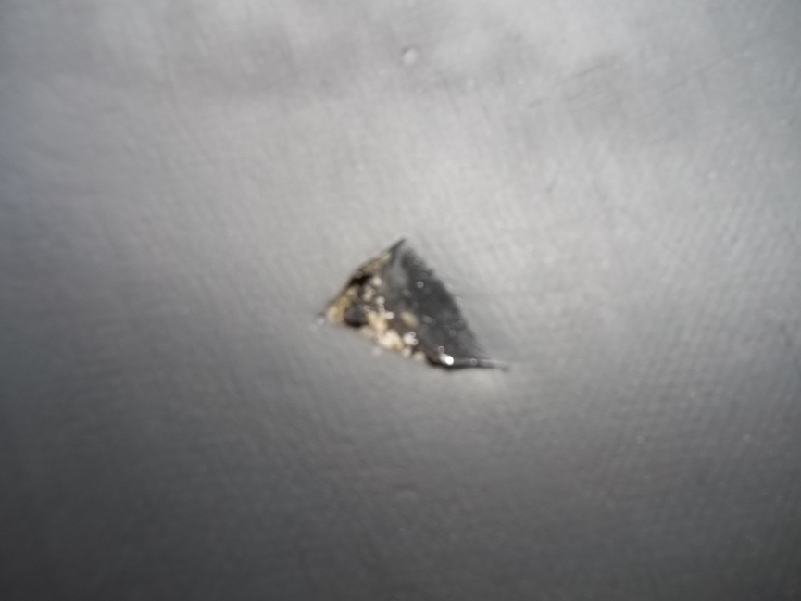
WARRANTY EXCLUSION PICTURES

Slide 26
Maintaining a Valid Warranty
Perform regular inspections and maintenance

Slide 27
Warranty Repairs
When a leak occurs on your roof that is under warranty
  Contact Manufacturer via phone, fax, or email. Then they will contact installing contractor.
  OR
  Contact your preferred contractor directly for a timely response. Elite contractors have a relationship with the Manufacturers that allows them to make service calls on our warranty roofs prior to processing the paperwork.
Contractor’s repair procedure
  Check roof area for defects
  Document and photograph all items found
  Indentify area of leak on aerial view/hand drawing of facility
  Fill out required paperwork for manufacturer; submit pictures and aerial view

Slide 28
Original Installing Contractor
“It’s not a life sentence”
  Warranties can be transferred from one contractor to another at the request of the building owner.

Slide 29
QUESTIONS ?

Slide 30
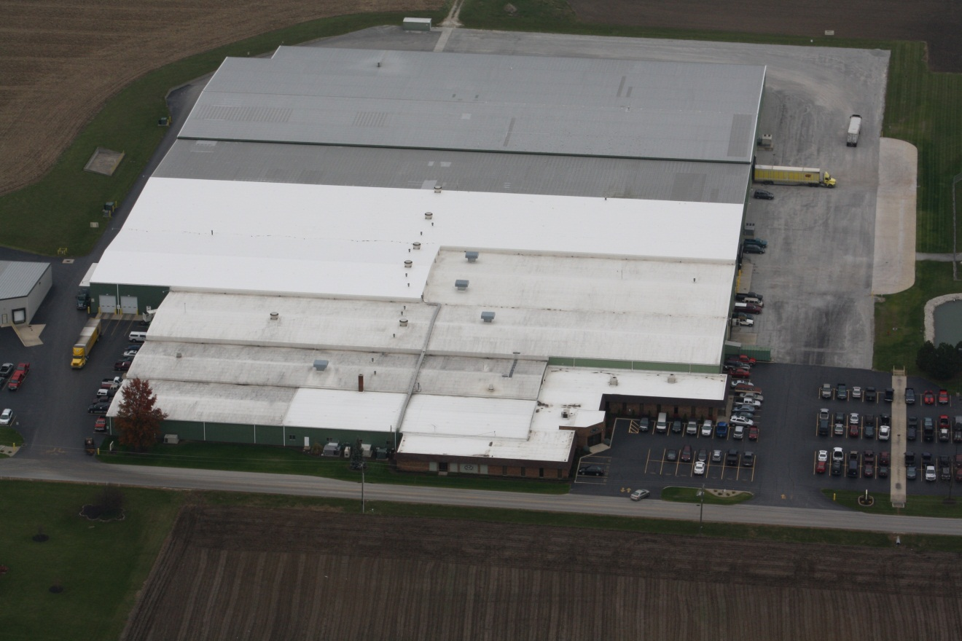
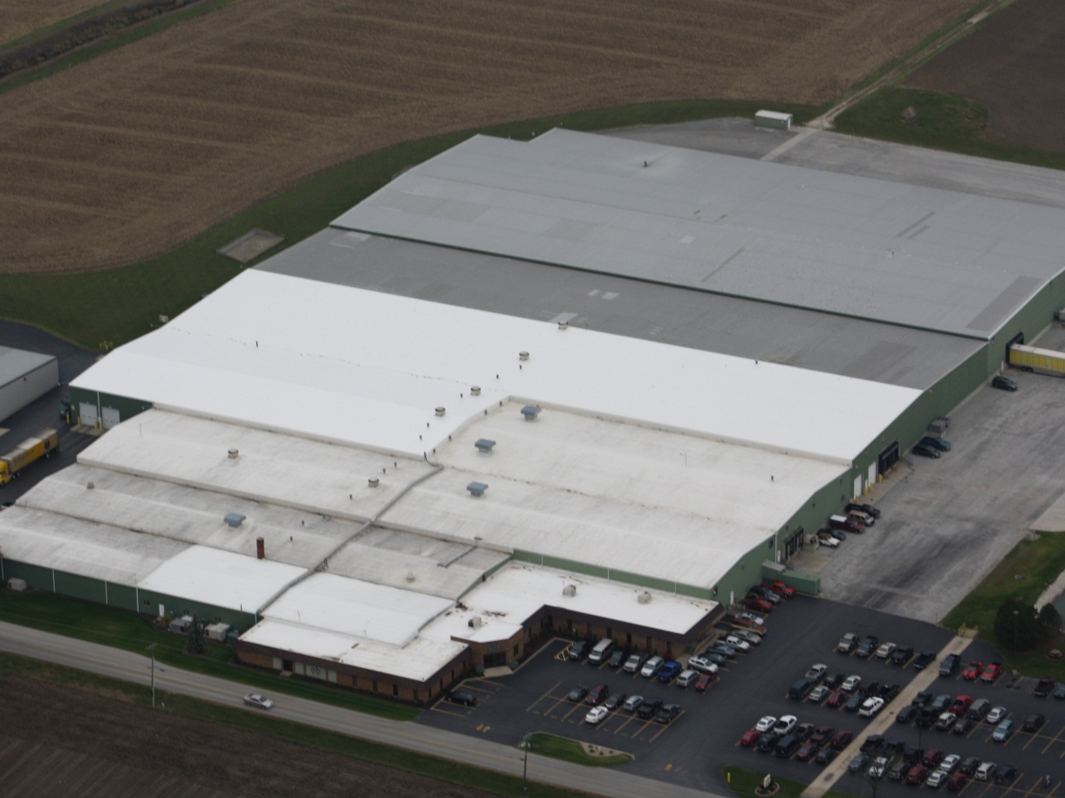
Roof Asset Management
A Pro-Active Approach of developing a long term cost effective roofing plan

Slide 31
Roof Asset Management
Planning and budgeting are critical factors of successful property management

Slide 32
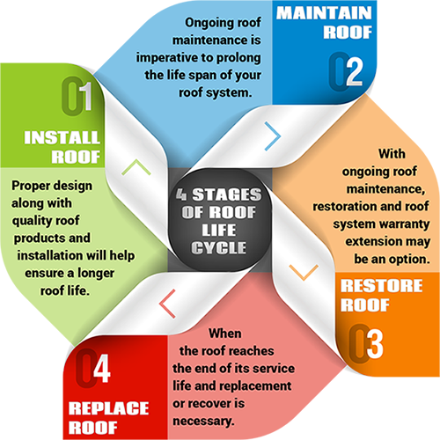
Life Cycle of Your Roof
Life Cycle of Your Roof

Slide 33
Identify & Prioritize
Accurately identify large expenditures in advance
Develop multi-year budget/roof plan
Prioritize critical areas
Have a complete plan for the life cycle of your facility

Slide 34
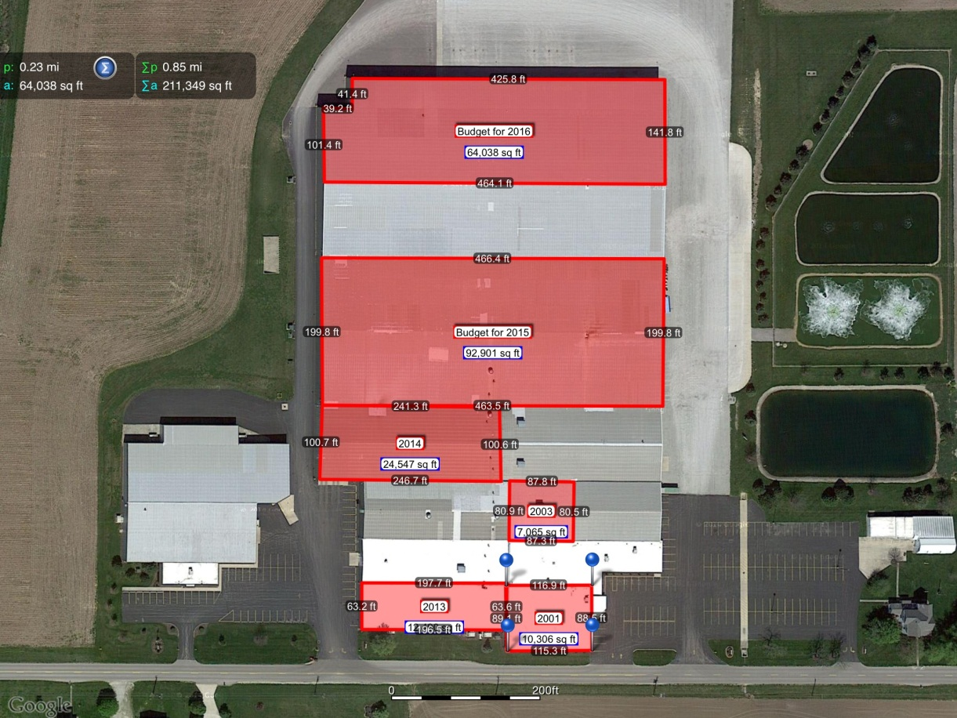
ROOF ASSET MANAGEMENT
Multi-Year Budget/Roof Plan

Slide 35
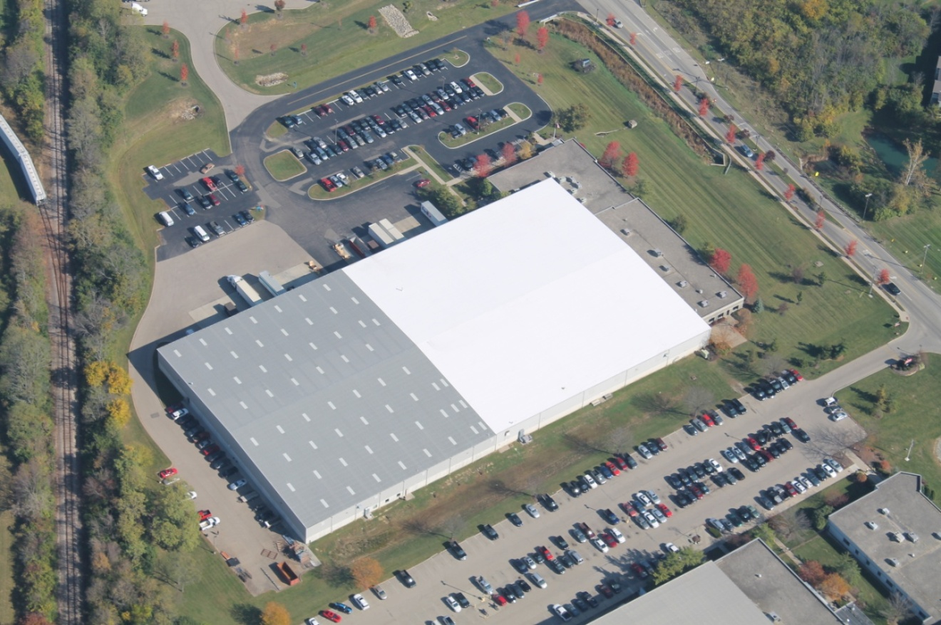
We worked with this company to establish a 3-year roofing plan that met their budgetary goals.

Slide 36
Business Strategy
Corporate America treats their facilities like an asset
They manage their roofs just like the rest of their valuable assets
No longer an “out of sight, out of mind” approach
No surprises

Slide 37
QUESTIONS ?

Slide 38
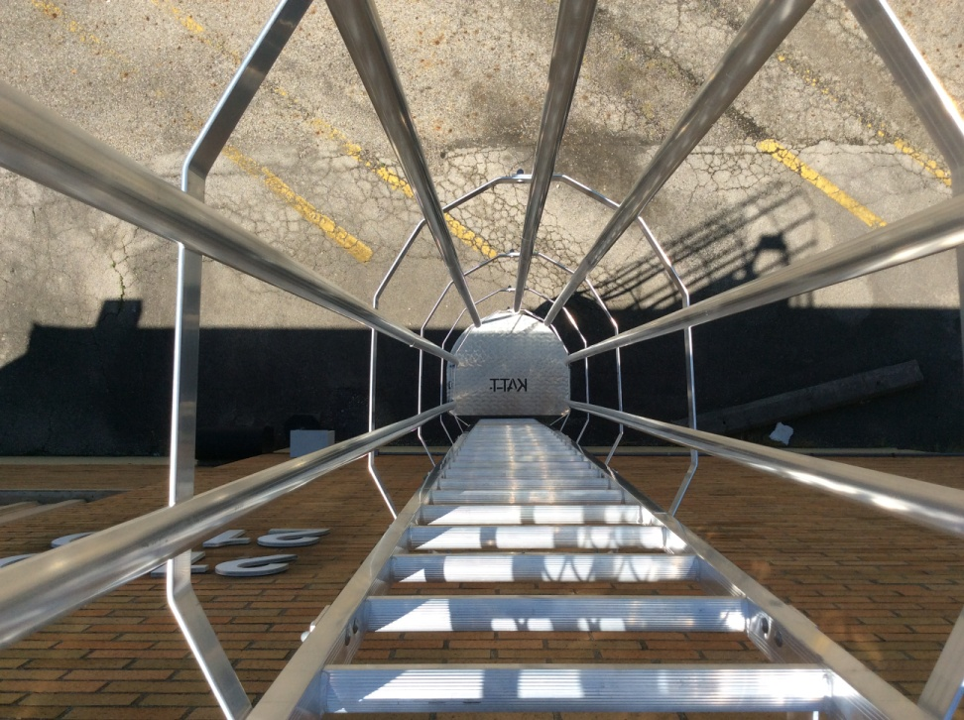
FALL PROTECTION

Slide 39

Making the rooftop a safer environment

Slide 40
OSHA 1926.501 – Duty to have fall protection
1926.501(b)(1)
"Unprotected sides and edges." Each employee on a walking/working surface (horizontal and vertical surface) with an unprotected side or edge which is 6 feet (1.8 m) or more above a lower level shall be protected from falling by the use of guardrail systems, safety net systems, or personal fall arrest systems.
1926.501(b)(4)(i)
Each employee on walking/working surfaces shall be protected from falling through holes (including skylights) more than 6 feet (1.8 m) above lower levels, by personal fall arrest systems, covers, or guardrail systems erected around such holes.

Slide 41
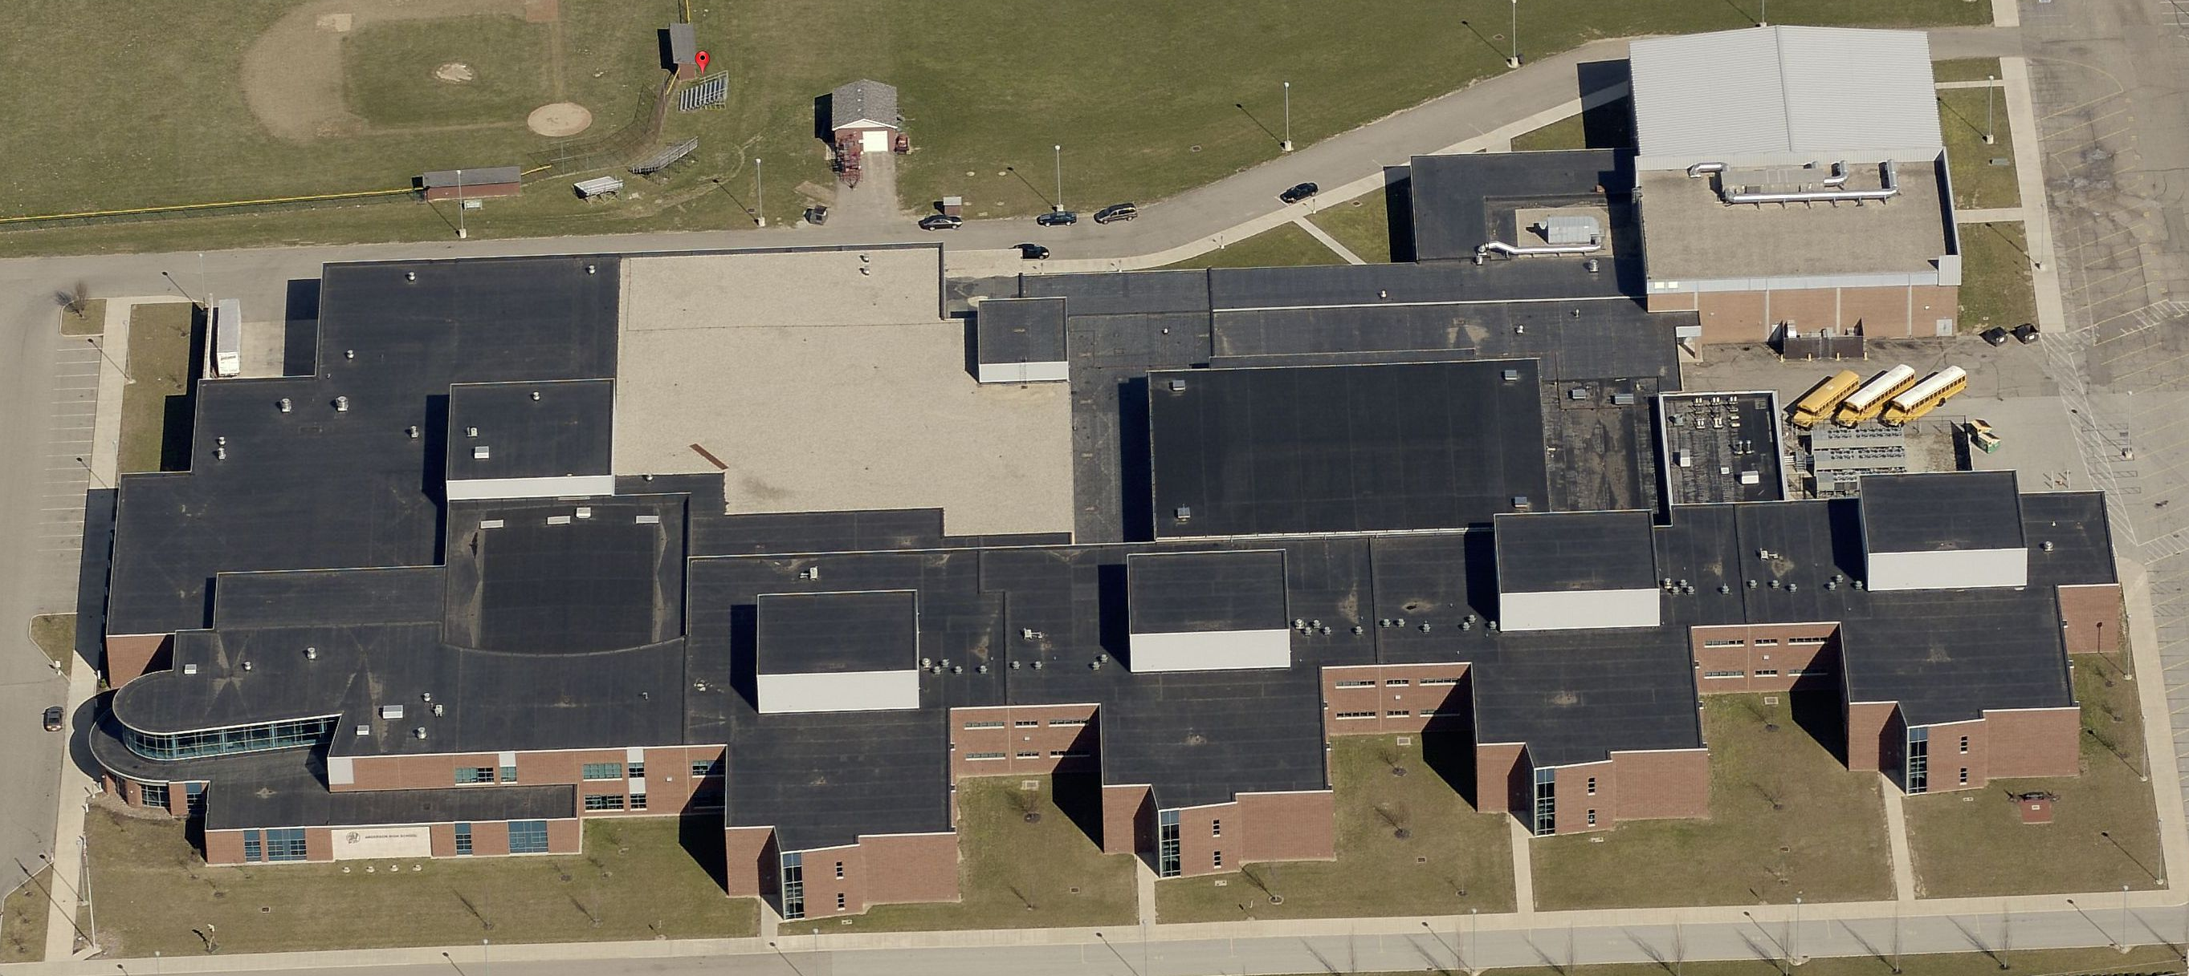
Educational Facilities – The Challenges

Slide 42
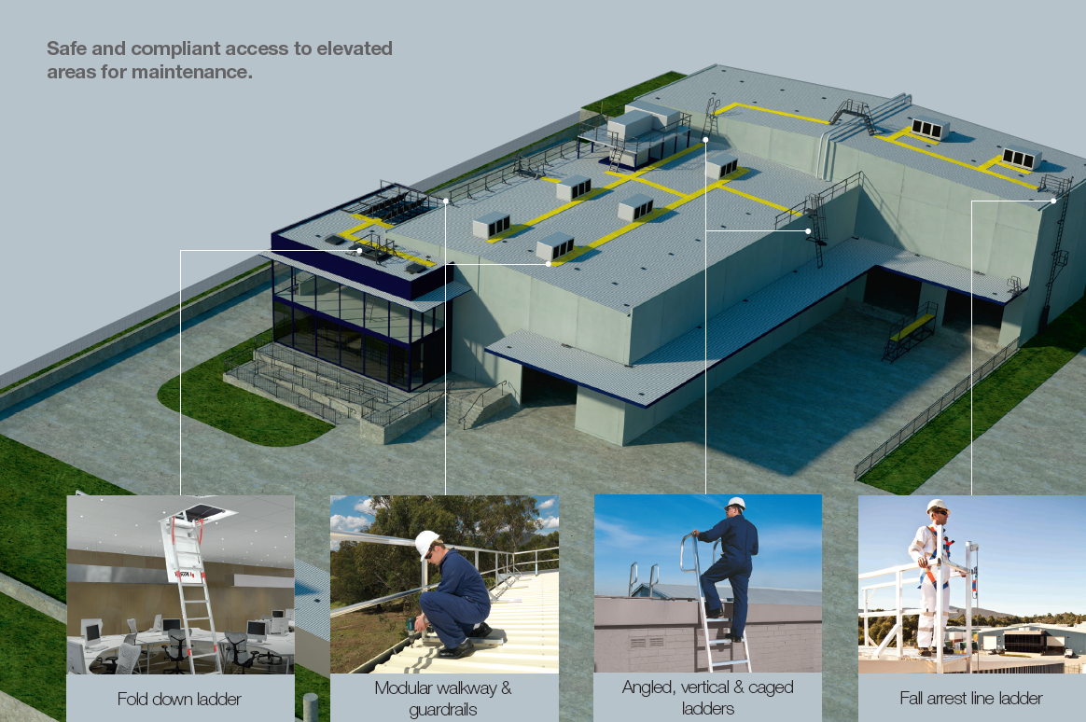
IN-ACTION

Slide 43
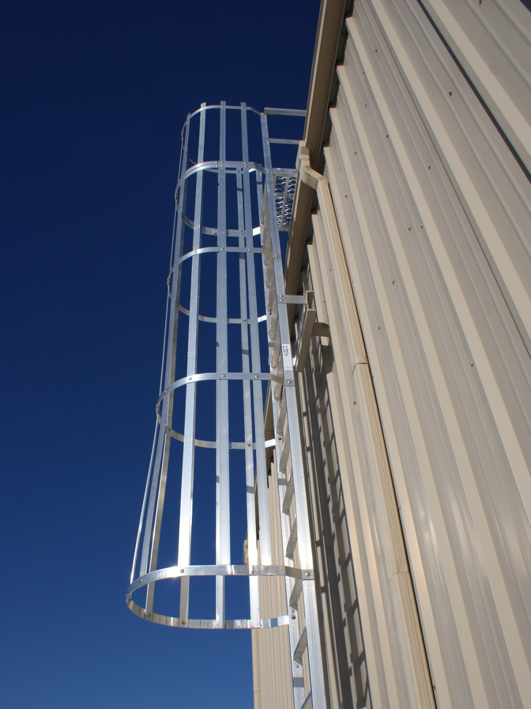
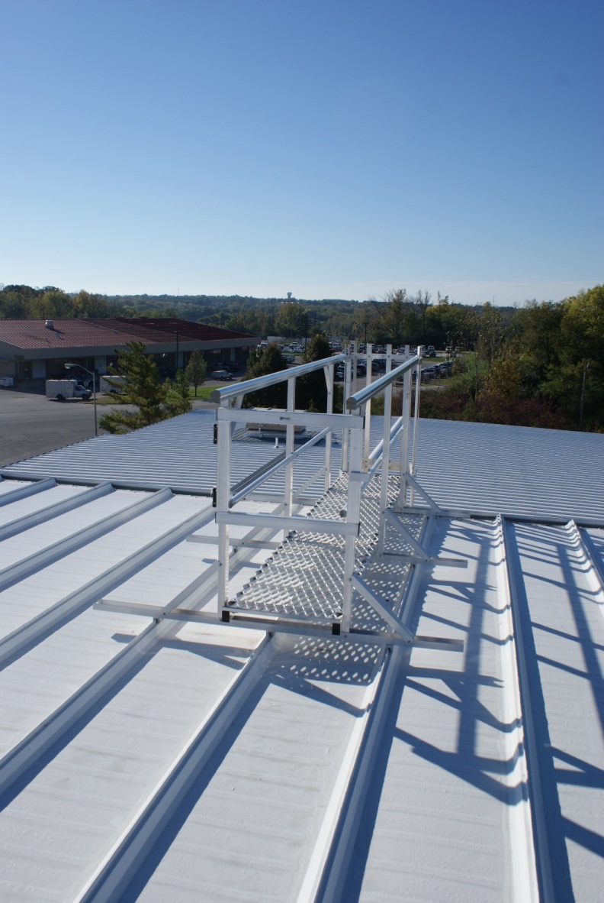

Slide 44
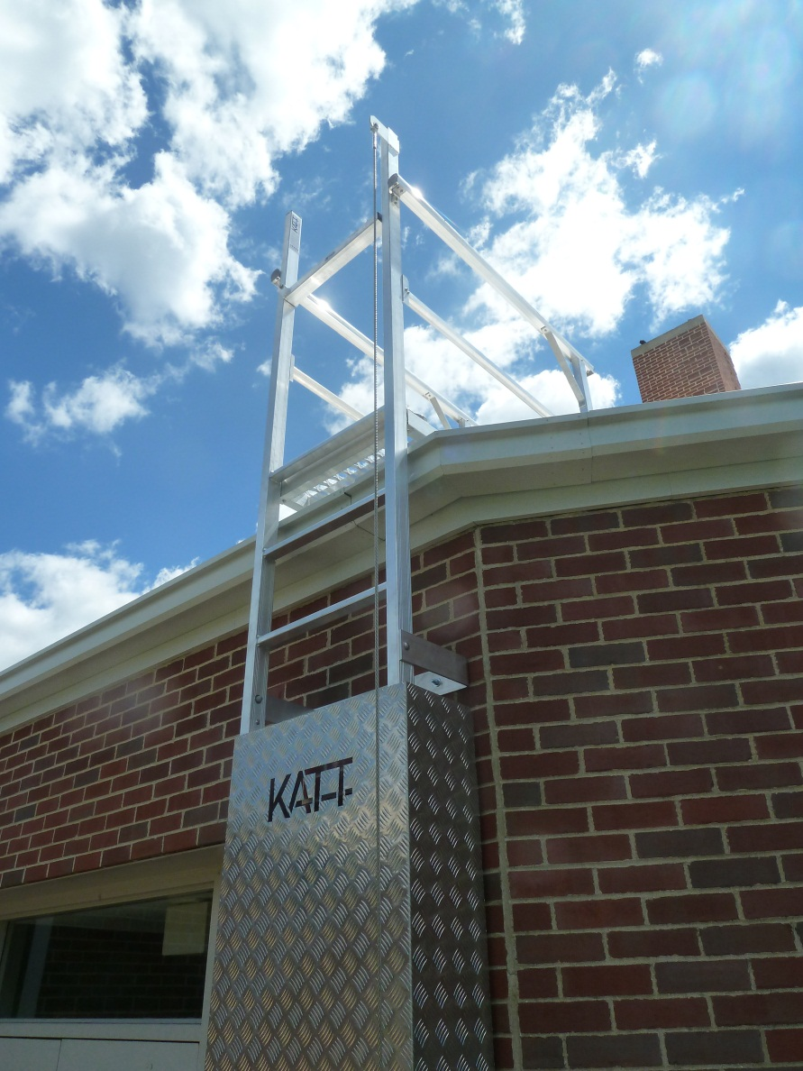
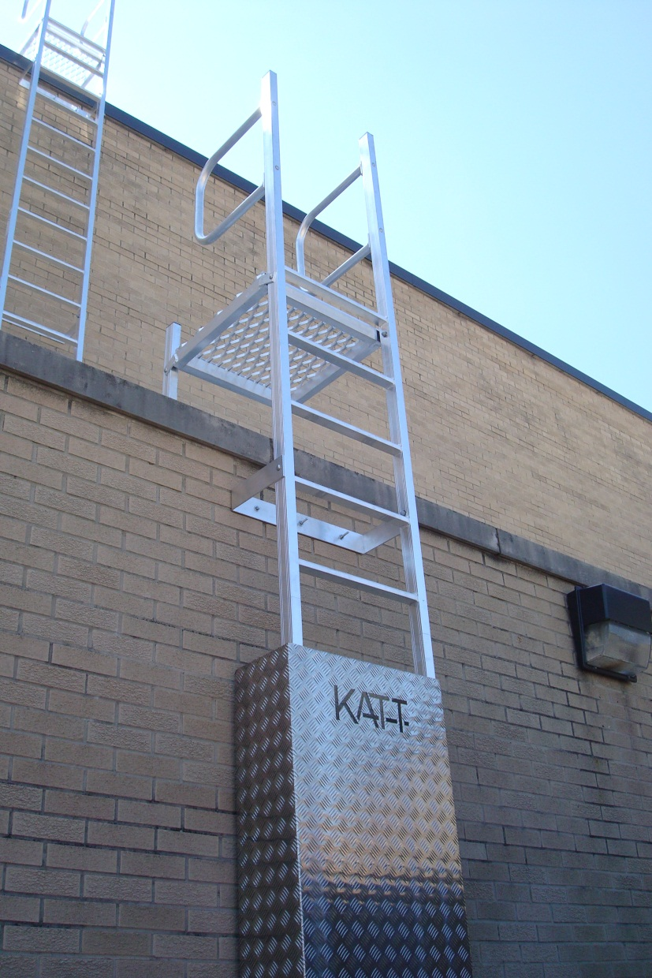

Slide 45
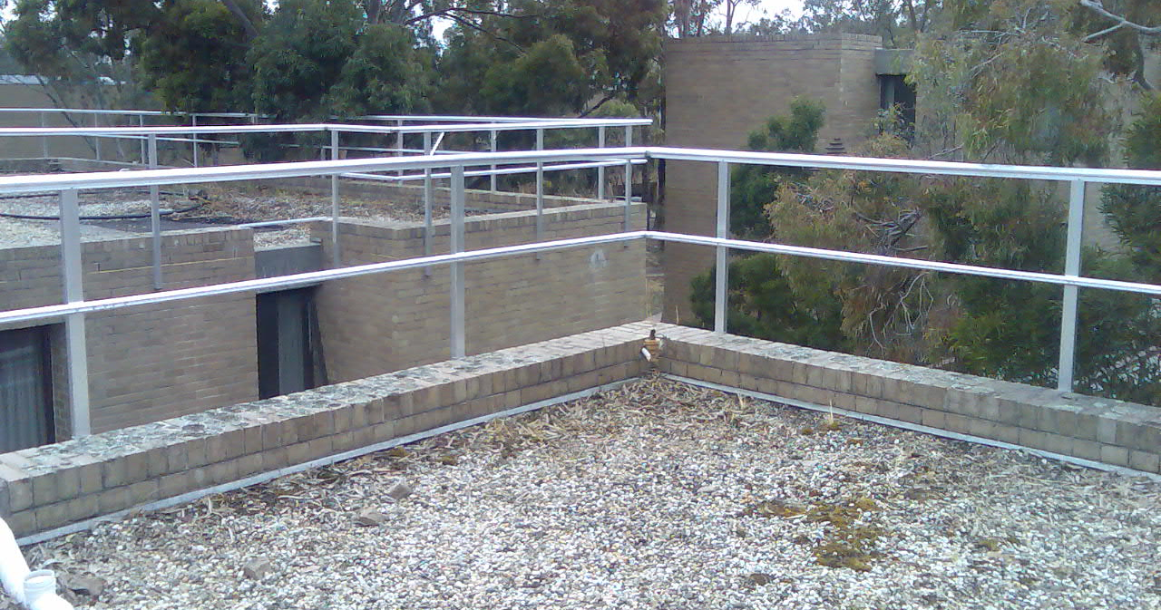
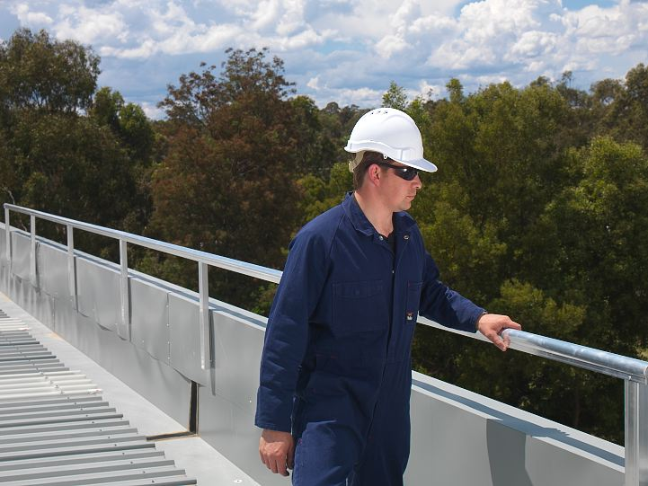
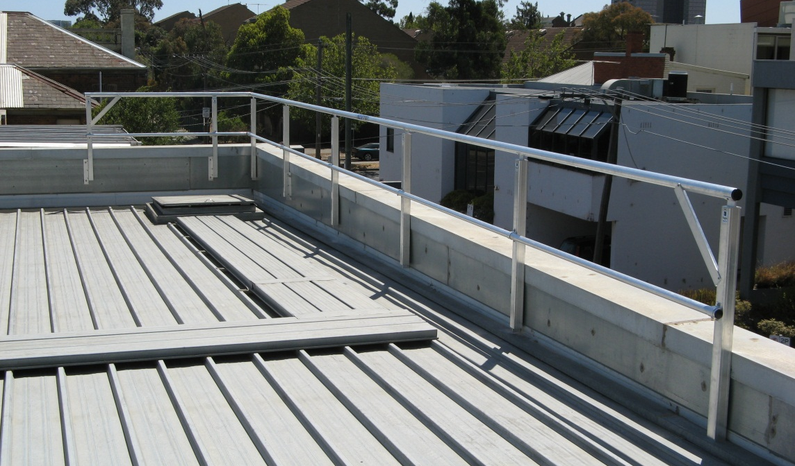
GW31 Series guardrail system
Features
Aluminum Mill finish
Customizable to suit all applications
Can be top or side mounted
Custom color railing is available
Complies with OSHA regulations 29 CFR 1910.23 and 1926.502

Slide 46
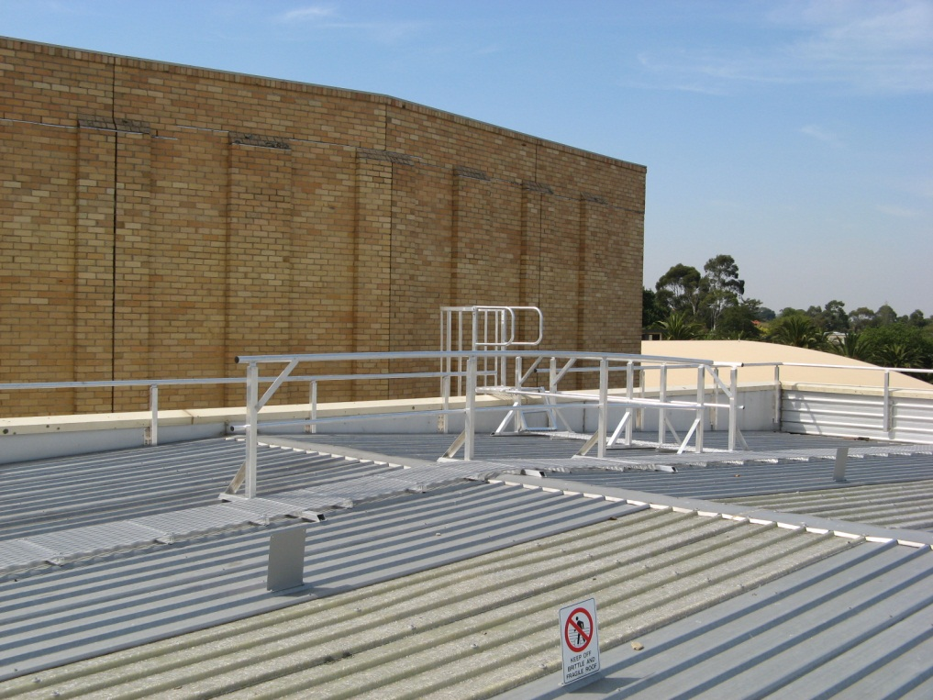
GW20 Modular walkway system

Slide 47
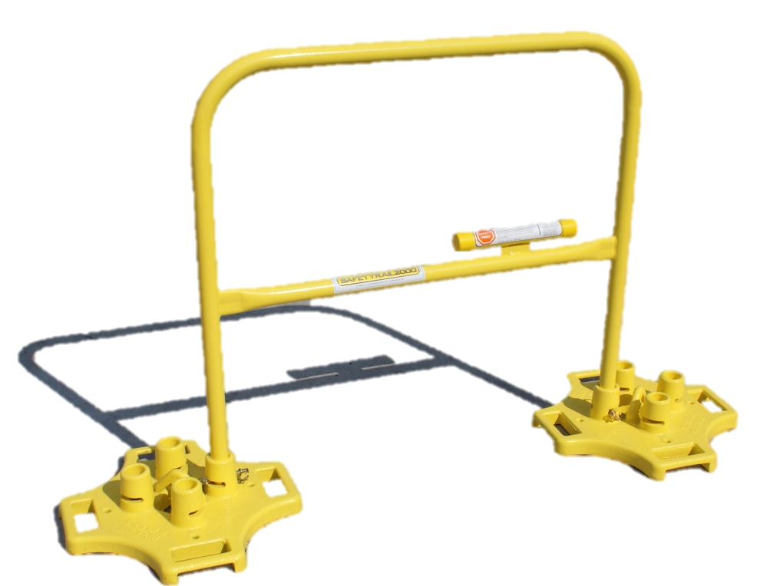
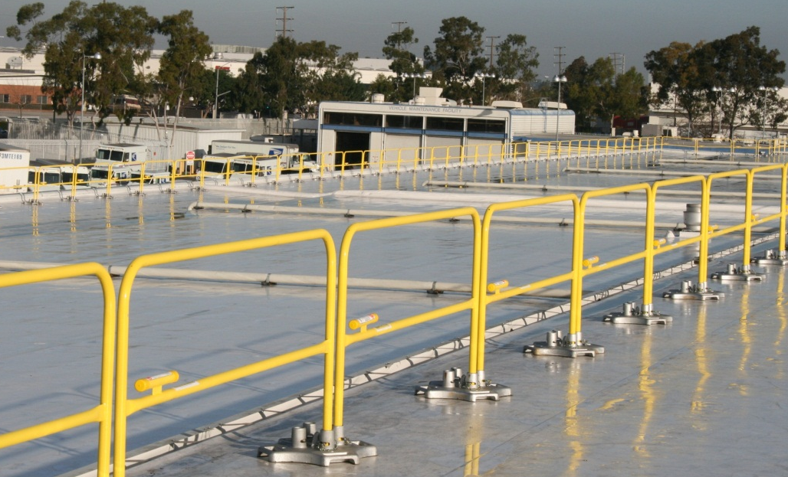
STACCO Modular railing system
Features
Non-penetrating weighted base – No penetration of the roof
Four port base allows infinite positioning of the rail sections
Positive locking system secures rails to base
Complies with OSHA regulations 29 CFR 1910.23 and 1926.502
Toe board adaptors available
No intermediate counterweights required, reducing trip hazards
Working handles are cast into base for easy lifting and positioning
Custom color railing is available

Slide 48
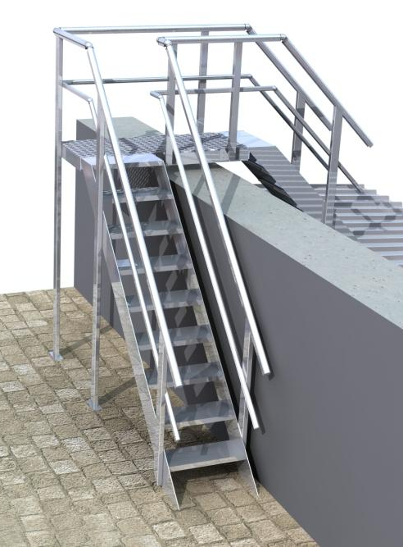
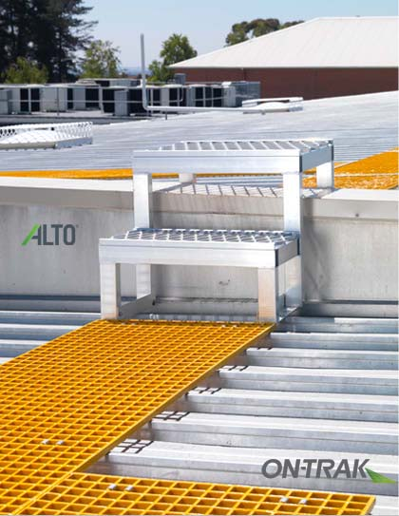
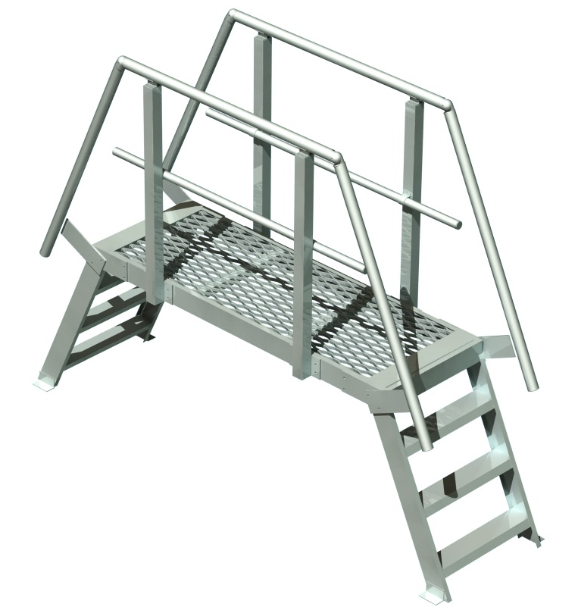
Crossovers, Stairs and Platforms

Slide 49
Building Codes & Good Roofing Practices

Slide 50
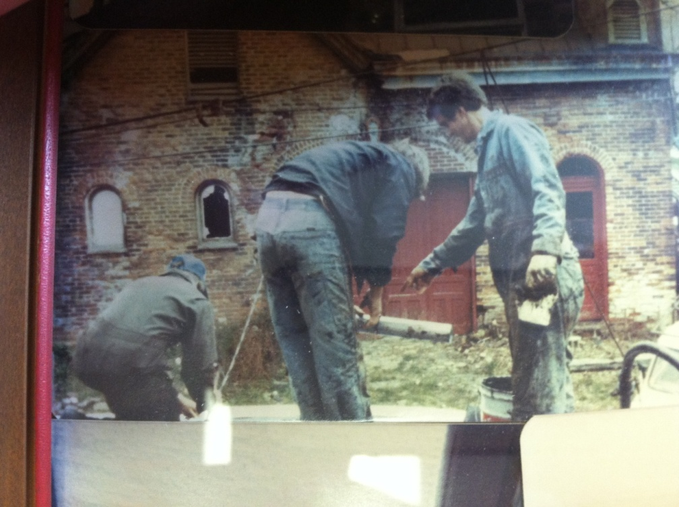
Building Code
The latest energy requirements, building code,
and good practices related to roofing
The codes have changed since the late 70’s

Slide 51
R-Value Requirements
R-Value is a measure of thermal resistance
The International Energy Conservation Code (IECC)
Climate Zone 5 requires R-25

Slide 52


Roof Core Cuts

Slide 53

During the initial evaluation, we found that the building needed additional R Value to meet the current building codes.

Slide 54
Fire Code Compliance
Determine existing roof substrate including roof deck construction
Specify the proper materials to meet or exceed the fire code classification

Slide 55


INSIDE INSPECTION

Slide 56
Good Roofing Practice
Create Positive drainage to prevent ponding water
Remove saturated insulation to prevent mold growth
Use appropriate materials to comply with temperature restrictions
Properly designing edge securement
Install walk protection around HVAC units and roof access points

Slide 57
QUESTIONS ?

Slide 58
The Cotterman Way
We utilize the latest technology in the industry to ensure….
  Safe working environment
  Quality workmanship for customer
  Customer operations are uninterrupted

Slide 59

Robotic welder
Minimize the human error factor
Leaves a consistent water-tight weld on seams
Increased production rates
Great ergonomic tool for our employees

Slide 60

Rhinobond Induction Weld Machine
Provides superior wind uplift performance
No membrane fastener penetrations
Increased production rates
Another great ergonomic tool being utilized

Slide 61

Factory Applied Tape
Factory Applied Tape
Uniform adhesive width and thickness
Reduces human error during seam installation
Increased production rates

Slide 62

SHEET METAL SHOP
Sheet Metal Shop
ANSI/SPRI ES-1 and UL Certified
Proper gauge, design, and fastening pattern to meet specific wind design standard
ES-1 Certification

Slide 63

Real-Time Database
Real-Time Database
Our service techs have access to the work order as they are called in along with building history
Tablets are utilized by the techs to retrieve and relay information in real-time

Slide 64


Field ticket recieved by service tech

Slide 65

Aerial image showing leak area

Slide 66


SAMPLE INVOICE TO CUSTOMER
Sample invoice to customer

Slide 67

New/Re-Roof
-Design Phase
-Construction Phase
-Field Quality Control
-Post Construction Service
Preventative Maintenance Program
-Inspections
-PM work performed
-Minor Maintenance & Repair
Cotterman
Online Roof Database
History of all roofing activities, inspection reports, photos, drawings, recommendations
Warranty Verification
-Status
-Managing issues

Slide 68
QUESTIONS ?

