Slide 1

Exclusion Solutions: Commercial + Residential Structures
Xcluder® Rodent and Pest Exclusion

Slide 2
Places for Exclusion:
Common Problem Areas and How to Address Them
  Gaps, Cracks and Holes
  Entry Doors
  Garage and Dock Doors
  Dock Levelers
  Grounds and Landscaping

Slide 3
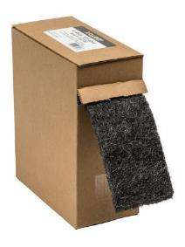
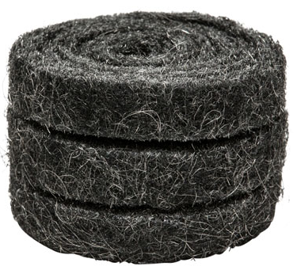
Xcluder® Fill Fabric
Benefits of Xcluder fill fabric:
No rust, permanent, a springiness to lock into holes and crevices, and economical and easy to install.
Product Options:
Xcluder Fill Fabric Roll, 4" x 10’
Xcluder Fill Fabric Case, 4" x 10’, 5 Rolls
Xcluder Blocks Case, 2" x 2" x 7.5", 72 Blocks
Xcluder Fabric Strips Case, 1" x 4', 36 Rolls
Xcluder Fill Fabric Starter Kit (gloves and scissors included)
Xcluder Wrap, Adhesive Back, 2" x 10', 2 Rolls
Xcluder Wrap, Adhesive Back, 4" x 10', 1 Roll
Xcluder Floor Joint Kit

Slide 4
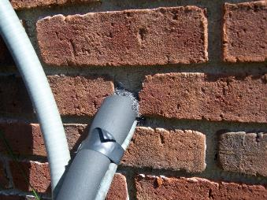
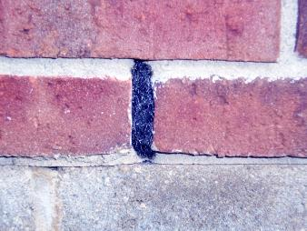
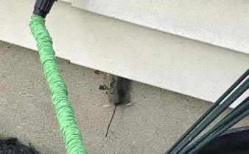
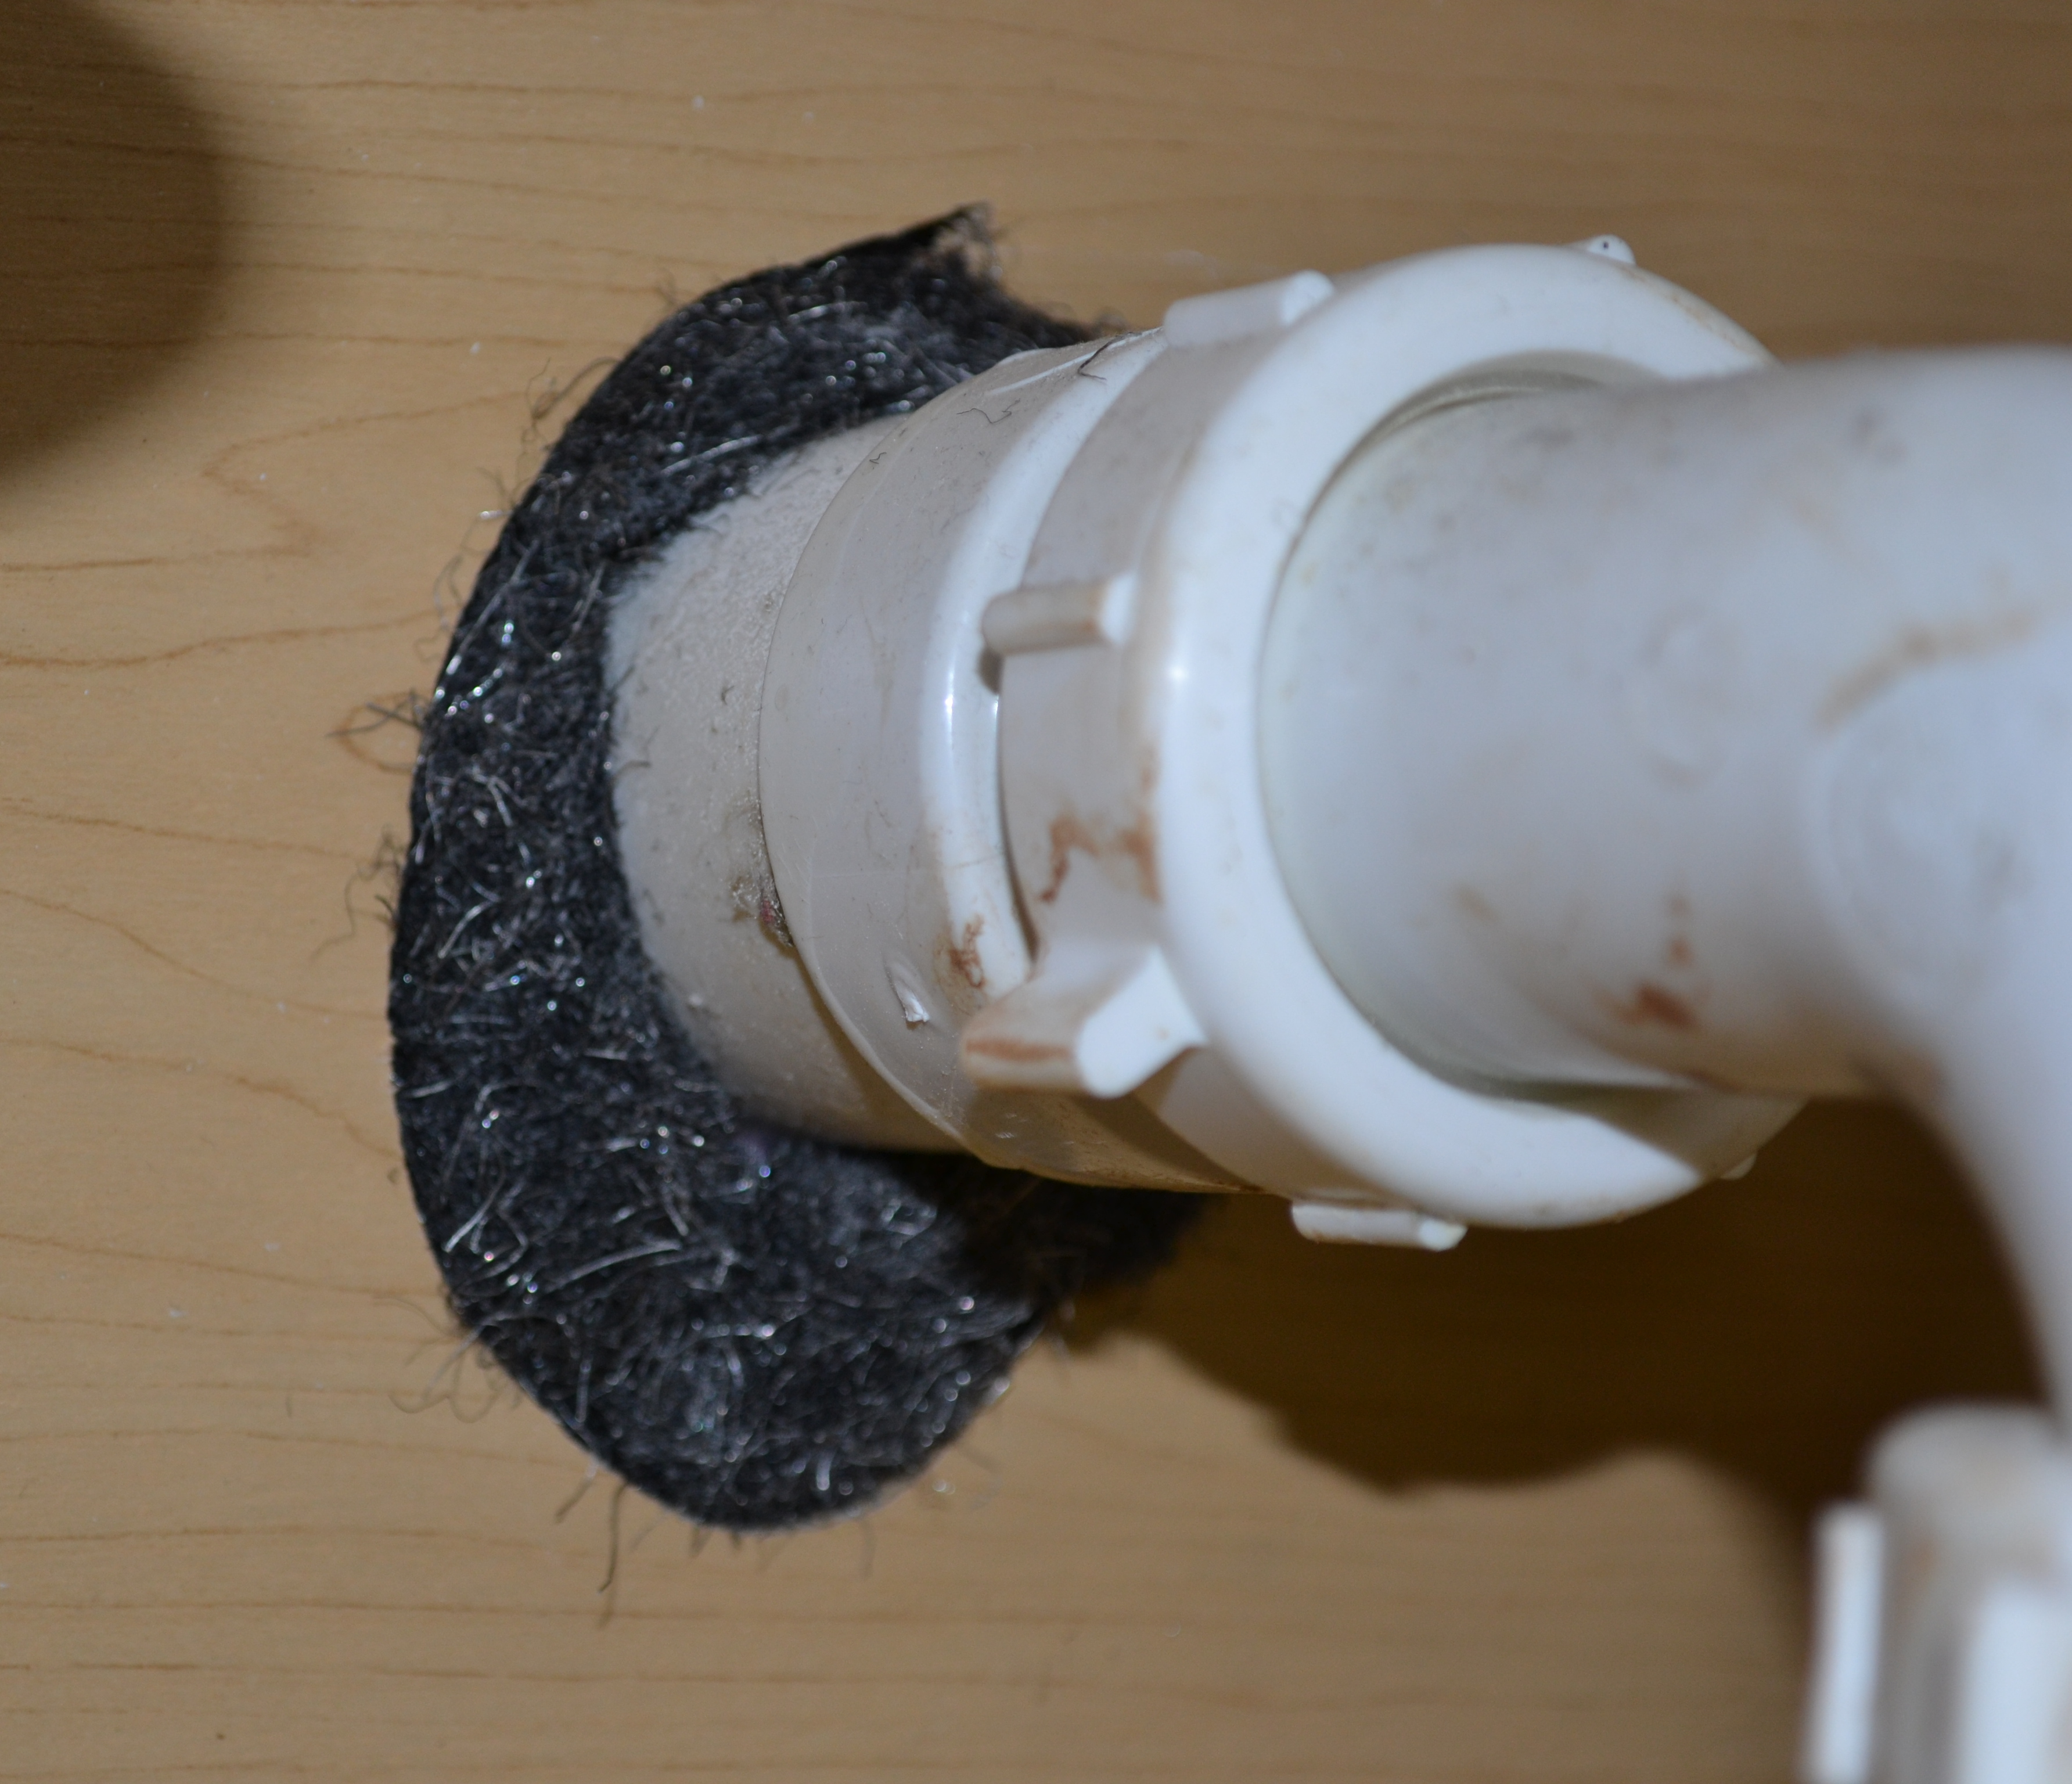
Typical Applications
Around HVAC Lines
Weep Holes
Around Plumbing
Under Siding

Slide 5
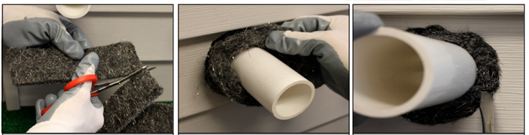
Installation
Installation
  seconds per hole- cut a piece and fill the hole
Tools required
  scissors / screw driver

Slide 6
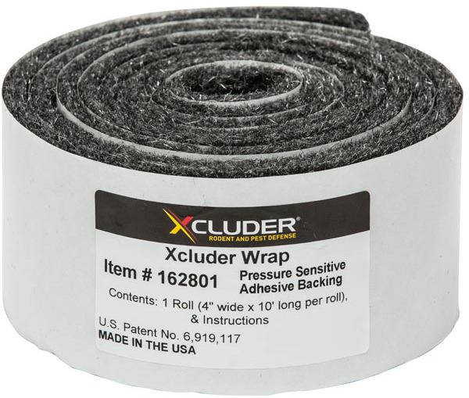
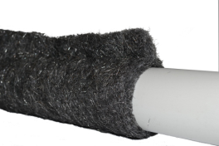
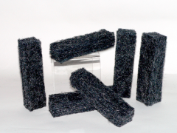
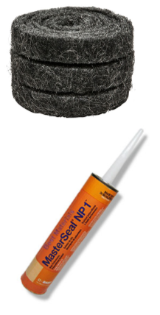
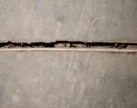
Additional Xcluder® Solutions
Xcluder® Wrap
  Adhesive backed Xcluder Fill Fabric
Xcluder® Blocks
  Ideal for sealing openings in corrugated metal
Joint Sealing Kit
  Rodent proofing kit for concrete floor joints & floor to wall joints

Slide 7
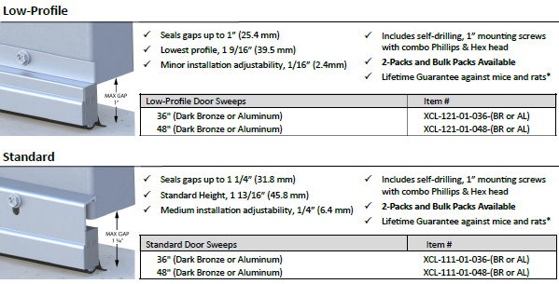
Door Sweeps:
Low Profile & Standard

Slide 8
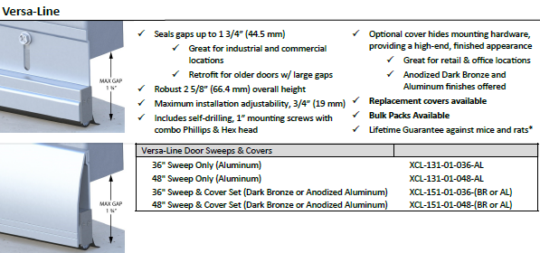
Door Sweeps:
Versa-Line

Slide 9
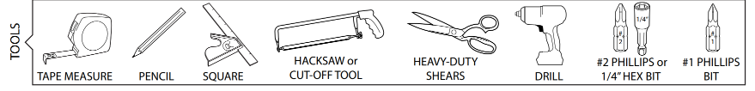
Options and Installation
Installation:
Should take about 10 minutes for an experienced installer.
Mounting hardware included with all sweeps.

Slide 10
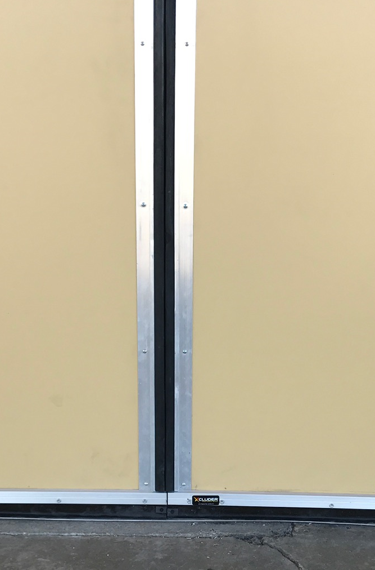
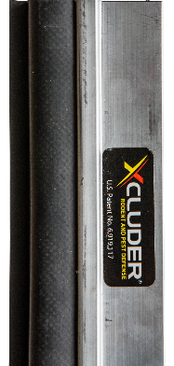
Astragal Seals for Vertical Gaps Between Doors
Xcluder Astragal Seals
Seals gap between double doors
Adhesive or screw mount options

Slide 11
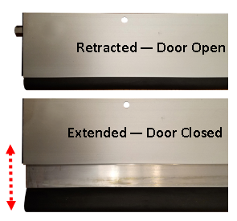
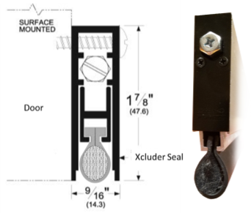
Automatic Door Bottom
Xcluder® Automatic Door Bottom
Ideal for uneven surfaces.
Aluminum case surrounding a movable drop-bar seal.
Drop-bar seal is actuated by a plunger which contacts the jamb as the door is closing, forcing the drop-bar seal down against the floor / threshold creating a secure seal.
Rubber seal is filled with Xcluder® fill fabric, providing dependable protection against rodents and the elements.

Slide 12
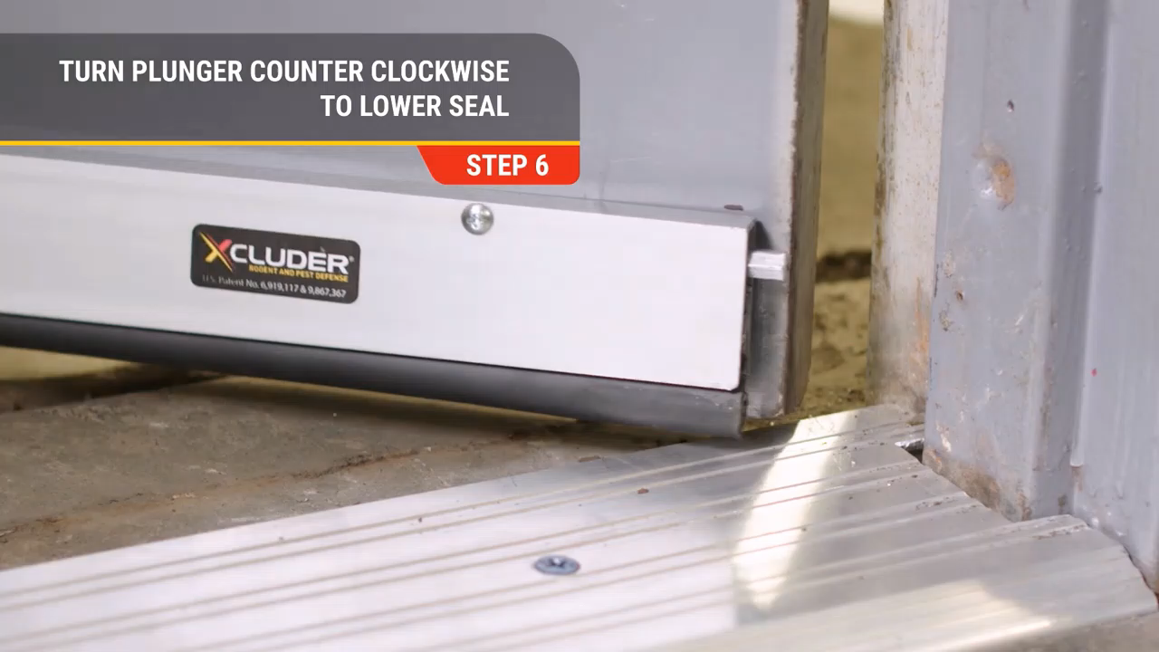
Automatic Door Bottom
Seal Lowers When Door Closes / Raises on Opening

Slide 13
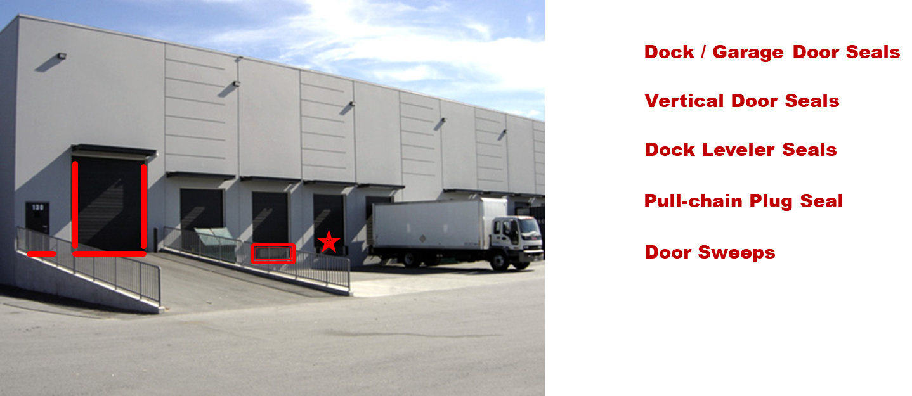
Sealing Garages and Docks

Slide 14
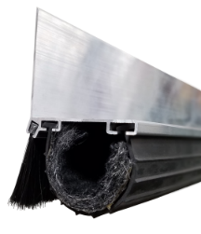
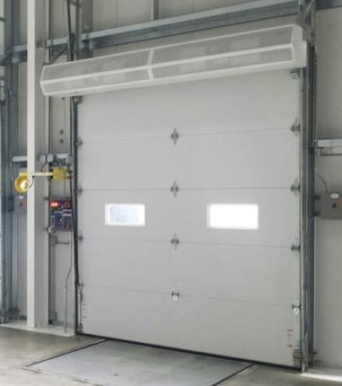
X2 Door Bottom Seals
Xcluder® X2 Garage & Dock Door Kits
2”x2” OVER HEAD DOOR
RETAINER (A2020) SHOWN
Provides ultimate pest protection for garages & dock doors
Kit Includes:
Retainer
Xcluder Door Seal
Brush seal (mounts inside door)
Mounting hardware
Comes in 8’, 12’ and 16’ lengths
Options for doors 1.5” – 2” thick

Slide 15
Products and Installation
Use for: Commercial and residential garage or dock doors
X2 Kits:
  Include retainers, rubber seal and brush seal
  Available in 8’, 12’ and 16’ lengths
Installation:
  Should take about ½ hour to an hour.
Tools required:
  Drill, Screwdriver, hack-saw
  Liquid soap or silicone spray
Xcluder Seal:
Use for locations that already have a suitable retainer
  Lengths 75’, 37’, 16’6”, 10’4”
    3”, 4”, and 6” widths
    Requires a retainer that accepts ¼” T rubber slots or tracks

Slide 16
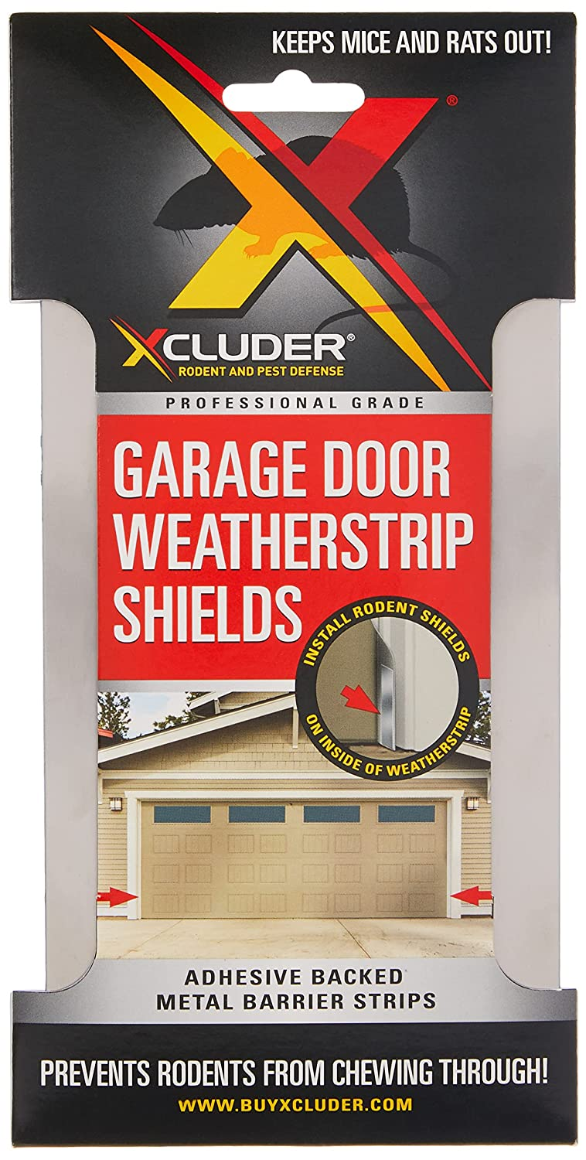
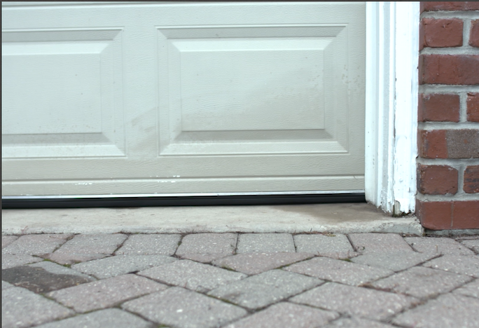

Garage Door Rodent Shield
(2) 8” x 1 “ Stainless steel strips
Adhesive backed for easy installation

Slide 17

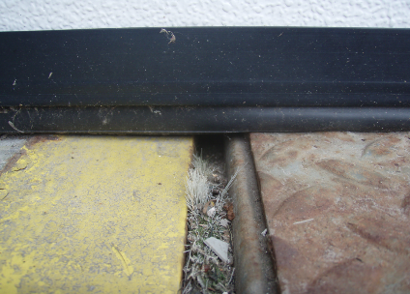
Xcluder®Sealing Dock Levelers
Loading dock levelers are a very common entry point for rodents
Gaps as large as 1” on each side provide an easy path for any rodent to enter a building
Xcluder dock leveler seals replace brush seals that do not protect against rodents
Key Benefits:
Keeps rodents from entering through the sides of dock levelers
Tough & Durable
Less Debris
Dock Leveler with a common brush type seal

Slide 18
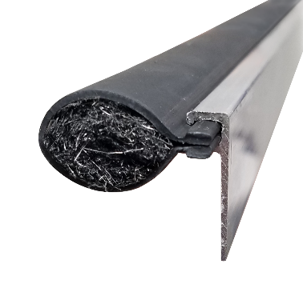
Dock Leveler Seal Kits
Dock Leveler Seal Kits
Dock levelers are a natural entry way for rodents
Fits levelers up to 96” long
Seals gaps of 1” - 1 1/4” - NOTE: 7/8” clearance between pit wall and leveler is required for installation.
Low-profile option available for smaller gaps
Kits include:
  (4) 48” Aluminum Retainer
  (16’) Xcluder Slide-’n-Seal
Hinge Seal (Optional) - Not required for levelers with continuous or “piano” style hinges (requires welding)
Don’t want to install this yourself?
We can refer you to our network of qualified installers.

Slide 19
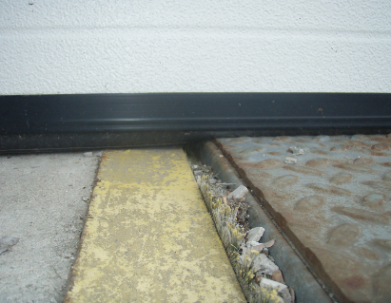
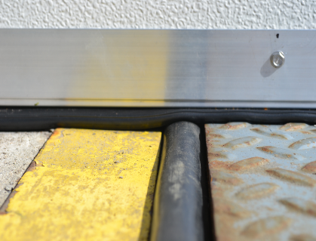
Properly Sealed
Before
After

Slide 20
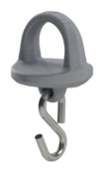
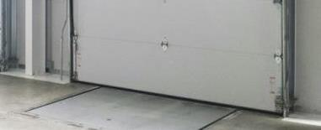
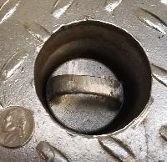
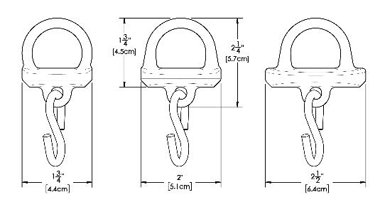
Pull Chain Seal
Xcluder® Pull Chain Seal
Often overlooked and left unprotected, the opening for the pull chain on dock levelers is an ideal entry point for mice and rats.
Available in 3 sizes
Plugs designed to sit completely below the surface of the dock plate; will not interfere with material handling equipment
Easy to install
  Hack saw or bolt cutters to remove old chain ring
  Pliers to crimp on new seal

Slide 21
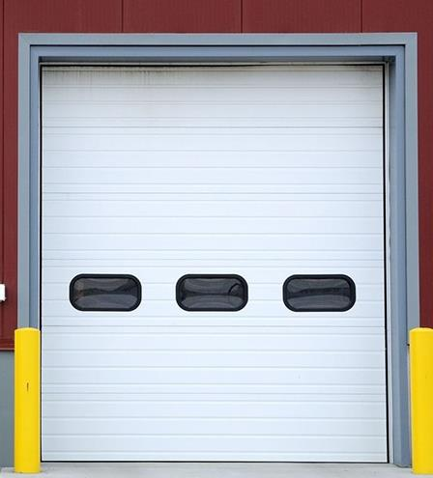
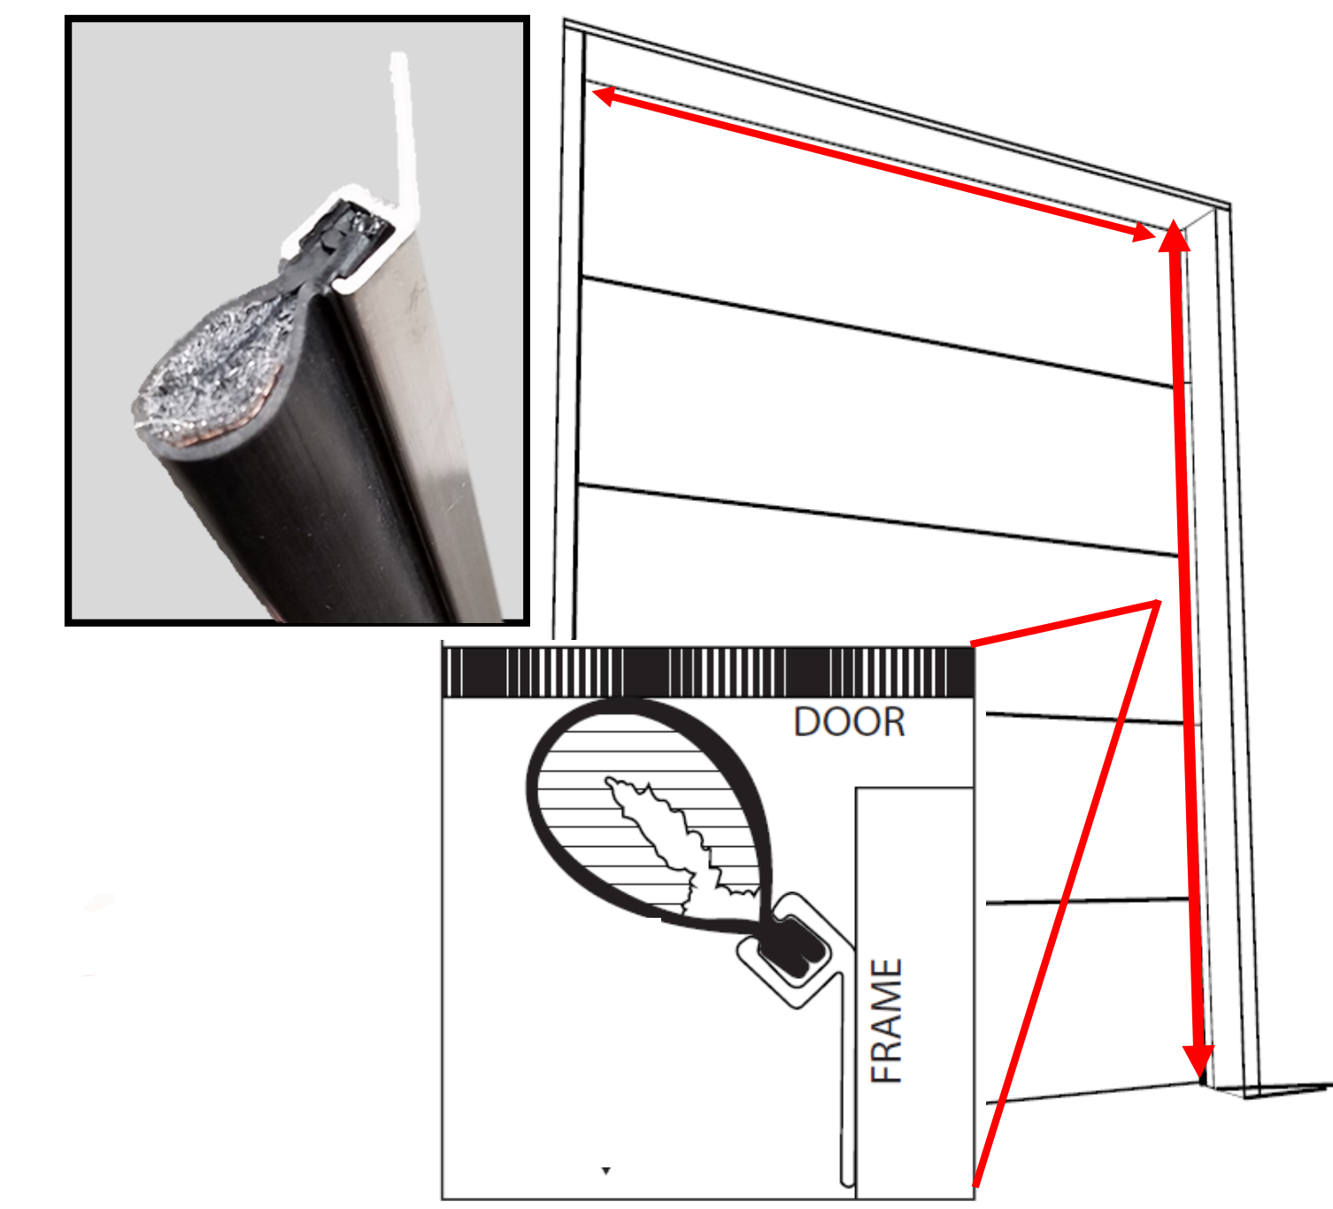
Xcluder® Garage & Dock Door Side and Top Seals
Top Seal
Kit includes:
(6) 4’ Aluminum retainer sections
(2) 12’ Xcluder Slide-’n-Seal gaskets
(16) Self tapping mounting screws
Seals both sides of a door up to 12’ high
Side Seals
Top Seal/Single Side Replacement Kit:
Seals top of one door up to 12’ wide or one side of a door up to 12’ high

Slide 22
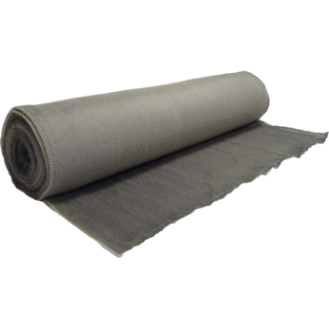
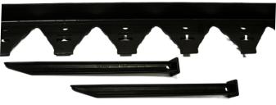
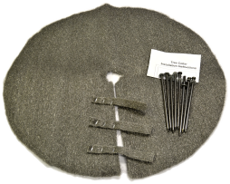
Xcluder® GEO Landscape Fabric
Widths and basis weights
  6’ wide x up to 100’ long
Installation:
  Varies to the size of the area
  Tools required:
    Shears
    Gloves
    Hammer
    Landscape edging & spikes
    10” nails.

Slide 23
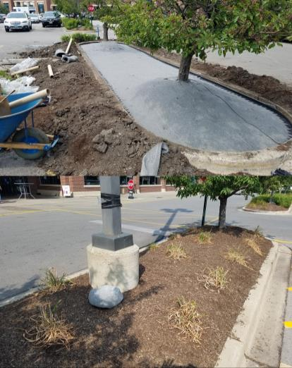
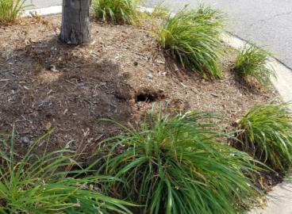
Landscaping
Xcluder® Geo
BEFORE – RAT BURROWS
Xcluder® Geo Landscaping Fabric
Coarse stainless steel fibers bound to a porous geotextile form an impenetrable barrier against burrowing pests.
Material allows grass and small plants to grow through .
Geo is currently protecting many public sites, including: Tree Pits & Planters, Sports Fields, National Historic Sites, Outdoor Theaters, Parks, etc.
AFTER
CHICAGO PARKING LOT
PLANTER - GREEN TOPPER

Slide 24
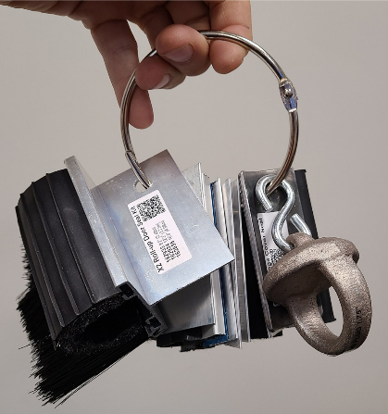
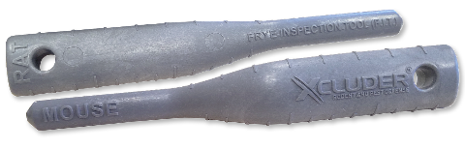
Demo and Assessment Tools
Frye Inspection Tool (F.I.T.)
Also available with custom imprint.
Sample Ring

Slide 25
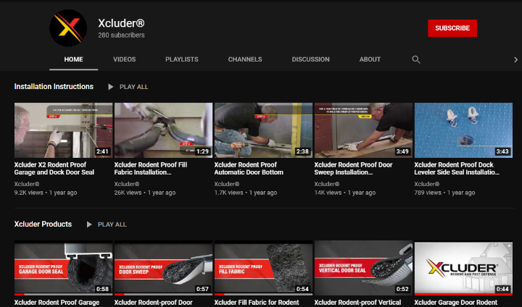
Installation and Product Videos
YouTube.com/buyxcluder

Slide 26




Questions?
Dave Colbert
DaveC@gmt-inc.com
Tel: 847-495-4700 x1112
Paul Rossler
PaulB@gmt-inc.com
Tel: 847-495-4700 x1183
@XcluderRodent
@Xcluder
@Xcluder
https://www.youtube.com/buyxcluder

