Slide 1
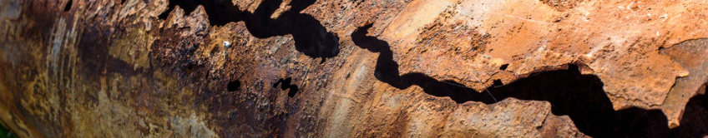
The Unseen Risk: Fire Sprinkler System Corrosion
Mathias Young
January 2024

Slide 2
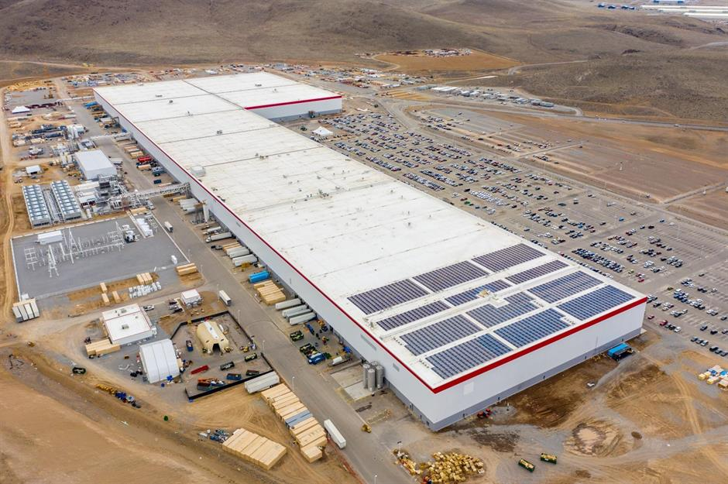
Satellite Manufacturer
Los Angeles, CA
Summer 2013
600k ft²
Sprinkler systems approx.
25 years old

Slide 3
What is corrosion in fire sprinkler systems?
What are the risks corrosion poses?
How will this affect your business?
What can you do about it?

Slide 4
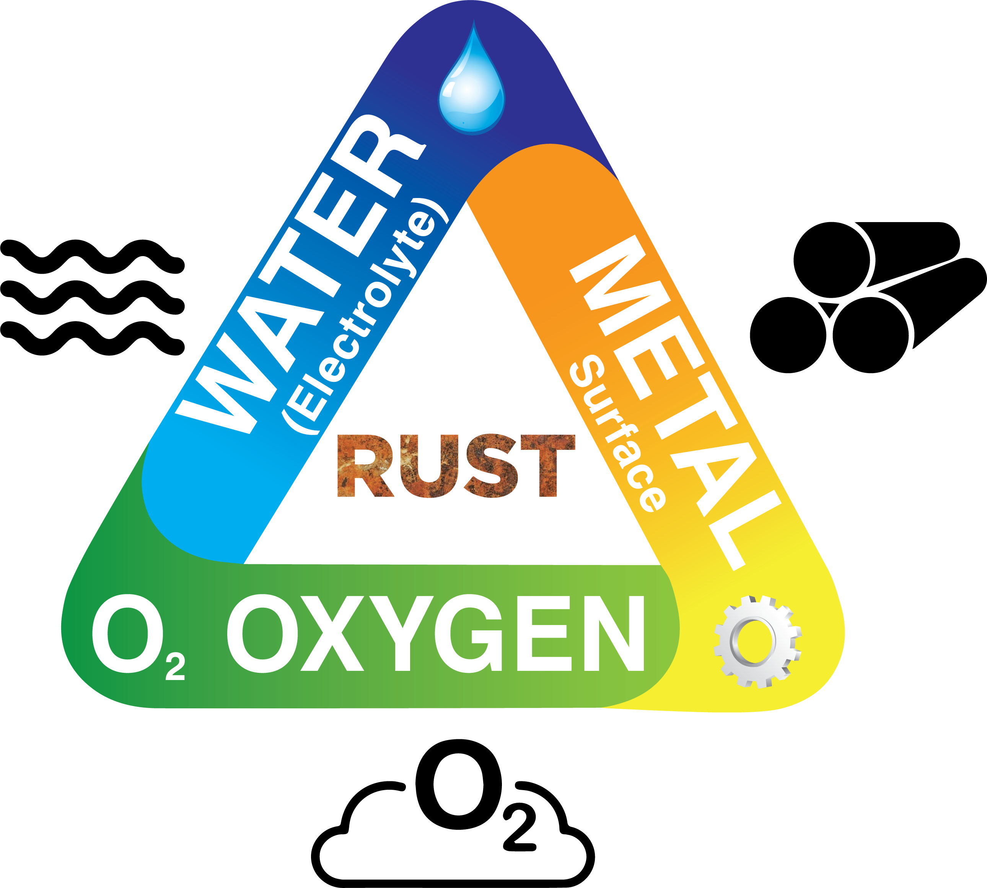
What Causes Corrosion?
Oxygen is the Primary Cause of Corrosion in Sprinkler Systems

Slide 5
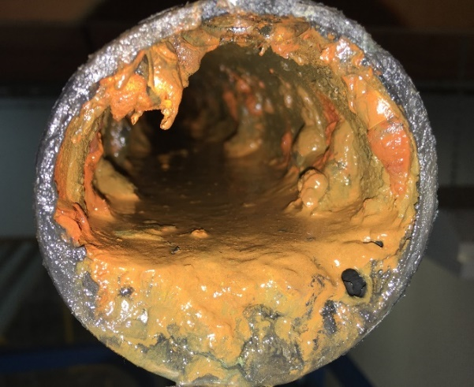
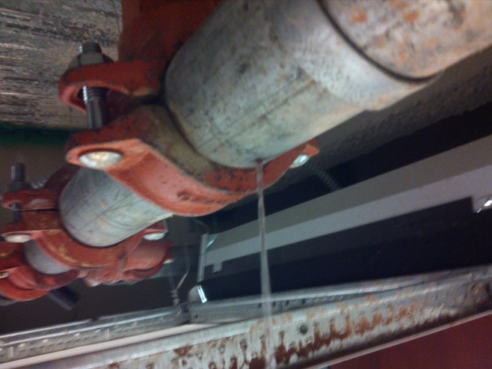

Slide 6
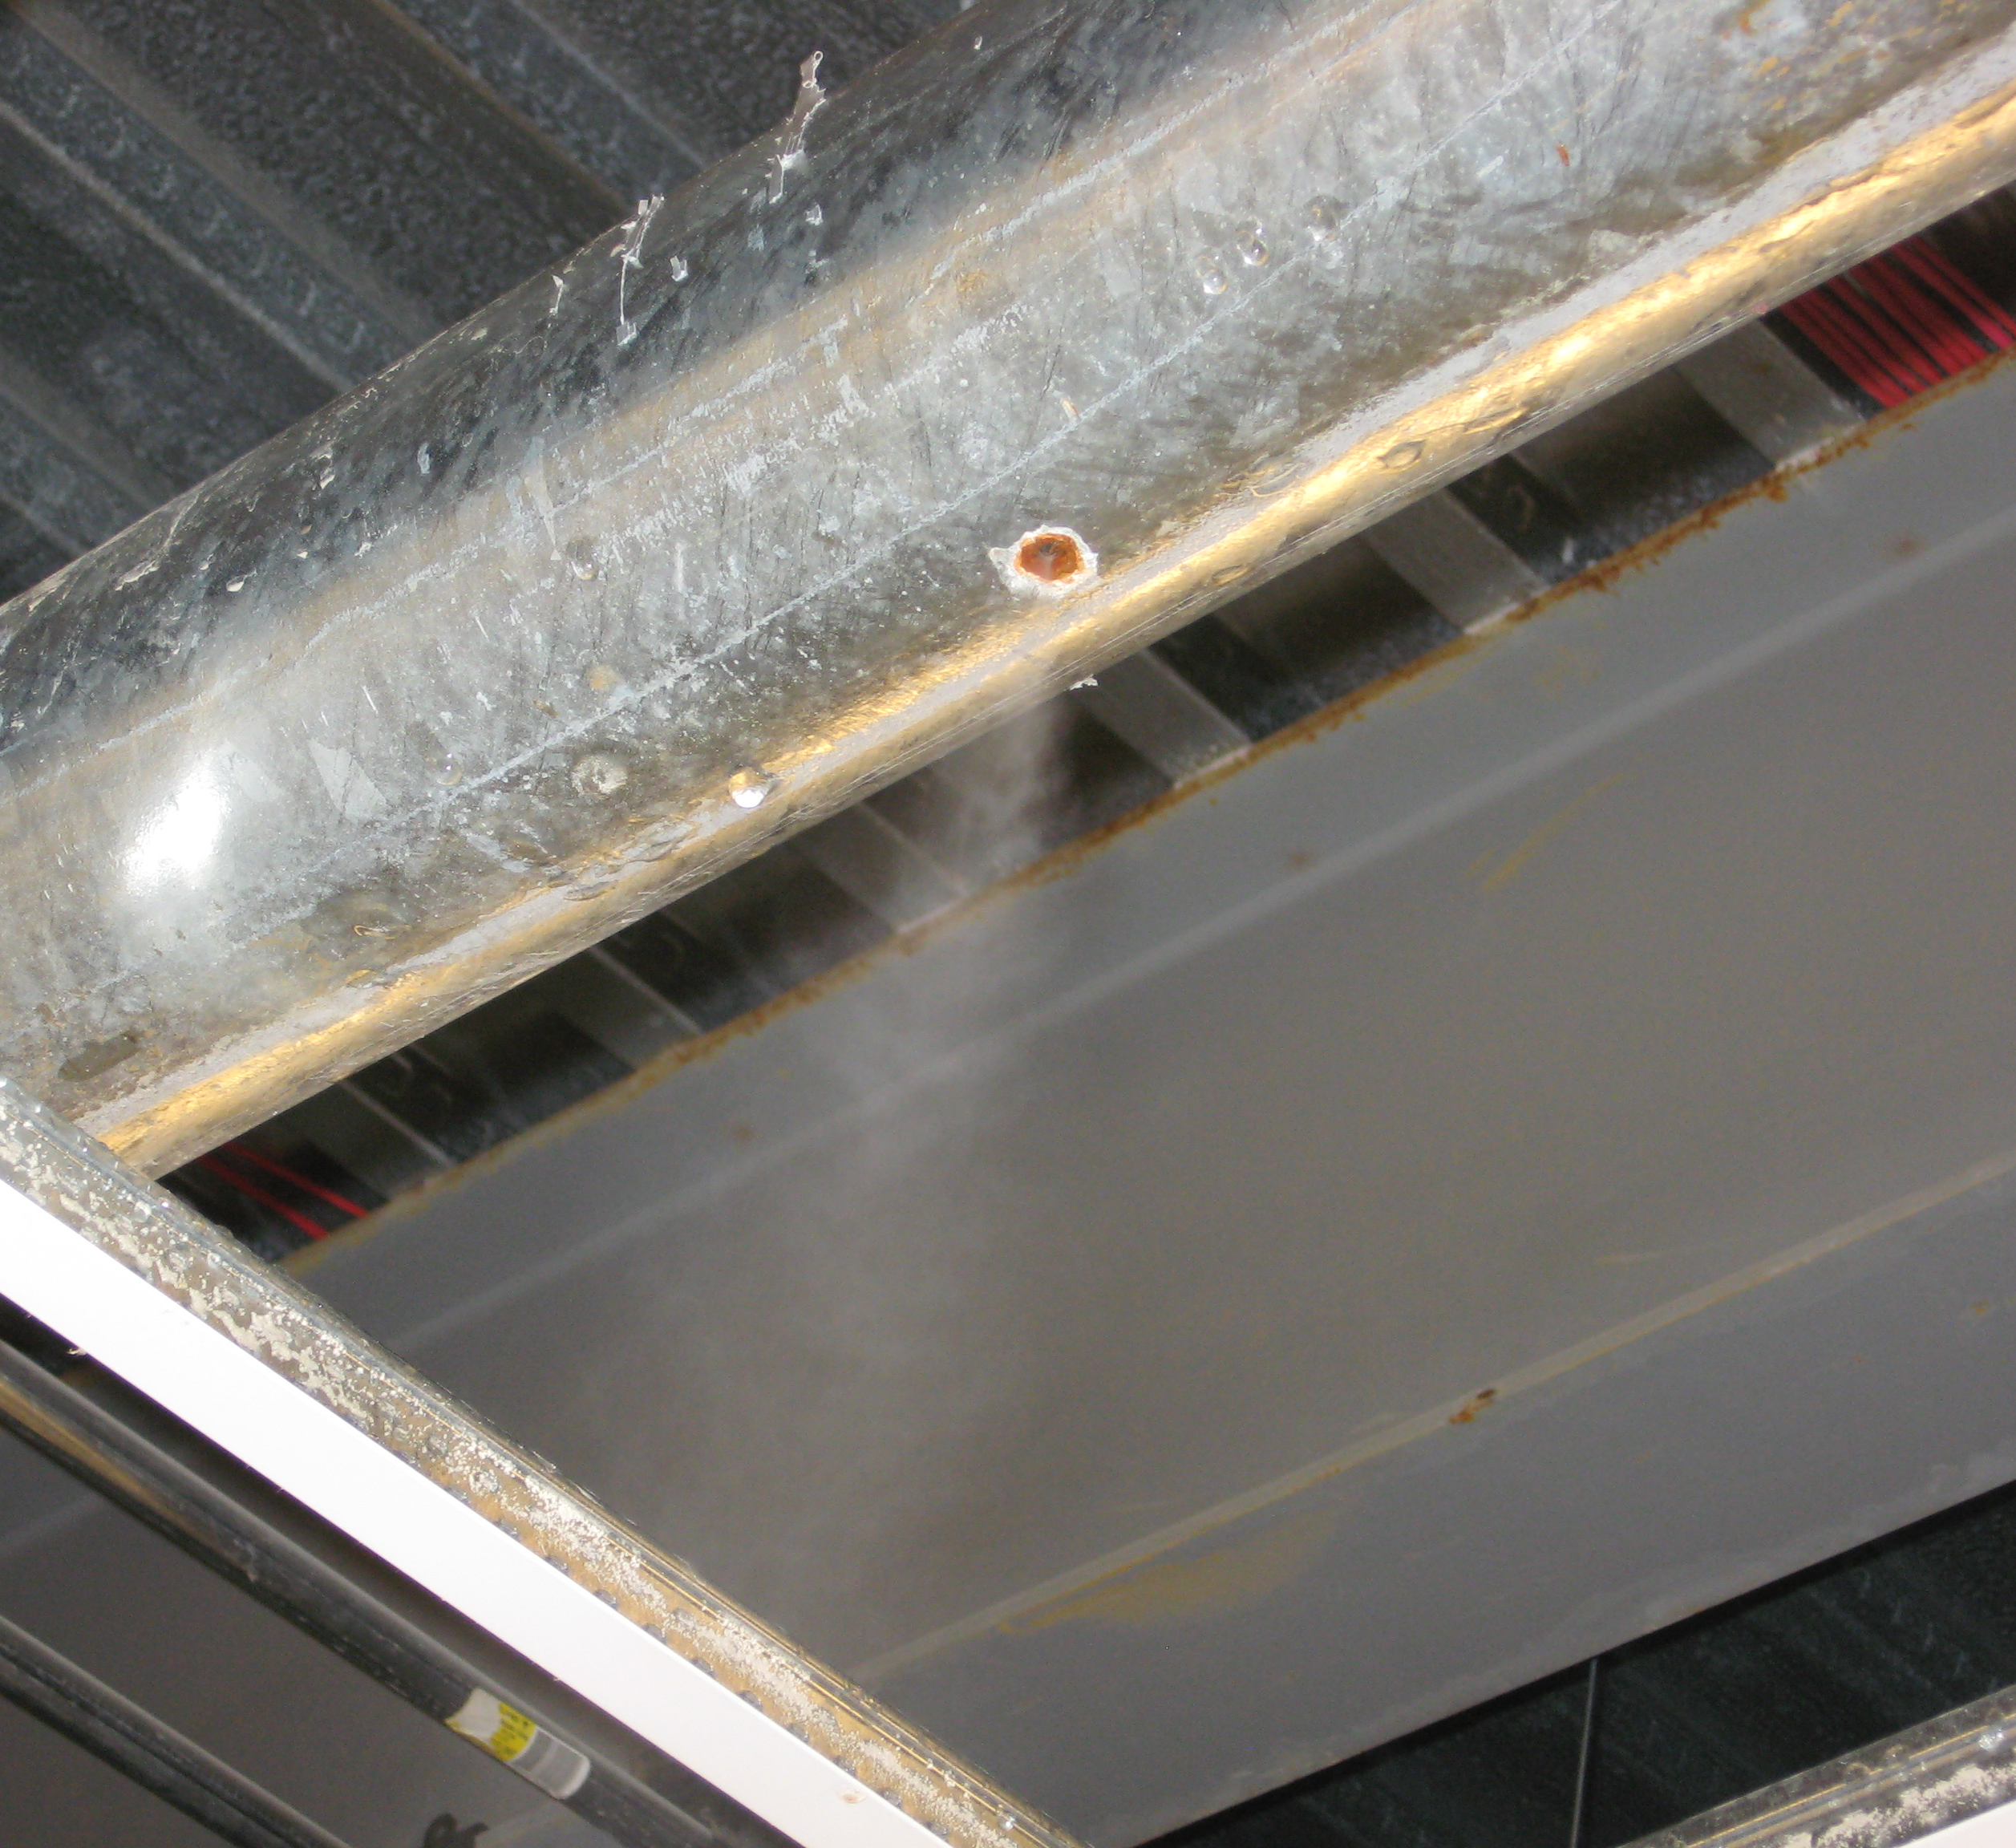
Operational Impact
Leaks Develop
  Water Damage
  Damage to Inventory
  Safety Hazard
  Pain to Deal With
Expensive
Cannot Provide a Good Working Environment

Slide 7
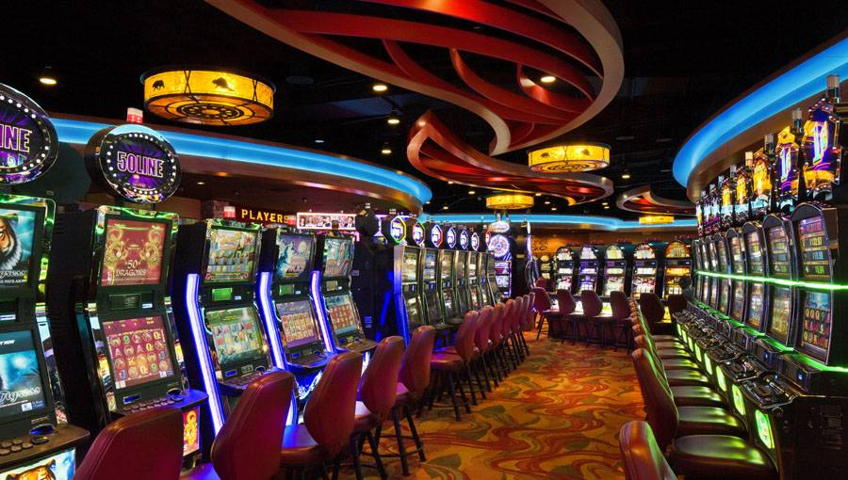

Slide 9
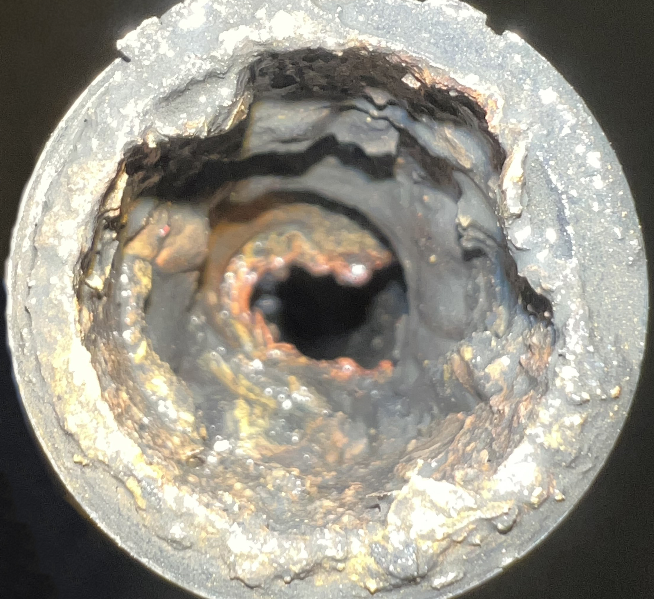
Fire Risk
Deposits Block Sprinklers
System Valves Are Shut

Slide 10
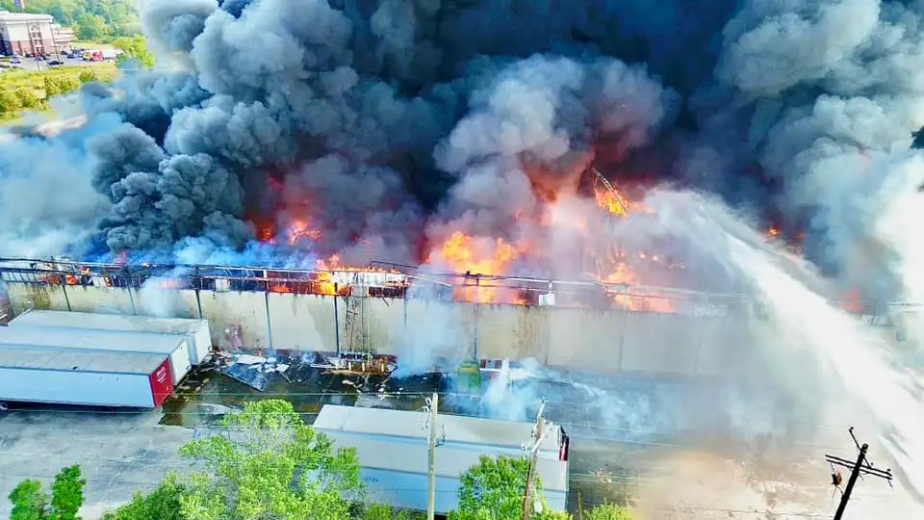

Slide 11
Impact to Strategic Plan
Where will business be conducted if the building is not occupiable?
Is the business model still viable?
How will this scenario impact growth plans?
Will capital need to be allocated to fixing the sprinkler system instead of another strategic investment like sustainability?
What is the opportunity cost of the facilities team managing a remediation project over other, more strategic projects?

Slide 12
Impact to Strategic Plan
How will insurance premiums change if a claim is made against damage caused by the fire sprinkler system?
What will this scenario do to production/income? How will money be made while the building isn’t operating?
How will a large remediation project be funded?
  Will cash be available?
  Will the current lending environment impact financing options?
  Will capital be reallocated from other investments?
  Will financial targets be met if funding is needed for this project?
Even if insurance covers fire or water damage, will enough cash be available to fund an interim solution while waiting for insurance proceeds?

Slide 13
What can I do about it?

Slide 14
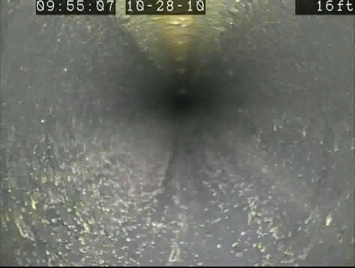
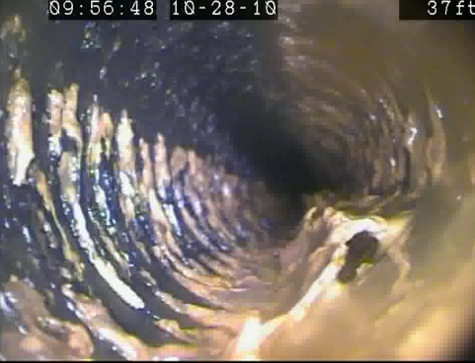
How do we “stop the bleeding” in problem facilities?
Myth: Systems with Frequent Leaks Must Be Completely Replaced
    Corrosion in sprinkler systems is highly localized.
    Typically affects less than 20-25% of system piping shows significant signs of corrosion.
  Low areas of trapped water (mains) in dry pipe and preaction sprinkler systems.
  High areas of trapped air (branch lines) in wet pipe sprinkler systems.
Branch line at 16 ft. with no corrosion, water filled with no air-water interface
Same branch line at 37 ft. with significant corrosion deposits, clear air-water interface

Slide 15
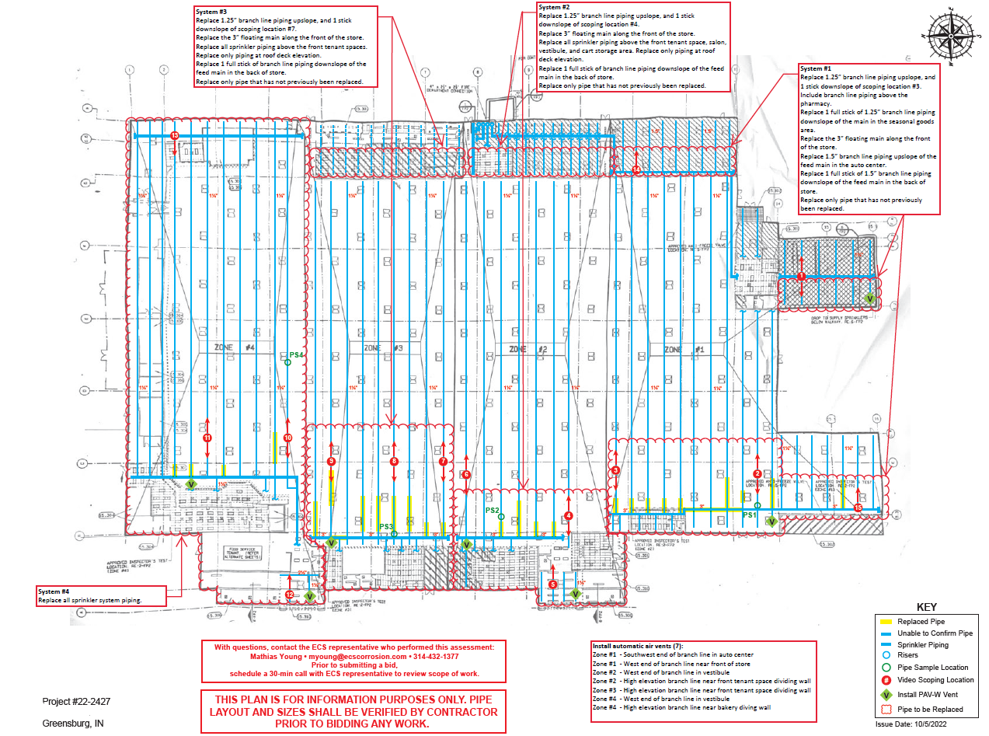

Slide 16
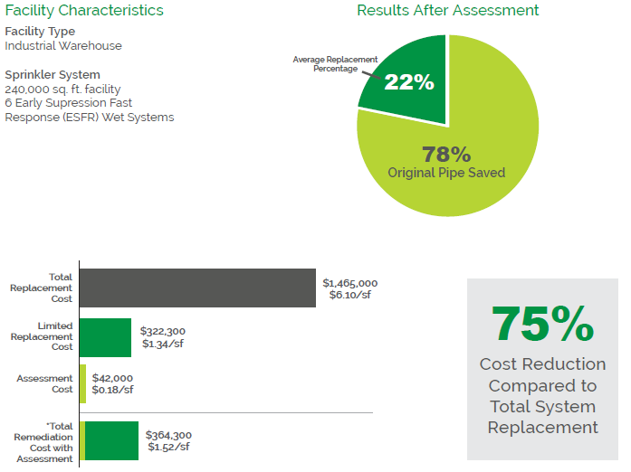
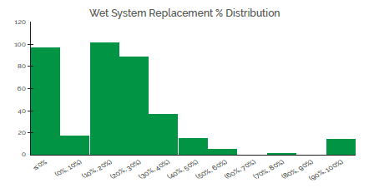
Corrosion Assessment Case Study – Big Box Stores
Background Information
Large US retailer
Total 102 stores assessed across US – chosen due to severity
Program completed in 2022
4 wet systems per store typical
Goal: Eliminate leak risk while minimizing pipe replacement
Results

Slide 17
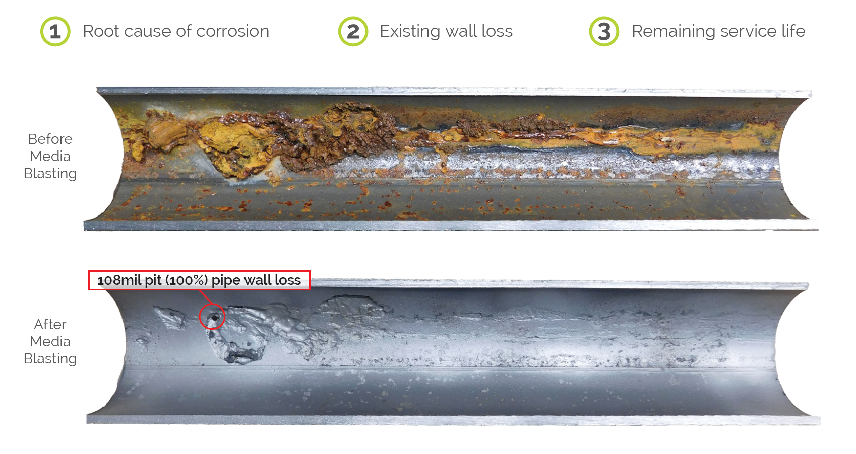
Pipe Sample Analysis

Slide 18
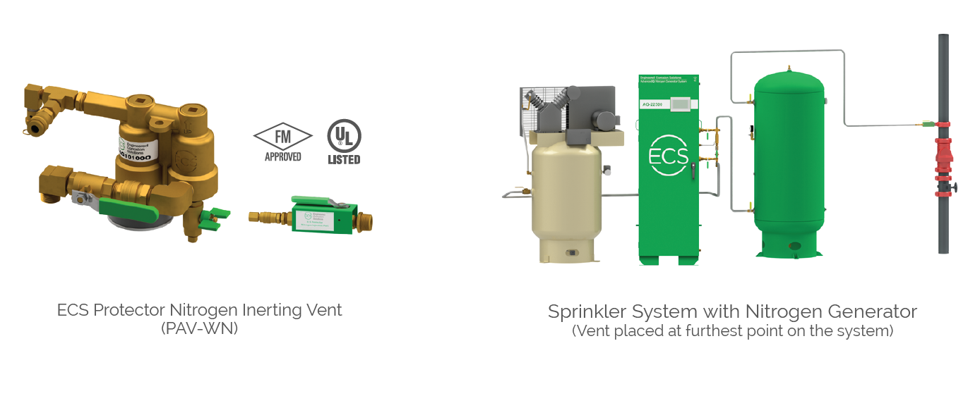
Preventing Corrosion

Slide 19
Resiliency

Slide 20

Mathias Young
Consulting Group Manager
myoung@ecscorrosion.com
(314) 432-1377
ecscorrosion.com

